Slide 1
Deposit Insurance and Bank Funding Stability: Evidence from the TAG Program
Ajay Palvia, George Shoukry, and Anna-Leigh Stone
September 20, 2024
Disclaimer: The views expressed are those of the authors and do not reflect the views of the FDIC or the United States.

Slide 2
Motivation
Deposit Insurance
Moral hazard
  Literature highlights the role of institutions
Financial Stability
  Difficult to measure, relatively understudied
  Difficulty with obtaining credible counterfactuals–similar banks facing different deposit insurance regimes
This paper: quantify the relationship between deposit insurance and bank funding stability
Funding stability
  Do deposits flow to banks with higher levels of deposit insurance?
  Do banks seek higher insurance to attract deposits?

Slide 3
Setting
The Transaction Account Guarantee (TAG) program
Unlimited deposit insurance
Mostly voluntary
  Banks could choose to opt out; all banks were initially covered
Covered only certain types of deposits (noninterest-bearing transaction accounts)
  We proxy using domestic noninterest-bearing deposits (NIBDs)

Slide 4
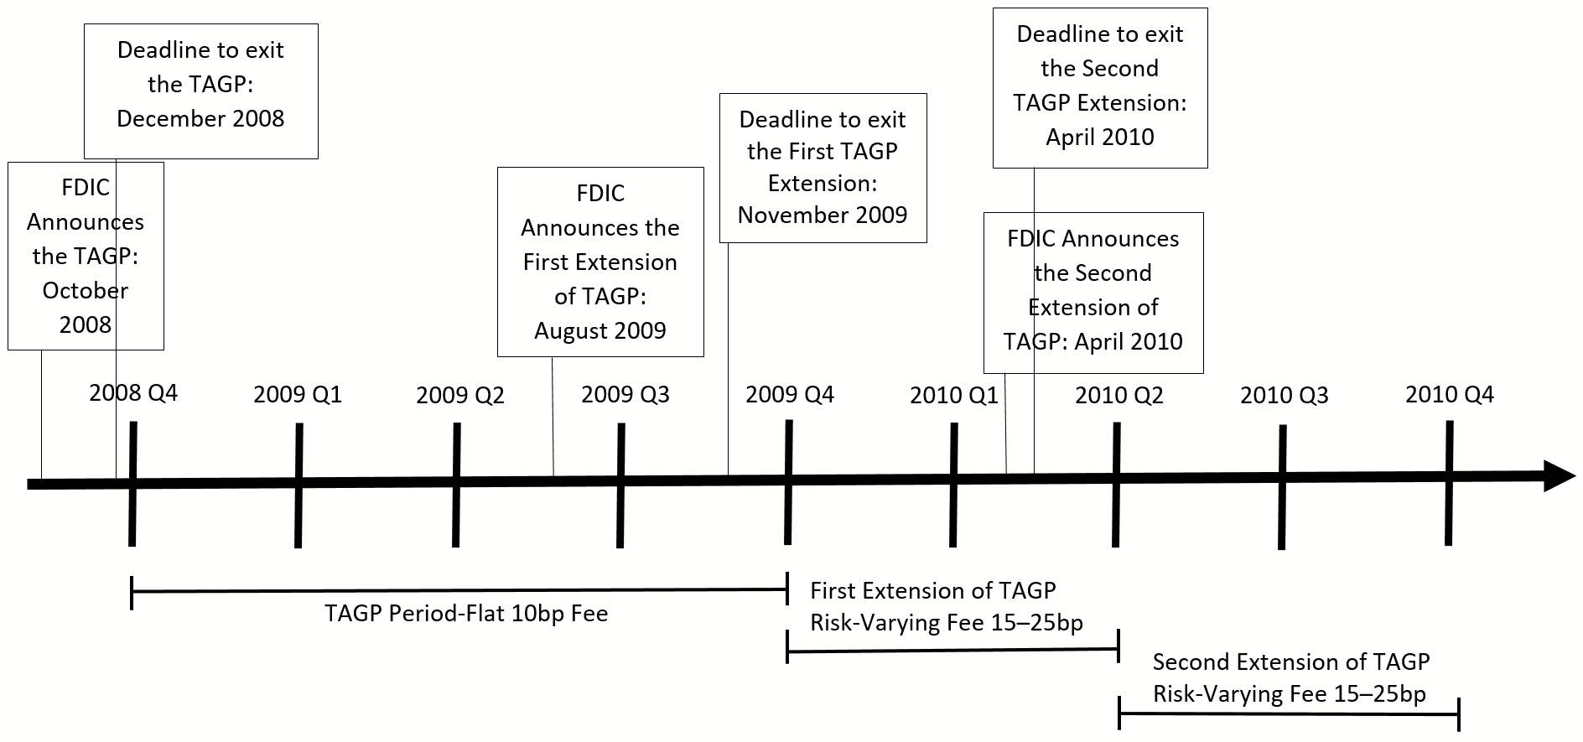
TAG Program Timeline

Slide 5
Did Opting Out Lead to Deposit Outflows?
i: bank, t: quarter
G(t₀): banks that opted out in quarter t₀
c_{i} and d_{t} are bank and quarter fixed effects
Sample Trimming: 8,324 institutions in the sample
Callaway and Sant’Anna (2021) estimator

Slide 7
2009 Q1 Opt-Out Sample

Slide 8
Combined Sample

Slide 9
IV Estimates
2010: TAG premiums were risk-based
  Premiums varied between 15 to 25 bp
Four Risk Categories (RCs), three premiums (15, 20, 25)
  Based on capitalization and composite CAMELS ratings
  Two thresholds between the three different premiums

Slide 10
IV Estimates
Use premiums as an instrument for TAG participation
Consider only banks close to one of the two thresholds

Slide 11
IV Specifications
OUT_{it} is an indicator = 1 if bank i had opted out of TAG by quarter t
max(RC) is the maximum of the risk category over 2010
P_{high} is the set of RCs resulting in a high premium
Note: no results around the first threshold

Slide 13
What Drove TAG Opt Outs?
More likely to opt out:
  Largest banks, especially during the TAG extensions
  Well capitalized banks
  More profitable banks
  Banks with strong NIBD inflows
  Banks with inflows of uninsured deposits

Slide 14
Conclusions
Banks that opted out of TAG faced subsequent declines in NIBDs
Large banks, healthy banks, and banks with particular types of deposit inflows were more likely to opt out of TAG
Implications for targeted, TAG-like insurance coverage
Reassures depositors, making them less likely to withdraw deposits
Helps banks stabilize their funding

