Slide 1


Bank Resilience and Financial Stability
1. A Framework for Evaluating Banks’ Resilience in a Rising Interest Rate Environment 2. Bank Lending to Nonbanks: Implications for Nonbank Financial Stability 3. Do Bank Mergers Create Stress
discussion by
Anna Chernobai

Slide 2
Background
Digitalization, financial innovation, globalization, M&A.
Banks are growing in size and complexity.
Size of banking sector has grown disproportionally in relation to real economy.
1970-2015: TA of world’s 50 biggest banks grew from 15% to 83% relative to world GDP.
Implicit government guarantees for TBTF banks. Risk of failure is shifted from banks to the government and taxpayers.

Slide 3
Systemic Risk and Regulation
Are banks contributing to systemic risk?
(negative externality to the system in case of default)
To limit banks’ contribution to systemic risk, regulators design measures to reduce individual default risk (e.g., capital buffer regulations & stress tests).
TBTF problem can be addressed by introducing limits on bank mergers.
2. Are banks exposed to sources of systemic risk and contagion?
(exposure to common risk factors can trigger defaults)
  Banks’ exposure to systemic risk can be addressed with measures aimed to reduce their common exposure (e.g., by putting restrictions on certain business activities).

Slide 4
Common Theme of the 3 Papers:
Bank (non)Resilience During Economic Stress
Market risk makes banks weaker (bank run) (Paper #1)
Banks shift extra risk to nonbanks by increasing lending to nonbanks (Paper #2)
Bank mergers make banks less resilient in periods of economic stress (Paper #3)

Slide 5
Paper #1

Slide 6
Paper #1
A Framework for Evaluating Banks‘ Resilience in a Rising Interest Rate Environment
by Filippo Curti & Jeffrey Gerlach
Key question:
How do changes in market risk affect bank fragility (bank run)?

Slide 7
Paper #1
A Framework for Evaluating Banks‘ Resilience in a Rising Interest Rate Environment
by Filippo Curti & Jeffrey Gerlach
Key question:
How do changes in market risk affect bank fragility (bank run)?
Motivation:
2023 run on SVB. On 3/9/23 and 3/10/23 depositors withdrew $40bln and $100bln.
Dec’22: Tier 1 Leverage Ratio 7.96% > regulatory 4% (99% higher)
CET1 Capital Ratio 15.26% > regulatory 8.5% (80% higher)
Problem: high levels of unrealized losses, and 86.44% of deposits uninsured.
Current regulatory framework doesn‘t fully incorporate unrealized losses and uninsured deposits into capital requirements and stress tests.

Slide 8
Paper #1
A Framework for Evaluating Banks‘ Resilience in a Rising Interest Rate Environment
by Filippo Curti & Jeffrey Gerlach
Key question:
How do changes in market risk affect bank fragility (bank run)?
Research idea:
Tier 1 Leverage ratio is a measure of solvency.
Propose a modified Tier 1 Leverage ratio:
Post-funding shock leverage ratio = Run Risk Ratio = risk of deposit runs
deducts all runnable funding (= uninsured deposits + short-term wholesale deposits), and
accounts for fair value gains & losses on the bank‘s assets

Slide 9
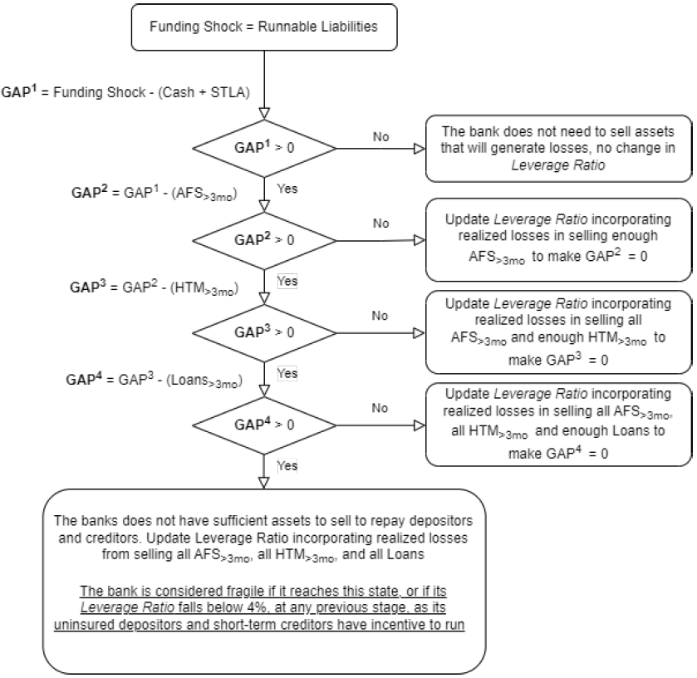
To meet withdrawal requests:
1) Sell cash and short-term liquid assets
If insufficient, then
2) Sell AFS securities, and realize previously unrealized losses
If insufficient, then
3) Sell HTM securities, and realize previously unrealized losses
If insufficient, then
4) Sell loans securities, shorter maturities first, and realize previously unrealized losses
If insufficient funds to repay to depositors and creditors, then:
Updated leverage ratio <0
Uninsured depositors have incentives to run on the bank.

Slide 10
Paper #1
Run Risk Ratio vs. Tier 1 Leverage Ratio
Run Risk Ratio is fair-value-based.
Marking to market provides investors with early warning signs, while historical cost allows management to misrepresent bank’s true economic performance.
Runs on deposits are more likely for banks with larger gaps between fair value and book value of assets. Especially for banks more exposed to interest rate risk.
Due to higher interest rates, high unrealized losses in the US banking sector.
Run Risk Ratio
Tier 1 Leverage Ratio
uses market value of assets
uses book value of assets

Slide 11
Paper #1
Run Risk Ratio vs. Tier 1 Leverage Ratio
Run Risk Ratio
Tier 1 Leverage Ratio
would increase if:
% uninsured deposits
are
high
Interest rates
go
up
or
runnable liabilities ↑↑
market value of assets ↓↓
Banks that are more exposed to market risk can compensate by restructuring their liabilities
a bank with high unrealized losses but stable funding won’t be considered as risky as a bank with lower unrealized losses but less stable funding

Slide 12
Paper #1
Run Risk Ratio:
In this paper, bank is considered weak if Run Risk Ratio < 4%
Based on Run Risk Ratio, SVB is estimated as weak already in 2022:Q1:

Slide 13
Paper #1
Key model:
Default (cloglog, logit regressions)
Z-score (OLS)
Prob(default) (OLS)
Horizons: up to 5 years
=1 if Run Risk Ratio <4%
Robust to other thresholds 3% to 7%
bank FE
Bank-level controls
quarter FE
Coefficient b1 is (+)*** : low Run Risk Ratio helps predict defaults.
Run Risk Ratio is more accurate in predicting defaults than other existing measures.
Reinforced results during periods of rising interest rates.

Slide 14
Paper #1
My comments / suggestions:
1.
Why not use continuous version of Run Risk Ratio, instead of indicator?
2. Common Equity Tier 1 Capital Ratio = (CET1 capital) / RWA
  In RWA gov‘t securities are assigned risk weight of 0%.
  If the weight >0%, then RWA ↑↑, CET1 ratio ↓↓, SVB would appear undercapitalized.
3. Unrealized gains & losses. Changes in mark-to-market values of loans due to changing interest rates are not reported in Call Reports. How does this methodology ensure that assets are fairly priced? How reliable are estimates of Run Risk Ratio?
4. Run Risk Ratio predicts defaults better for larger banks.
How is this result related to TBTF banks? Could it be that due to their TBTF status, depositors often exceed $250k threshold, causing Run Risk Ratios ↑↑. By pooling large bank data with small bank data, estimations mechanically yield lower likelihood of detecting smaller banks as weak.

Slide 15
Paper #2

Slide 16
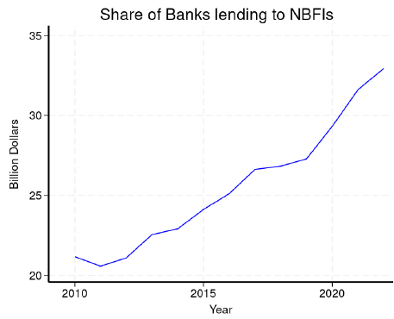
Paper #2
Bank Lending to Nonbanks: A Robust Channel Fueled by Constrained Capital?
by John Krainer, Farindokht Vaghefi, and Teng Wang
Key idea:
Banks are increasingly lending to nonbanks, especially in recent years.

Slide 17
Paper #2
Bank Lending to Nonbanks: A Robust Channel Fueled by Constrained Capital?
by John Krainer, Farindokht Vaghefi, and Teng Wang
Key idea:
Banks are increasingly lending to nonbanks, especially in recent years.
Observation:
Bank lending to nonbanks has >doubled since 2013, >$2 trln in Oct 2023.
Especially during periods of stress (Basel III, oil price shock 2014-2016, Covid-19) banks reduced lending to corporate borrowers but not to nonbank borrowers.
Increasing role of nonbanks as credit suppliers to the real economy.

Slide 18
Paper #2
Bank Lending to Nonbanks: A Robust Channel Fueled by Constrained Capital?
by John Krainer, Farindokht Vaghefi, and Teng Wang
Key idea:
Banks are increasingly lending to nonbanks, especially in recent years.
Channels:
#1: Banks‘ higher regulatory costs. Risk being shifted from regulated to unregulated sector.
More stringent capital regulatory requirements. → Banks shift their risk to nonbanks, who are less regulated but have lower risk than corporate firms.
#2: Nonbanks have comparative advantage over banks in fintech.
Banks are able to participate in the fintech market indirectly through nonbanks.

Slide 19
Paper #2
Bank Lending to Nonbanks: A Robust Channel Fueled by Constrained Capital?
by John Krainer, Farindokht Vaghefi, and Teng Wang
Key model:
Higher regulatory costs. Examine changes in bank‘s participation in syndicate loan after origination:
change in bank share commitment in loan
=1 if bank’s CET1 ratio is in bottom quartile
CET1 ratio bottom quartile dummy
x
Nonbank=1 if borrower is nonbank
Bank-level controls
Coefficient b2 (+)***: banks with weaker regulatory capital position are more likely to increase lending to nonbanks.

Slide 20
Paper #2
Bank Lending to Nonbanks: A Robust Channel Fueled by Constrained Capital?
by John Krainer, Farindokht Vaghefi, and Teng Wang
Does having a loan from a bank allow nonbank to extend more credit to the real economy?
change in nonbank share commitment in loan
=1 if nonbank has a bank loan in previous year
Coefficient b (+)***: nonbanks that received a loan from a bank in previous year increase their participation in a loan.
Nonbanks with access to bank funding exhibit less cyclical behavior in credit originations.

Slide 21
Paper #2
Bank Lending to Nonbanks: A Robust Channel Fueled by Constrained Capital?
by John Krainer, Farindokht Vaghefi, and Teng Wang
Examine bank lending to nonbanks during 3 economic shocks:
Banks‘ lending to nonbanks in periods of more stringent capital requirements and exogenous shocks.
Basel III shock: Drop in CET1 ratio → decrease in lending to nonfinancial firms & increase in lending to nonbanks.
Oil and gas shock: Higher lending to nonbanks than to nonfinancials.
Covid-19 shock: Higher lending to nonbanks than to nonfinancials.

Slide 22
Paper #2
My comments/suggestions:
.
I struggled with interpreting the main dependent variable dLnCredit. Is it $ or % change? Need both?
2. Difference-in-differences estimator. Quasi-natural experiment.
Basel III, oil & gas shock, Covid-19 shock = exogenous shocks to banks’ capital positions. OK
Treatment and control groups are problematic:
Treatment group = nonbanks, control = nonfinancial borrowers. Propensity score matching.
OK Try synthetic controls?
b) In another specification, treatment group = banks above the 85th percentile by shock
exposure (meaning=?), control group = banks below the 85th percentile.
Check diff-in-diff assumptions (parallel trends), do placebo tests.
3. .
LoanSales is an indicator (0/1) variable. Shouldn’t use OLS. Use Logistic regression.

Slide 23
Paper #3

Slide 24
Paper #3
Do Bank Mergers Create Stress
by Jeffrey Jou, Teng Wang, and Jeffery Zhang
Key idea:
After mergers, banks become weaker during a crisis. Especially large banks.

Slide 25
Paper #3
Do Bank Mergers Create Stress
by Jeffrey Jou, Teng Wang, and Jeffery Zhang
Regulatory background:
Stricter regulations regarding bank mergers:
FDIC (06/2024): Section 18(c) of the Federal Deposit Insurance Act (Bank Merger Act).
Banks require prior written approval of the FDIC before bank may merge or acquire another bank.
The Bank Merger Act prohibits the FDIC from approving a merger that “would result in monopoly“ (www).
Federal Reserve (2017): “The Board's experience has shown that proposals involving an acquisition of less than $10 billion in assets, or that results in a firm with less than $100 billion in total assets, are generally not likely to pose systemic risks.”

Slide 26
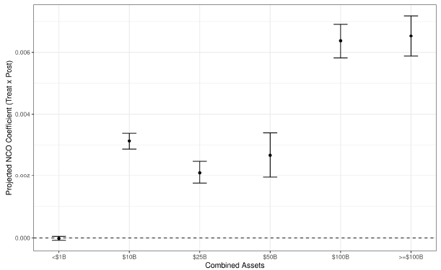
Paper #3
Do Bank Mergers Create Stress
by Jeffrey Jou, Teng Wang, and Jeffery Zhang
Research question:
After merger, are larger banks less resilient during times of economic shock? Are TBTF banks less safe?
Lower resilience
Merger size

Slide 27
Paper #3
Do Bank Mergers Create Stress
by Jeffrey Jou, Teng Wang, and Jeffery Zhang
Are mergers good? Mixed empirical evidence.
YES.
Benefits of diversification: economies of scale, reduced idiosyncratic risk, more stable earnings. Banks with better geographical, asset, and business diversification increase lending, and are more resilient to economic shocks.
NO.
Greater diversification makes banks more complex.
Certain activities of banks (e.g., securities trading) are more risky than others.
Larger banks → TBTF.
2008 GFC: Diversification was blamed for increased fragility & systemic risk.

Slide 28
Paper #3
Do Bank Mergers Create Stress
by Jeffrey Jou, Teng Wang, and Jeffery Zhang
Measure of financial (non)resilience:
Net charge-off (NCO) rates = % delinquent debt.
Diff-in-diff research design:
Treatment banks (engaged in M&A), matched with
Control banks (did not engage in M&A) via propensity score matching.

Slide 29
Paper #3
Do Bank Mergers Create Stress
by Jeffrey Jou, Teng Wang, and Jeffery Zhang
3-step methodology:
Estimate historic sensitivity of NCO to macro variables during 5 yrs before & after M&A.
Project financial resilience under adverse economic conditions (“severely averse scenario“ in 2019 Dodd-Frank stress test: 10% unempl r, real GDP ↓8%, ...)
Staggered diff-in-diff: how do mergers affect change in resiliency?
ΔResiliency = Δ projected NCO rates during “severely adverse scenario”

Slide 30
Paper #3
Do Bank Mergers Create Stress
by Jeffrey Jou, Teng Wang, and Jeffery Zhang
Key findings:
Merged banks experience higher projected loan losses during adverse economic conditions.
More pronounced for larger mergers (combined assets ≥ $50 bln).
Mitigating effects?
  NO. Greater portfolio “distance” between acquirer and target.
  NO. Greater geographical diversification (# miles between acquirer and target HQs).
  YES. Higher measures of liquidity (leverage ratio, Tier 1 capital ratio, total capital ratio).

Slide 31
Paper #3
My comments and recommendations:
1. This paper uses staggered diff-in-diff. Quasi-natural experiment.
Need an exogenous shock, instead of mergers (endogenous).
Recommendation: Riegle-Neal Interstate Banking and Branching Efficiency Act of 1994. BHCs are allowed to acquire banks in any state.
Refocus on geographical / asset diversification rather that merger itself.
Treatment group = banks that had been involved in a merger in previous 5 years. These banks are in the best position to take advantage of removal of restrictions.
Control group = other similar banks that weren‘t.
Since banks in control group may be different, can try synthetic controls.
Gelman, Goldstein, MacKinlay (2023 wp) “Bank diversification and lending resiliency“ use Riegle-Neal Act as an exogenous shock to asset diversification. Treatment group = banks that were already lending in deregulated state, control group = those that didn‘t.

Slide 32
Paper #3
My comments and recommendations (cont.):
2. Estimation period of “normal“ NCO rates is 1980-2018 includes 2008 GFC.
End estimation period sooner?
3. Projected NCO rates in adverse economic conditions are estimates based on common coefficients obtained from step 1, not actuals.
Hence, diff-in-diff results are driven in differences in NCO rates during regular economic conditions (5 yrs before & after merger).
4. Net charge-offs as a measure of (non)resilience.
Try alternative measures:
Distance-to-default
Equity volatility
Tail risk
...

Slide 33
Summary
Common Theme of the 3 Papers:
Bank (non)Resilience During Economic Stress
Banks are getting larger, more complex, and (potentially) weaker.
Market risk makes banks weaker (bank run) (Paper #1)
Banks shift extra risk to nonbanks by increasing lending to nonbanks (Paper #2)
Bank mergers make banks less resilient in periods of economic stress (Paper #3)
What is a good metric for financial resilience?
Capitalization? Leverage ratio (Paper #1): book values vs. market values
CET1 ratio (Paper #2)
Loan portfolio quality? NCO ratio (Paper #3)

Slide 34

Thank you!
  annac@syr.edu

