Slide 1
Comprehensive Deposit Insurance Seminar For Bankers
Important: This is a printable version of the seminar and does not include certain graphics, video and animation that are part of the “live” presentation of the seminar. To view the entire presentation, please see FIL-18-2017 for registration instructions.
2017

Slide 2
Outline
Part 1
General Principles
Part 2 Introduction to Ownership Categories
Part 3
Review of Ownership Category Requirements
Part 4
Deposit Insurance Coverage Resources
2

Slide 3
Deposit Insurance Coverage Resources – www.fdic.gov/deposit
Many of the FDIC’s deposit insurance resources are available on FDIC’s Deposit Insurance Coverage webpage.
FDIC’s Electronic Deposit Insurance Estimator (EDIE) – http://www.fdic.gov/edie.
FDIC’s Your Insured Deposits – a written guide for use and distribution to depositors -https://www.fdic.gov/deposit/deposits/brochures/your_insured_deposits-english.html
FDIC’s Online Product Catalogue – https://catalog.fdic.gov/
Financial Institution Employee’s Guide to Deposit Insurance (Employee’s Guide) – https://www.fdic.gov/deposit/DIGuideBankers/index.html
FDIC’s toll free number 1-877-ASK-FDIC or 1-800-275-3342
Consumer Assistance On-Line Form – https://www2.fdic.gov/starsmail/index.asp
Important: The “live” seminar provides animation on this slide which can only be viewed by participating in the WebEx conference. See FIL-18-2017 to register.

Slide 4
The Financial Institution Employee’s Guide to Deposit Insurance
2016 New Version of
The Financial Institution Employee’s Guide to Deposit Insurance
https://www.fdic.gov/deposit
4

Slide 5
The Financial Institution Employee’s Guide to Deposit Insurance
The Employee’s Guide is available on the FDIC’s deposit insurance webpage.
This resource was published in 2016 and is designed to assist bank employees in understanding deposit insurance coverage.
This resource provides bankers in-depth explanations of the 14 deposit insurance ownership categories, as well as comprehensive examples for the nine most common ownership categories.
This presentation is a summary of information that can be found in the Employee’s Guide.
This link to the Employee’s Guide can be bookmarked or a PDF version available may be printed.
https://www.fdic.gov/deposit/diguidebankers/index.html
Important: The “live” seminar provides animation on this slide which can only be viewed by participating in the WebEx conference. See FIL-18-2017 to register.
5

Slide 6
Seminar on Deposit Insurance Coverage
Part 1 – General Principles
6

Slide 7
General Principles
Since 1933, the FDIC seal at financial institutions has
signified trust and stability to millions of Americans.
FDIC deposit insurance is backed by the full faith and credit of
the United States government.
Since the FDIC’s inception no depositor has ever lost a penny of insured deposits.
FDIC insurance enables consumers to confidently deposit their money at FDIC insured banks across the United States and in the unlikely event of a bank failure, guarantees they can get their insured deposits promptly.
Important: The “live” seminar provides animation on this slide which can only be viewed by participating in the WebEx conference. See FIL-18-2017 to register.
7

Slide 8
General Principles
Depositors are insured at each bank for up to at least the standard maximum deposit insurance amount (“SMDIA”).
The SMDIA is $250,000 (made permanent in 2010 under the Dodd-Frank Wall Street Reform and Consumer Protection Act).
Coverage includes principal and accrued interest up through the date of a bank’s failure.
8

Slide 9
General Principles
FDIC deposit insurance is provided for “deposit” products only.
Insured—Bank Deposits
Checking Accounts
Money Market Deposit Accounts (“MMDA”)
Savings Accounts
NOW Accounts
Certificates of Deposit (“CDs”)
Not Insured—Non-deposit Products
Stocks, Bonds, Municipal Bonds, and Other Securities
Mutual Funds (money market mutual funds and stock, bond, or other security mutual funds)
Annuities
Insurance Products
Safe Deposit Box Contents
9

Slide 10
Basic Insurance Coverage Example
Coverage includes principal and interest earned up to the SMDIA.
Jane Smith | Balance
Principal Amount | $248,000
Accrued Interest | $3,000
Total | $251,000
Amount Insured | $250,000
Amount Uninsured | $1,000

Slide 11
General Principles
Deposit insurance coverage is provided
Per Depositor
Per Ownership Category
Per Bank
11

Slide 12
General Principles: Per Depositor
Coverage is provided on a per depositor basis
Deposit accounts owned by different depositors are separately insured.
Depositors that may qualify to receive FDIC deposit insurance coverage include:
Natural persons;
Legal entities such as corporations, partnerships, and unincorporated associations; and
Public units such as cities and counties.
A depositor does not have to be a citizen or resident of the United States to be eligible for deposit insurance coverage.
12

Slide 13
General Principles: Per Ownership Category
Coverage is provided per ownership category
Deposits that a person or entity maintains in different ownership categories at the same bank are separately insured up to the insurance limit.
Deposits that a person or entity maintains in the same ownership category at the same bank are added together and insured up to at least $250,000.
13

Slide 14
General Principles: Per Bank
Coverage is provided on a per bank basis
Deposits placed in the branch offices of a bank with the same charter are added together.
Deposits placed in separately chartered banks are separately insured.
Deposits in separate branches of a bank are NOT separately insured even if the branches are in different states.
Deposit insurance coverage is exactly the same at every FDIC-insured bank.
14

Slide 15
General Principles
BankFind
Depositors can determine whether a particular institution is insured by the FDIC by entering information onto the FDIC's BankFind Directory (ID).
BankFind provides the latest comprehensive financial and demographic data for every FDIC-insured institution.
You can access the database from the main FDIC webpage at www.fdic.gov or, by clicking on the BankFind link provided on this slide: http://research.fdic.gov/bankfind/.
Once on the BankFind Directory, depositors can enter the name of the institution they wish to search and BankFind will return results indicating whether the institution by that name is insured.
Important: The “live” seminar provides animation on this slide which can only be viewed by participating in the WebEx conference. See FIL-18-2017 to register.
15

Slide 16
General Principles
Death of an Account Owner
The death of an account owner will in some cases reduce the amount of deposit insurance coverage. This is especially the case for co-owned accounts.
If an account owner dies, the FDIC provides a six-month grace period during which the account will be insured as if the account owner had not died.
After the six-month grace period, the funds will be insured according to the ownership category in which the deposits are held.
16

Slide 17
General Principles
Coverage When Banks Merge
Basic rule – There is separate deposit insurance coverage (i.e., for deposits at each bank) for up to six months (after the effective date of the merger) if a depositor has funds in two banks that merged.
Special exception for time deposits – For time deposits (i.e., CDs) issued by the assumed bank, separate deposit insurance coverage will continue for the greater of either six months or the first maturity date of the time deposit.
For additional information on mergers, please call the FDIC at 1-877-275-3342 or view the FDIC’s Seminar on Advanced Topics in Deposit Insurance Coverage at the following link: https://youtu.be/X3Vr7EfOG9w
17

Slide 18
General Principles
FDIC pays depositors “as soon as possible.”
Coverage When A Bank Fails
FDIC’s goal is to make deposit insurance payments within two business days after a bank’s failure.
Processing brokered deposits may take longer since the broker needs to supply the FDIC with information about each depositor.
FDIC pays 100 cents on the dollar for all insured deposits.
Depositors with uninsured deposits may recover a portion of their uninsured funds.
18

Slide 19
General Principles
Examples of bank deposit account records may include:
Account ledgers
Signature cards
Certificate of deposits (CDs)
Corporate resolutions in possession of the bank authorizing the accounts
Other books and records of the bank including computer records that relate to the bank’s deposit-taking function
In the event of a bank failure, the FDIC relies on bank deposit account records to determine ownership.
Deposit Account Records
19

Slide 20
Seminar on Deposit Insurance Coverage
Part 2 - Introduction to Ownership Categories
20

Slide 21
Introduction to Ownership Categories
In order to determine deposit insurance coverage, bankers must ask and answer the following three questions:
Who owns the funds?
What ownership category is the depositor eligible to use or attempting to use?
Does the depositor meet the requirements of that category?
21

Slide 22
Introduction to Ownership Categories
1. Who Owns The Funds:
Calculating the amount of FDIC deposit insurance coverage begins with determining who owns the funds.
An owner or a depositor can be:
A person
A business/organization
A government entity
22

Slide 23
Introduction to Ownership Categories
2.
What ownership category is the depositor eligible to use or attempting to use?
An “ownership category,” also referred to as a “right and capacity” in the deposit insurance regulations, is defined by either a federal statute or by an FDIC regulation and provides for separate FDIC deposit insurance coverage.
The FDIC regulations provide for 14 ownership categories. This seminar will discuss the nine most common ownership categories.
23

Slide 24
Introduction to Ownership Categories
3. Does the depositor meet the requirements of a specific category?
If depositors can meet the rules for a specific category, then their deposits will be entitled to both of the following:
Separate coverage from funds deposited under a different ownership category, and
Up to the SMDIA in deposit insurance coverage that is provided for under the ownership category.
24

Slide 25
Nine Most Common Ownership Categories
Owner = individual
Owner = business/organization
Category 1
Single Accounts
Category 2
Joint Accounts
Category 7
Corporations, Partnerships and Unincorporated Association Accounts
Owner = government entity
Category 3
Revocable Trust Accounts
Category 4
Irrevocable Trust Accounts
Category 8
Government Accounts
Category 5
Certain Retirement Accounts
Category 6
Employee Benefit Plan Accounts
Owner = mortgage servicer
Category 9
Mortgage Servicing Accounts

Slide 26
Five Least Common Ownership Categories
Category 11
Irrevocable Trust Account with Bank as Trustee
Category 12
Annuity Contract Accounts
Category 10
Public Bonds Accounts
Category 14
Accounts of a Bank pursuant to the Bank Deposit Financial Assistance Program of the Department of Energy
Category 13
Custodian Accounts for Native Americans

Slide 27
Seminar on Deposit Insurance Coverage
Part 3 – Review of Ownership Category Requirements

Slide 28
Hypothetical Signature Card

Slide 29
Hypothetical Signature Card
Ownership Categories
Individual / Single
Estate
Individual Unincorporated (e.g. DBA)
(Cat.1) Single Accounts
(Cat.2) Joint Accounts
Joint With Survivorship (JTWROS)
Joint No Survivorship (TIC)
POD / ITF / Totten (Informal)
Revocable Trust (Formal)
(Cat.3) Revocable Trust Accounts

Slide 30
Hypothetical Signature Card
Ownership Categories
(Cat.4) Irrevocable Trust Accounts
Irrevocable Trust
(Cat.7) Corporation, Partnership, Unincorporated Association Accounts
Corporation/Partnership/LLC
Non-Profit
(Cat.8) Public Unit/Government Accounts
Government
Traditional IRA
Roth IRA
Simple IRA
SEP IRA
Inherited IRA
Inherited Roth IRA
Rollover IRA
Keogh
(Cat.5) Certain Retirement Accounts*
NOT AN OWNERSHIP CATEGORY- Deposit insurance coverage “passes through” the fiduciary to the actual owner, based on how the funds are held.
Fiduciary (Broker, IOLTA, UTMA, etc.)
*Note: Self-directed defined contribution plans are included under Category 5

Slide 31
Six Ownership Categories Available To Individuals
Category 1
Single Accounts
Category 2
Joint Accounts
Category 3
Revocable Trust Accounts
Category 4
Irrevocable Trust Accounts
Category 5
Certain Retirement Accounts
Category 6
Employee Benefit Plan Accounts

Slide 32
Category 1- Single Accounts
A Single Account represents funds:
Owned by one natural person and where no beneficiaries are named.
Examples of Single Accounts:
Funds owned by a Sole Proprietorship or DBA (not insured as Category 7 – Business/Organization accounts);
Accounts established for a deceased person (not insured as Category 3 – Revocable Trust accounts).

Slide 33
Category 1- Single Account Coverage
Coverage:
Up to $250,000 for all Category 1 – Single Account deposits.
All Category 1 – Single Accounts owned by the same depositor at the same bank are added together and insured up to $250,000.
Remember!
If a depositor designates an account as “payable on death” and names beneficiaries, the deposit will NOT be insured as a Category 1 – Single Account, (deposits that designate beneficiaries, are insured under Category 3 – Revocable Trust Accounts).
Category 1 – Single Account is the default category for depositors who do not meet the requirements of another category.

Slide 34
Category 1 – Single Account Example
Account Title
Jane Smith
Jane Smith
Jane Smith
Jane Smith
Total
Deposit Types
Savings
CD (6 month maturity)
CD (2 year maturity)
MMDA
Balance
$15,000
$20,000
$200,000
$25,000
$260,000
Amount Insured | $250,000
Amount Uninsured | $10,000
Important: The “live” seminar provides animation on this slide which can only be viewed by participating in the WebEx conference. See FIL-18-2017 to register.

Slide 35
Category 1 – Single Account Example
Deposit Types
Savings
CD (6 month maturity)
CD (2 year maturity)
MMDA
Total
Balance
$15,000
$20,000
$200,000
$25,000
$260,000
Amount Insured | $250,000
Amount Uninsured | $10,000

Slide 36
Category 2 – Joint Accounts
Joint Accounts represent funds owned by two or more depositors.
Requirements:
Depositors must be natural persons.
Corporations, partnerships, associations, trusts and estates are not eligible for Category 2 – Joint Account coverage.
Each co-owner must sign the signature card.
CDs, broker or agent exceptions.
Electronic signatures are acceptable.
Each co-owner must have the same withdrawal rights as the other co-owner(s).
Be aware of restrictions when adding minors as co-owners.
Note: FDIC assumes ownership of a joint account is equal unless otherwise stated in the bank’s records.

Slide 37
Category 2 – Joint Accounts
Coverage:
Up to $250,000 for each owner’s share of all Category 2 – Joint Account deposits at the same bank.
If a depositor establishes multiple joint accounts, the owner’s shares in all joint accounts are added together and insured up to $250,000.
Remember!
Adding a name to a joint account for convenience purposes may limit equal withdrawal rights and result in the account being insured as a Category 1 – Single Account.
If two or more depositors designate an account as “payable on death” and name beneficiaries, the deposit will be analyzed as a Category 3 – Revocable Trust Account.

Slide 38
Category 2 – Joint Accounts
Deposit insurance coverage for joint accounts is NOT increased by:
Rearranging the names listed on multiple joint accounts
Substituting “and” for “or” in account titles for multiple joint accounts
Using different Social Security numbers on multiple joint accounts

Slide 39
Category 2 – Multiple Joint Accounts Example
Account | Account Title | Balance
Account 1 | Jane Smith and Andrew Smith | $400,000
Account 2 | Jane Smith and Harry Jones | $200,000
Total |  | $600,000
Are all of the owners fully insured?

Slide 40
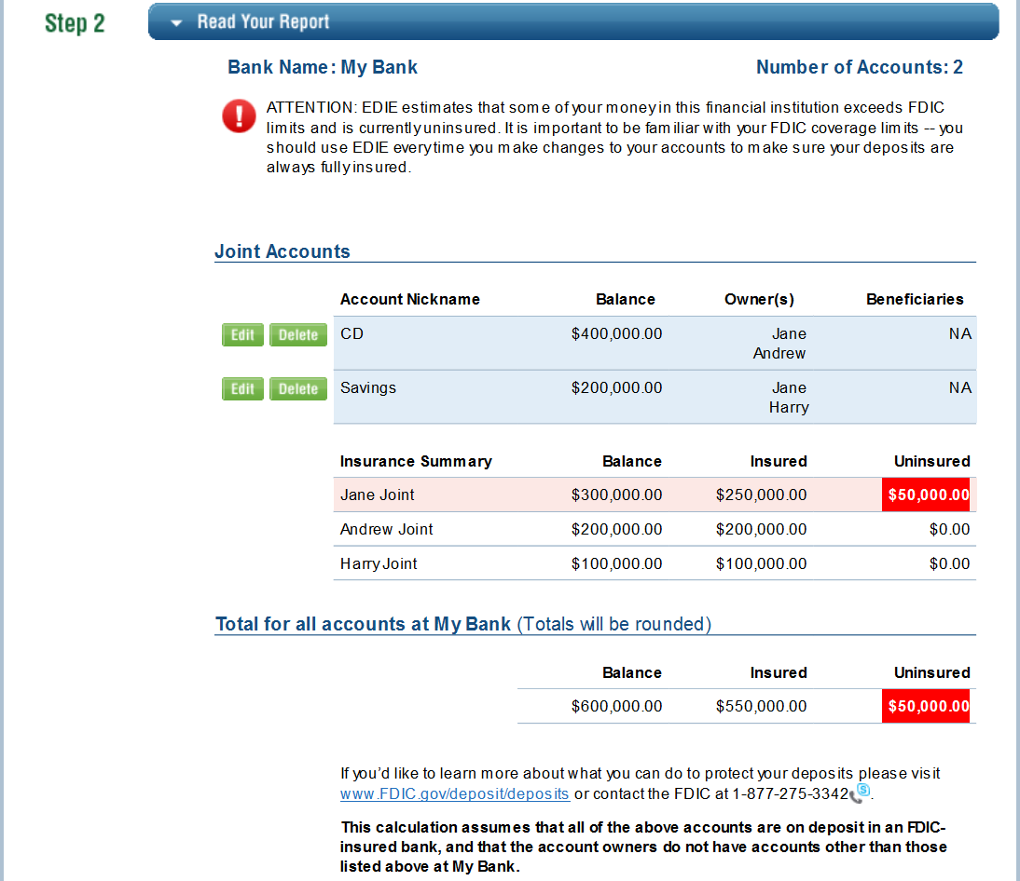
Multiple Joint Accounts Example - EDIE
https://www5.fdic.gov/edie/index.html
Important: The “live” seminar provides animation on this slide which can only be viewed by participating in the WebEx conference. See FIL-18-2017 to register.

Slide 41
Category 2 – Multiple Joint Accounts Example
Account | Jane’s Interest | Andrew’s Interest | Harry’s Interest | Total
Account 1 | $200,000 | $200,000 | $0 | $400,000
Account 2 | $100,000 | $0 | $100,000 | $200,000
Total | $300,000 | $200,000 | $100,000 | $600,000
Amount Insured | $250,000 | $200,000 | $100,000 | $550,000
Amount Uninsured | $50,000 | $0 | $0 | $50,000

Slide 42
Category 2 – Joint Account Coverage
Death of an Account Owner
Example: John and Jane Smith opened a joint account for $500,000 on January 1, 2013. John dies on March 31, 2013. What is the deposit insurance coverage for the account?
Six Month Rule Applies:
For six months after John’s death, the account will be insured for $500,000 as though John was still living.
After the six-month grace period, beginning October 1, 2013, assuming the account has not been restructured and Jane does not have any other single accounts at that bank, she would be insured for $250,000 in her Category 1 – Single Account and uninsured for $250,000.

Slide 43
Category 3 – Revocable Trust Accounts
A Revocable Trust Account is a deposit where the owner indicates an intention that the funds will belong to one or more named beneficiaries upon the last owner’s death.
In a Revocable Trust, the owner retains the right to change beneficiaries and/or allocations or to terminate the trust.
The FDIC recognizes two types of revocable trusts:
Informal revocable trusts
Formal revocable trusts

Slide 44
Category 3 – Revocable Trust Beneficiaries
Who or what can be a beneficiary?
The beneficiary must be an eligible beneficiary as defined below:
A natural person (living),
A charity (must be valid under IRS rules) or
A non-profit organization (must be valid under IRS rules)
An eligible beneficiary is any natural person.
There is no kinship requirement.

Slide 45
Category 3 – Revocable Trust Account Titling
For revocable trust accounts, the trust relationship must exist in the account title.
For informal revocable trust accounts, commonly accepted terms such as “payable-on-death”, “in trust for” and “as trustee for” must appear in the account title.
For purposes of this rule, “account title” includes the electronic deposit account records of the bank.
The FDIC will recognize the account as a revocable trust account provided the bank’s electronic deposit account records identify the deposit as a POD account. For instance, this designation can be made using a code in the bank’s electronic deposit account records.

Slide 46
Category 3 – Five or Fewer Beneficiaries
Coverage depends on the number of beneficiaries named by an owner and the amount of the deposit:
Owner
5 or fewer beneficiaries
If the owner names five or fewer unique eligible beneficiaries, then the deposit insurance coverage is:
Up to $250,000 multiplied by the number of unique eligible beneficiaries named by the owner. This applies to the combined interests for all beneficiaries the owner has named in all (both informal and formal) revocable trust deposits.
The result is the same as above even if the owner has allocated different or unequal percentages or amounts to multiple beneficiaries. To calculate the deposit insurance coverage, multiply $250,000 by the number of owners multiplied by the number of unique eligible beneficiaries.

Slide 47
Category 3 – Six or More Beneficiaries
Coverage depends on the number of beneficiaries named by an owner and the amount of the deposit:
6 or more equal beneficiaries
Owner
6 or more unequal beneficiaries
If the owner names six or more unique eligible beneficiaries:
With six or more unique eligible beneficiaries where the allocation to each and every beneficiary is equal, the deposit insurance coverage is $250,000 multiplied by the number of unique eligible beneficiaries.
With six or more unique eligible beneficiaries with unequal percentages or dollar amount allocations to the beneficiaries, the deposit insurance coverage is at least $1,250,000.
Note: For any questions, please call the FDIC at 1-877-275-3342 or view the FDIC’s Seminar on Revocable Trust Accounts at the following link: https://youtu.be/pUYZRPpTfVo

Slide 48
Category 3 – Revocable Trust Accounts
There is a misconception that deposit insurance is determined by counting or adding the total number of owners and beneficiaries listed on a POD account. This is incorrect!
Example: John POD Lisa
What is the maximum amount that can be insured for this deposit?
For five or fewer beneficiaries, deposit insurance coverage is determined by using the following formula:
Number of owners multiplied by the number of beneficiaries multiplied by $250,000 = deposit insurance coverage.
There is one owner (John) and there is one beneficiary (Lisa).
1 owner x 1 beneficiary x $250,000 = $250,000.
The maximum deposit insurance coverage is $250,000, NOT $500,000.
What is the deposit insurance coverage for a POD account with one owner and one beneficiary?

Slide 49
Category 3 – Revocable Trust Accounts
Owner A
Beneficiary B
Beneficiary C
Owner A has opened a POD account where he has identified
B and C as his beneficiaries.
What is the maximum amount that can be insured?

Slide 50
Category 3 – Revocable Trust Accounts
Owner A
Owner A
receives $250,000 of coverage for
Beneficiary B.
Owner A
receives $250,000 of coverage for
Beneficiary C.
Deposit insurance coverage is $500,000 not $750,000.
This example illustrates the misconception that each person on the POD account is entitled to $250,000. We refer to this as the “counting heads” method.
It is incorrect!
Deposit insurance coverage is based on one owner and two unique beneficiaries.
To determine coverage, we use the following formula:
1 owner x 2 beneficiaries x $250,000 = $500,000

Slide 51
Category 3 – Revocable Trust Accounts Example
Coverage is based on the number of unique beneficiaries named by an owner. While a beneficiary can be named on multiple accounts by an owner, FDIC will only recognize the beneficiary once in applying the insurance coverage.
Example: John opens three POD accounts:
What is the deposit insurance coverage when an owner identifies the same beneficiaries on multiple POD accounts?
Account | Owner | Title | Beneficiary
Account 1 | John | POD | Alice
Account 2 | John | POD | Betty & Alice
Account 3 | John | POD | Cindy & Betty
What is the maximum amount that can be insured for John’s deposits?

Slide 52
Category 3 – Revocable Trust Accounts Example
Deposit insurance coverage formula = the number of owners multiplied by the number of unique beneficiaries multiplied by $250,000.
1 owner x 3 beneficiaries x $250,000 = $750,000.
The maximum deposit insurance coverage for these POD accounts is $750,000, NOT $1,250,000
John’s Beneficiaries | Distribution of Beneficiaries | Unique Beneficiaries
Account 1 – Alice | Alice
Account 2 – Betty & Alice | Alice | Betty
Account 3 – Cindy & Betty |  | Betty | Cindy
Total | Alice | Betty | Cindy | 3

Slide 53
Category 4 – Irrevocable Trust Accounts
For the purpose of FDIC deposit insurance coverage, irrevocable means that the grantor (person who created the trust) does not possess the power to terminate or revoke the trust.
An Irrevocable Trust may be created through:
Death of the grantor of a revocable living trust.
Execution or creation of an irrevocable trust agreement.
Statute or court order.
Coverage:
An Irrevocable Trust Account is usually insured for a maximum of up to $250,000.

Slide 54
Category 4 – Irrevocable Trust Accounts
To determine the maximum deposit insurance coverage for an Irrevocable Trust Account, consider the following:
Grantor Retained Interest:
Insured up to $250,000 as the grantor’s Category 1 – Single Account deposits along with any other single accounts owned by the grantor.
Contingent Beneficial Interests:
All such interests are added together and insured up to $250,000.
Contingency examples include:
Beneficiaries do not receive funds unless certain conditions are met
Trustee may invade principal of the trust on behalf of another beneficiary
Trustee may exercise discretion in allocating funds
Non-contingent Beneficial Interests:
Coverage for each beneficial interest would be up to $250,000.

Slide 55
Category 5 - Certain Retirement Accounts
In a Certain Retirement Account, deposits are owned by only one participant.
Requirements:
Must be self-directed (except for Section 457 Plans).
The owner of the plan, not an administrator, has the right to direct how the funds are invested, including the ability to direct that the funds be deposited at a specific bank.
Account must be titled in the name of the owner’s self-directed retirement plan.
Coverage:
$250,000 for all deposits in Category 5 – Certain Retirement Accounts.

Slide 56
Category 5 - Certain Retirement Accounts
Types of accounts insured under this category include:
Traditional and Roth IRAs (IRAs in non-deposit products are not insured)
Savings Incentive Match Plan for Employees (SIMPLE) IRAs
Simplified Employee Pension (SEP) IRAs
Section 457 deferred compensation plans (whether or not self-directed)
Self-directed defined contribution plans
Self-directed Keogh plans
Remember!
For deposits under this category such as IRAs, deposit insurance coverage does NOT increase by adding beneficiaries.
All “defined benefit plans” are excluded from this category but included under Category 6 – Employee Benefit Plan Accounts.

Slide 57
Category 6 – Employee Benefit Plan Accounts
Employee Benefit Plan Accounts are deposits held by any plan that satisfies the definition of an employee benefit plan in section 3(3) of the Employee Retirement Income Security Act of 1974 (“ERISA”), except for those plans that qualify under Category 5 – Certain Retirement Accounts.
Requirements:
Account title must indicate the existence of an employee benefit plan.
Plan administrator must be prepared to produce copies of the plan documents.
Coverage:
$250,000 for each participant’s non-contingent interest*.
*Non-contingent interest means an interest that can be determined without evaluation of a contingency other than life expectancy.
57

Slide 58
Category 6 – Employee Benefit Plan Accounts
Types of accounts insured under this category include:
Defined contribution plans, including profit-sharing plans and 401(k) plans that do NOT qualify as “self-directed” plans;
All defined benefit plans.

Slide 59
Category 6 – Employee Benefit Plan Accounts Example
The Pet Vet Clinic Defined Benefit Plan
Plan Participants
Dr. Todd
Dr. Jones
Tech Barnes
Tech Evans
Tech Cassidy
Plan Totals
Share of Plan
40%
30%
10%
10%
10%
100%
Note: Assume the actuary for the plan has determined these percentages represent the non-contingent share for each participant. The value of an employee's non-contingent interest in a defined benefit plan shall be deemed to be the present value of the employee's interest in the plan, evaluated in accordance with the method of calculation ordinarily used under such plan, as of the date of the bank failure.
59

Slide 60
Category 6 – Employee Benefit Plan Accounts Example
What is the maximum amount that can be deposited for this plan with 100% of the deposit fully insured?
What is the maximum amount that can be deposited for this plan with 100% of the deposit fully insured?
$ 250,000
Divided by
Largest participant interest .40 (Dr. Todd)
Maximum deposit insurance
amount eligible for full
insurance coverage
Maximum Coverage Per
Participant
÷
=
$ 625,000
60

Slide 61
Category 6 – Employee Benefit Plan Accounts Example
Account Title Account Balance The Pet Vet Clinic Defined Benefit Plan $ 625,000
Plan Participants | Share of Plan Multiplied by Maximum Insured Amount = Share of Deposit | Amount Insured | Amount Uninsured
Dr. Todd | 40% x $625,000 = $250,000 | $250,000 | $0
Dr. Jones | 30% x $625,000 = $187,500 | $187,500 | $0
Tech Barnes | 10% x $625,000 = $ 62,500 | $62,500 | $0
Tech Cassidy | 10% x $625,000 = $ 62,500 | $62,500 | $0
Tech Evans | 10% x $625,000 = $ 62,500 | $62,500 | $0
Totals | 100% | $625,000 | $0
61

Slide 62
Category 7 – Business/Organization Accounts
Business/Organization Accounts represent funds owned by a business or an organization.
Requirements:
Based on state law, the business/organization must be a legally created entity:
Corporation (includes Subchapter S, LLCs, and PCs)
Partnership
Unincorporated Association
The business/organization must be engaged in an independent activity* which is generally supported by:
Separate tax identification numbers
Separate charter or bylaws
* Independent activity means the entity was formed for a business reason and not solely to increase deposit insurance coverage.

Slide 63
Category 7 – Business/Organization Accounts
Coverage:
$250,000 per legal entity, engaged in an independent activity.
Remember!
The existence of multiple signers such as partners, officers or directors does not increase coverage.
A separate business purpose for funds owned by the same legal entity does not increase coverage.

Slide 64
Category 8 – Government Accounts
Government Accounts are funds placed by an official custodian of a government entity, including a federal, state, county, municipal entity, or political subdivision.
For Category 8 – Government Accounts, the insured party is the “official custodian”– an appointed or elected official who has “plenary authority” over funds in the account owned by the public unit.
“Plenary authority” includes possession, as well as the authority to establish accounts for such funds in banks and to make deposits, withdrawals, and disbursements of such funds.
Note: Please be careful not to assume that all of the “signers” on a government account qualify as official custodians. For the purpose of internal control, a government account might have three signers on an account, with the requirement that two out of three signers must authorize a transaction to withdraw funds. In this situation, the FDIC finds there is one official custodian.

Slide 65
Category 8 – Government Accounts
By law, each of these government entities is eligible for deposit insurance coverage:
United States States Counties Municipalities District of Columbia Puerto Rico Other territories Indian tribes School districts Power districts Irrigation districts Bridge or port authorities Other “political subdivisions”

Slide 66
Category 8 – Government Accounts
Coverage:
Funds held by an official custodian of a government entity are insured as follows:
Accounts held in an in-state bank
Up to $250,000 for the combined amount of all time and savings accounts (including NOW accounts) and
Up to $250,000 for all demand deposit accounts (interest-bearing and noninterest-bearing)
Accounts held in an out-of-state bank
Up to $250,000 for the combined total of all deposit accounts

Slide 67
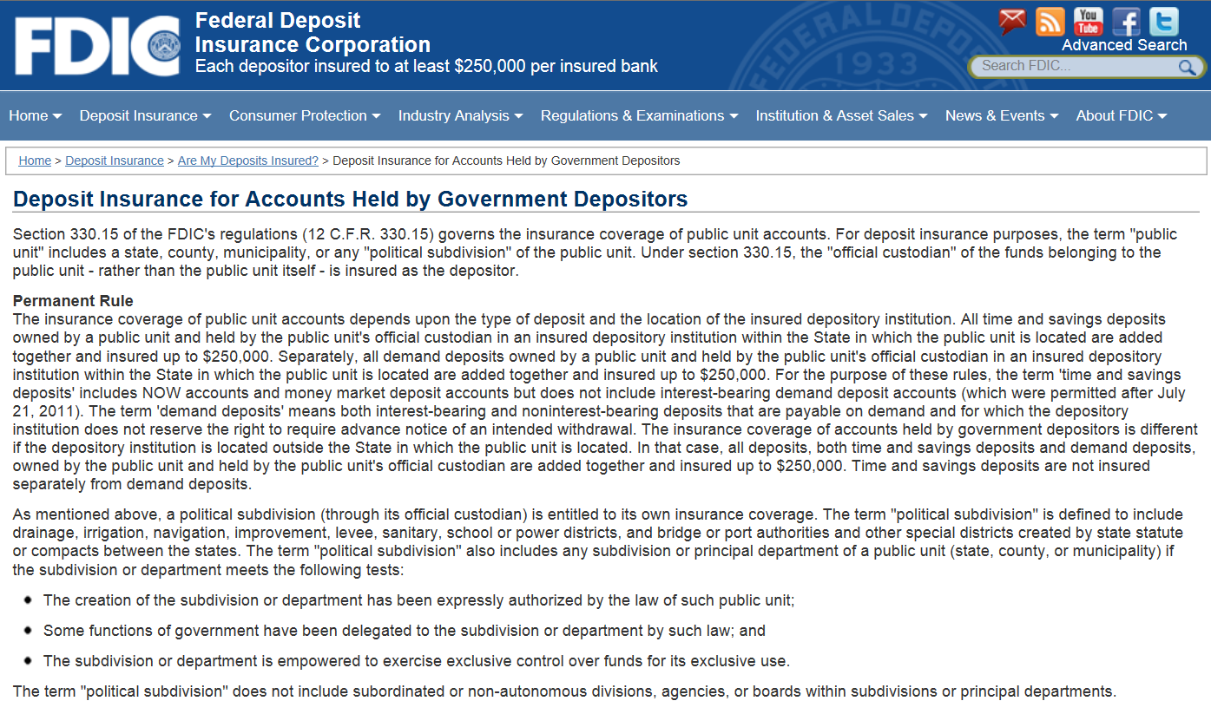
Government Accounts Fact Sheet
https://www.fdic.gov/deposit/deposits/factsheet.html
67

Slide 68
Category 9 – Mortgage Servicing Accounts
Mortgage Servicing Accounts are established by mortgage servicers and represent commingled principal and interest payments received from mortgagors (also known as “borrowers”).
Coverage:
Based on the borrowers’ payments of principal and interest into the mortgage servicing account.
Provided to the mortgage servicer on behalf of the mortgagees.
Up to $250,000 per borrower.
These funds will not be aggregated with other deposit accounts that the borrowers or mortgagees may maintain at the same bank.

Slide 69
Category 9 – Mortgage Servicing Accounts
A typical mortgage payment received by a mortgage servicer could be insured under different deposit insurance categories as described below:
Payment Type | Insured Owner | Insurance Category
The Principal & Interest (P&I) | Mortgage Servicer | Mortgage Servicing
Borrowers’ Tax & Insurance Escrow (T&I) | Borrower (Mortgagor) | Pass-through to Borrower in same ownership category as they hold title to the real estate.
Mortgage Related Fees (for example: guaranty fees, pair-off fees, extension fees and any other fees required by the Mortgagee) | Mortgagee | Pass-through to Mortgagee in the Business Organization Accounts ownership category.

Slide 70
Category 9 – Mortgage Servicing Accounts Example
Example:
A mortgage servicer collects from one thousand different borrowers their monthly mortgage payments of $2,000 (P&I) and places the funds into a mortgage servicing account.
Is the $2,000,000 aggregate balance of the mortgage servicer’s mortgage servicing account fully insured?
Yes, the account is fully insured to the mortgage servicer because each mortgagor’s payment of $2,000 (P&I) is insured separately for up to $250,000.

Slide 71
Pass-Through Deposit Insurance Coverage
Pass-through deposit insurance regulations can be found at
12 C.F.R. § 330.5 and 12 C.F.R. § 330.7 (on the FDIC’s Website at:
https://www.fdic.gov/regulations/laws/rules/2000-5400.html).
Fiduciary or agency accounts may be entitled to receive pass-through coverage. These accounts are established and maintained by third parties on behalf of the actual owners (referred to as the principals).
An account that meets the definition of a fiduciary or agency account is entitled to “pass-through” deposit insurance coverage from the FDIC through the third party who establishes the account to the actual owner/principal, provided certain conditions are met.
Important!
Fiduciary or agency accounts are not an ownership category!

Slide 72
Pass-Through Deposit Insurance Coverage
Examples of Third Parties Who Establish Fiduciary Accounts
Agent
Nominee
Guardian
Conservator
Executor
Broker
Examples of Fiduciary or Agency Accounts
Escrow
Power of Attorney
Uniform Transfer to Minors Act (UTMA)
Attorney Trust (IOLTA)
Agency
Brokered CDs

Slide 73
Pass-Through Deposit Insurance Coverage
What is “pass-through” deposit insurance coverage?
When funds are deposited by a fiduciary or custodian on behalf of one or more actual owners of the funds, the FDIC will insure the funds as if the actual owners had established the deposit in the bank.
What is the amount of “pass-through” deposit insurance coverage?
Assuming the deposit meets the requirements for pass-through insurance coverage, the amount of FDIC deposit insurance coverage will be based on the ownership capacity (i.e., under the applicable ownership category) in which each principal holds the funds.

Slide 74
Requirements for Pass-through Coverage
Funds must be owned by the principal, not the third party who set up the account (i.e., the fiduciary or custodian who is placing the funds). To confirm the actual ownership of the deposit funds, the FDIC may review:
The agreement between the third party and the principal and
Applicable state law
The bank’s account records must indicate the agency nature of the account (e.g., XYZ Company as Custodian, XYZ FBO, Jane Doe UTMA John Smith, Jr.).
The bank’s records or accountholder’s records must indicate both the principals’ identities as well as their ownership interests in the deposit.
Deposit terms (i.e., the interest rate and maturity date) for accounts opened at the bank must match the terms the third party agent promised the customer.
If the terms don’t match, the third party agent might be deemed to be the legal owner of the funds by the FDIC. An agent may retain a portion of the interest (as the agent’s fee) without precluding pass-through coverage.
*For more information, please see FIL-29-2010: https://www.fdic.gov/news/news/financial/2010/fil10029.pdf

Slide 75
Prepaid Cards and Deposit Insurance Coverage
There has been an increase in the use of prepaid cards.
These cards may be offered directly through the bank or through a third party program manager.
In order for deposit insurance to apply to prepaid funds, the pass-through requirements must be met.
Once the pass-through requirements are met (may require card registration), the actual owner of the funds, and not the custodian, is the insured party. The deposit insurance coverage will be based on the ownership category in which the funds are held.
Deposit insurance only applies when a bank fails.
The funds underlying the prepaid cards must be deposited in a bank.

Slide 76
Health Savings Accounts - Employee’s Guide
The Financial Institution Employee’s Guide to Deposit Insurance - the “Employee’s Guide” is intended to assist IDI employees in providing accurate information about FDIC insurance coverage. The Employee’s guide is available at: www.fdic.gov/deposit/diguidebankers/index.html
Example:
Using the “Employee’s Guide” to answer Health Savings Accounts (“HSAs”) questions:
What is a Health Savings Account (“HSA”)
How are Health Savings Accounts (“HSAs”) insured?

Slide 77
Health Savings Accounts - Employee’s Guide
https://www.fdic.gov/deposit/diguidebankers/index.html
Important: The “live” seminar provides animation on this slide which can only be viewed by participating in the WebEx conference. See FIL-18-2017 to register.
77

Slide 78
Section 529 Plans
Qualified Tuition Savings Programs under Section 529 of the Internal Revenue Code (“529 Plans”) are state-sponsored plans which are tax-advantaged accounts that help families and individuals save for higher education expenses.
While most states limit participants’ choices to investments such as stocks and bonds, some states allow participants to place their 529 plan money in bank deposits.
Deposits placed in a 529 plan at a bank are insured up to $250,000 for the owner of the funds, as determined by the state law in which the plan is created. This varies as to each state.
78

Slide 79
Section 529A ABLE Accounts
What are Section 529A - ABLE Accounts?
529A - Achieving A Better Life Experience (ABLE) accounts are a type of tax-advantaged account that an eligible individual can use to save funds for the disability-related expenses of the account’s designated beneficiary.
How are 529A accounts insured?
The designated beneficiaries of the 529A will be insured as single accounts up to the insurance limit of $250,000.
Are 529A accounts aggregated with any other deposits?
Each 529A beneficiary’s deposits would be insured together with any other single ownership category deposits the beneficiary may have at that same insured depository institution up to a combined total of $250,000.
79

Slide 80
Seminar on Deposit Insurance
Part 4 – Deposit Insurance Coverage Resources

Slide 81
Deposit Insurance Coverage Resources - Appendix 9 Most Common Deposit Insurance Categories
Category 1: Single accounts (12 C.F.R. § 330.6) – Slides 32-35
Category 2: Joint accounts (12 C.F.R. § 330.9) – Slides 36-42
Category 3: Revocable trust accounts (12 C.F.R. § 330.10) – Slides 43-52
Category 4: Irrevocable trust accounts (12 C.F.R. § 330.13) – Slides 53-54
Category 5: Certain retirement accounts (12 C.F.R. § 330.14(b)(2)) – Slides 55-56
Category 6: Employee benefit plan accounts (12 C.F.R. § 330.14) – Slides 57-61
Category 7: Business/Organization accounts (12 C.F.R. § 330.11) – Slides 62-63
Category 8: Government accounts (12 CFR § 330.15) – Slides 64-67
Category 9: Mortgage servicing accounts (12 CFR § 330.7(d)) – Slides 68-70
81

Slide 82
Deposit Insurance Coverage Resources –Appendix 5 Least Common DI Categories
Category 10: Public bonds accounts. (12 CFR § 330.15(c)) - This category consists of funds which by law or under a bond indenture are required to be set aside to discharge a debt owed to the holders of notes or bonds issued by a public unit. Deposit insurance coverage under this category is up to $250,000 for the beneficial interest of each noteholder or bondholder provided certain requirements are met.
Category 11: Irrevocable trust accounts with an insured depository institution as trustee. (12 CFR § 330.12) - This category consists of trust funds held by an insured depository institution in its capacity as trustee of an irrevocable trust. Deposit insurance coverage under this category is up to $250,000 for each owner or beneficiary provided certain requirements are met.
Category 12: Annuity contract accounts. (12 CFR § 330.8) – This category consists of funds held by an insurance company or other corporation in a deposit account for the sole purpose of funding life insurance or annuity contracts and any benefits linked to the contracts. FDIC deposit insurance under this category is up to $250,000 per annuitant provided certain requirements are met.
Category 13: Custodian accounts for American Indians. (12 CFR § 330.7(e)) –This category consists of funds held on behalf of an individual American Indian deposited by the Bureau of Indian Affairs of the United States Department of the Interior in a bank. Deposit insurance coverage under this category is up to $250,000 for the interest of each American Indian provided certain requirements are met.
Category 14: Accounts of an insured depository institution pursuant to the Bank Deposit Financial Assistance Program of the Department of Energy. (12 U.S.C . 1817 (i)(3)) - This category consists of funds deposited by a bank pursuant to the Bank Deposit Financial Assistance Program of the Department of Energy. Separate deposit insurance is provided up to $250,000 for each participant in the DOE program provided certain requirements are met.
If you have any questions regarding these categories, please call the FDIC at 1-877-ASK-FDIC.
82

Slide 83
Additional FDIC Seminars on YouTube
Fundamentals of Deposit Insurance Coverage
Discussion of the nine most common deposit insurance categories
Available at: https://youtu.be/OqM4uGkFCXU
Deposit Insurance Coverage for Revocable Trust Accounts
Detailed discussion for depositors with accounts in excess of $1,250,000 and six or more beneficiaries
Available at: https://youtu.be/pUYZRPpTfVo
Advanced Topics in Deposit Insurance Coverage
Health Savings Accounts
When Banks Merge
Right of Offset
Available at: https://youtu.be/X3Vr7EfOG9w
Also available at: www.fdic.gov/deposit/seminars.html
83

Slide 84
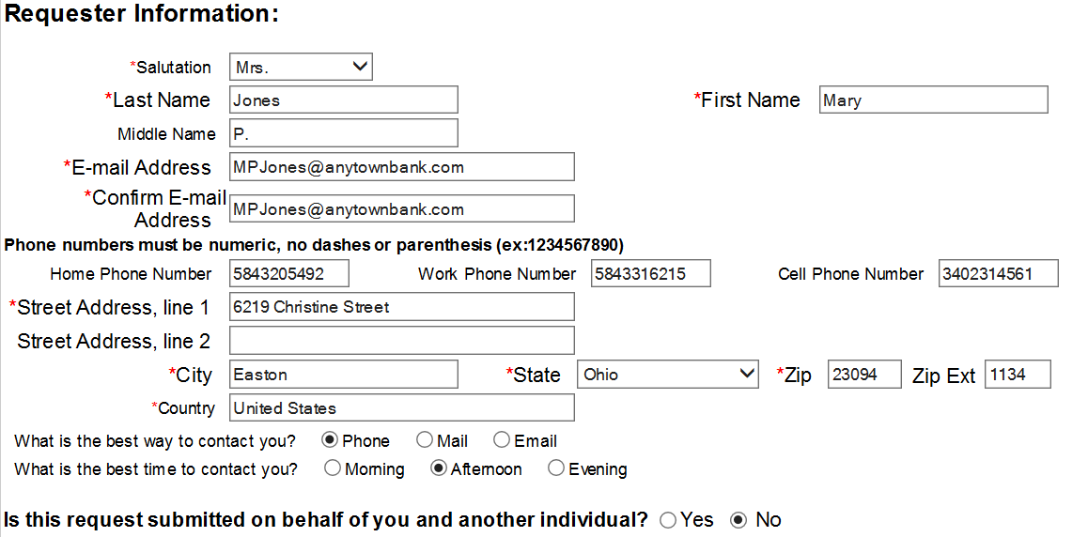
Additional FDIC Resources - Correspondence
www2.fdic.gov/starsmail/index.asp
Important: The “live” seminar provides animation on this slide which can only be viewed by participating in the WebEx conference. See FIL-18-2017 to register.

Slide 85
Seminar on Deposit Insurance
Thank you for participating in the seminar!
85

