Slide 1




Budgeting and Financial Statements

Slide 2

Learning Objectives
Explain how budgeting helps you manage your business
Create a basic monthly budget for your business
Explain how financial statements are used to manage your business

Slide 3
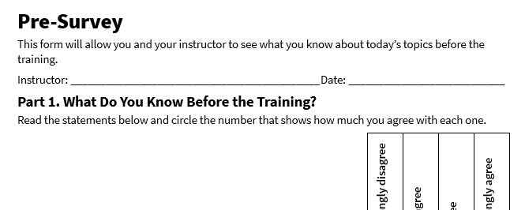
Pre-Survey
See page 1 in your participant guide.

Slide 4

SECTION 1
Budgeting
See page 2 in your participant guide.
4

Slide 5

Budgeting
A plan that estimates your income and expenditures over a certain period

Slide 6
Budgeting Basics
Bookkeeping
Budgeting
Using the Budget to Manage Your Business
Maintain accurate data on past income and expenditures
Maintain accurate data on cash and other resources
Estimate income
Estimate expenditures
Plan and make decisions
Compare estimates to actual income and expenditures
Prepare financial statements and projections

Slide 7

Budgeting Period
Budget for any period of time: week, month, quarter, or year
Smooth periodic costs

Slide 8

Try It: Budgeting for Next Month
See page 2 in your participant guide.

Slide 9
Budget: Cash Available and Income
Budget Item | Amount | Notes
Cash Available at Beginning of Period | $500
Repair Services | $18,000
Parts Sales | $1,500
Cash Available and Income Total | $20,000

Slide 10
Budget: Fixed Expenditures
Budget Item | Amount | Notes
Rent/Lease | $2,500
Utilities | $200
Employee Salaries/Benefits/Payroll Taxes | $4,000
Insurance | $300
Property Taxes | $0
Fixed Expenditures Subtotal | $7,000

Slide 11
Budget: Variable Expenditures
Budget Item | Amount | Notes
Marketing | $0
Inventory | $4,500
Equipment Repairs and Maintenance | $0
Office Supplies | $500
Travel | $0
Professional Fees | $0
Variable Expenditures Subtotal | $5,000

Slide 12
Budget: Income Taxes
Budget Item | Amount | Notes
Federal Income Taxes | $1,500
Federal Self-Employment Taxes | $0 | Not applicable for a C‑corporation
State Income Taxes | $400
Local Income Taxes | $100
Income Taxes Subtotal | $2,000
Total Expenditures $ 14,000

Slide 13
Budget: Amount Remaining
Budget Item | Amount | Notes
Amount Remaining (Cash Available and Income Total – Total Expenditures) | $

Slide 14

Apply It: My Business’ Budget
See page 5 in your participant guide.

Slide 15
SECTION 2
Financial Statements
See page 7 in your participant guide.
15

Slide 16
Background: Financial Statements
Balance Sheet
Provides a snapshot of a business's financial position at a specific point in time, detailing its assets, liabilities, and owner's equity.
Profit and Loss (P&L) Statement
Summarizes a business's revenues, expenses, and profits or losses over a specific period.
Cash Flow Statement
Tracks the inflows and outflows of cash within a business over a specific period.
Statement of Owner's Equity
Outlines the changes in the owner's equity over a specific accounting period, including contributions, withdrawals, and the business's net income or loss.

Slide 17
Terms and Concepts for Financial Statements
Asset
Liability
Owner’s Equity
Accounting Equation
Revenue
Cost
Cost of Goods Sold (COGS)
Expense
Gross Profit
Gross Profit Margin
Operating Margin
Net Profit
Net Profit Margin

Slide 18
Balance Sheet
Provides a snapshot of a business's financial position at a specific point in time
Often prepared at the conclusions of accounting periods, such as the end of a month, quarter, or year
Shows:
Assets: What the business owns
Liabilities: What the business owes
Owner’s Equity: The owner’s share of the business
Based on the Accounting Equation: Assets = Liabilities + Owner’s Equity

Slide 19

The Balance Sheet Tells a Story

Slide 20

Try It: Reviewing a Balance Sheet
See page 10 in your participant guide.

Slide 21
Balance Sheet at-a-Glance
Three sections: Assets, Liabilities, and Owner’s Equity
Current assets: Can be converted to cash within one year
Long-term assets: Provide value for more than one year
Current liabilities: Must be paid within one year
Long-term liabilities: Due in more than one year
Owner’s equity: The owner’s share of the business after liabilities are subtracted from assets
Assets = Liabilities + Owner’s Equity
Assets
Current Assets
Long-Term Assets
Total Assets
Liabilities
Current Liabilities
Long-Term Liabilities
Owner’s Equity
Total Liabilities and Owner’s Equity

Slide 22
Volt Balance Sheet: Current Assets
Assets
Current Assets
Current Assets | Amount | Notes
Cash | $ 28,000
Accounts Receivable | $ 3,000
Inventory | $ 5,000
Other: Prepaid Rent | $ 4,000
Other: | $
Total Current Assets | $ 40,000

Slide 23
Volt Balance Sheet: Long-Term Assets
Long-Terms Assets
Fixed / Long-Term Assets | Amount | Notes
Equipment | $ 3,000
Furniture and Fixtures | $ 3,000
Land and Buildings | $ 0
Other: ______________________ | $
Other: ______________________ | $
Total Long-Term Assets | $ 6,000
Total Assets
$ 46,000

Slide 24
Volt Balance Sheet: Current Liabilities
Liabilities
Current Liabilities
Current Liabilities | Amount | Notes
Accounts Payable | $ 1,000
Taxes Payable | $ 5,000
Salaries/Wages Payable | $ 4,000
Other: | $
Other: | $
Total Current Liabilities | $ 10,000

Slide 25
Volt Balance Sheet: Long-Term Liabilities
Long-Term Liabilities
Fixed / Long-Term Liabilities | Amount | Notes
Loan 1: SBA Microloan | $ 6,000
Loan 2: | $
Other: | $
Other: | $
Total Long-Term Liabilities | $ 6,000
Total Liabilities
$ 16,000

Slide 26
Volt Balance Sheet: Owner’s Equity
Owner’s Equity
Total Assets – Total Liabilities = Total Owner’s Equity
Total Owner’s Equity
$ 30,000
Total Liabilities & Owners Equity
$ 46,000

Slide 27

What are Volt’s Strengths and Weaknesses?

Slide 28

Apply It: My Balance Sheet
See page 12 in your participant guide.

Slide 29

Profit and Loss Statement Basics
Shows a company's revenues and expenses over a specific period
Also known as an income statement
Can be used to assess a company's financial performance and profitability

Slide 30
Basic Profit and Loss Statement
Revenues: What you receive for the products and services you sell in a period of time
Cost of goods sold: Total expenditure for providing the products or services that have been sold
Gross profit: Your sales minus cost of goods sold
Overhead: Expenses associated with your ongoing business operation
Net profit before taxes (operating profit): Gross profit minus overhead
Net profit: Net profit before taxes minus income taxes
+ Revenues
‒ Cost of Goods Sold
= Gross Profit
‒ Overhead
= Net Profit Before Taxes
‒ Income Taxes
= Net Profit

Slide 31

Profit Margin
A common measure of profitability
Shown as a percentage
Profit Margin = Net Profit ÷ Revenue
Reminder: Net Profit = Revenue – (Costs + Expenses + Taxes)

Slide 32

Try It: Creating a Profit and Loss Statement
See page 15 in your participant guide.

Slide 33
Volt P&L Statement: Revenue, Cost of Goods Sold, and Gross Profit
Revenue
Item | Amount | Notes
Repair Services | $ 250,000
Parts Sales | $ 50,000
Total Revenue | $ 300,000
Cost of Goods Sold
Item | Amount | Notes
Inventory / Merchandise | $ 30,000
Raw Materials | $ 10,000
Direct Labor | $ 60,000
Total Cost of Goods Sold | $ 100,000
Gross Profit
$ __________________
Note: Gross Profit = Total Revenue – Total Cost of Goods Sold

Slide 34
Volt P&L Statement: Overhead and Net Profit Before Taxes
Overhead
Item | Amount | Notes
Rent | $ 25,000
Utilities | $ 2,000
Employee Salaries/Benefits/Payroll Taxes | $ 51,000
Equipment Repairs and Maintenance | $ 0
Insurance | $ 2,000
Marketing | $ 2,000
Office Supplies | $ 2,000
Travel | $ 0
Professional Fees | $ 1,000
Other: | $
Other: | $
Other: | $
Other: | $
Total Expenses | $ 85,000
Net Profit Before Taxes
$ __________________
Note: Gross Profit = Total Revenue – Total Cost of Goods Sold

Slide 35
Volt P&L Statement: Income Taxes and Net Profit
Income Taxes
Item | Amount | Notes
Federal Income Taxes | $ 20,000
State Income Taxes | $ 4,000
Local Income Taxes | $ 1,000
Other: | $
Other: | $
Total Income Taxes | $ 25,000
Net Profit
$ __________________
Note: Net Profit = Net Profit Before Taxes – Total Income Taxes
Profit Margin
$ __________________
Note: Profit Margin = Net Profit ÷ Total Revenue; multiply by 100% to express profit margin as a percentage

Slide 36

Apply It: My Profit and Loss Statement
See page 17 in your participant guide.

Slide 37
Cash Flow Statements
Shows how cash moves in and out of a business over a specific period
Historical, showing what has already happened; not a projection
Divided into three sections:
Operating Activities
Investing Activities
Financing Activities
Cash generated or used in the day-to-day operations of the business
Cash used for or generated by investments in assets, such as equipment or property
Cash received from or paid to lenders and investors, such as loan repayments or equity contributions

Slide 38

Why do you think it’s important to track cash flow?

Slide 39
Example Cash Flow Statement
Cash Flow Item | Amount
Operating Activities
Cash from Sales | $150,000
Cash Paid for Cost of Goods Sold | ($50,000)
Cash Paid for Expenses | ($25,000)
Cash Flow from Operations | $75,000
Investing Activities
Equipment Purchase | ($5,000)
Cash Flow from Investing | ($5,000)
Financing Activities
Loan Received | $26,000
Loan Repayment | ($1,000)
Distributions to Partners | ($75,000)
Cash Flow from Financing | ($50,000)
Net Cash Flow | $20,000

Slide 40
Statement of Owner’s Equity
Shows changes in the owner’s equity over a specific period, such as:
Investments made by the owner
Net income or loss from the business
Withdrawals taken by the owner
Closely related to the balance sheet

Slide 41
Example Statement of Owner’s Equity
Statement of Owner’s Equity Item | Amount
Beginning Owner’s Equity | $100,000
Additions
Net Income | $40,000
Additional Investment by the Owner | $10,000
Deductions
Owner’s Draw | ($20,000)
Ending Owner’s Equity | $130,000

Slide 42
Take Action
What is one goal you will pursue?
What first step will you take toward your goal?
How will you get and give support to other participants?

Slide 43

For More Information
See page 22 in your participant guide.

Slide 44
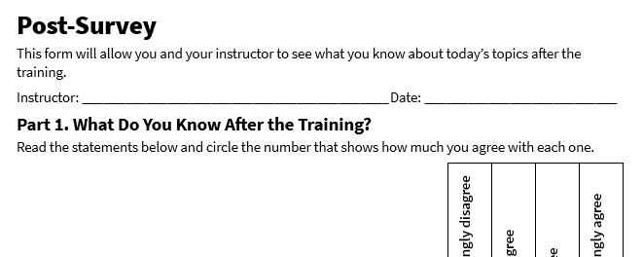
Post-Survey
See page 27 in your participant guide.

Slide 45
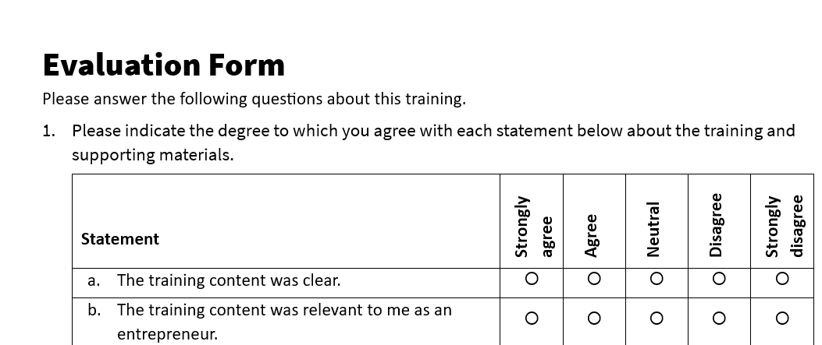
Evaluation
See page 28 in your participant guide.

Slide 46
Thank you!
Thank you!

