Slide 1




Module 10 Buying a Car
Small Business
Financing

Slide 2

Learning Objectives
List types of funding available for small businesses and where to access them
Choose the types of financing best suited for your small business
Explain the process and requirements for acquiring a small business loan
Explain what lenders look for when deciding who to lend money to and on what terms

Slide 3
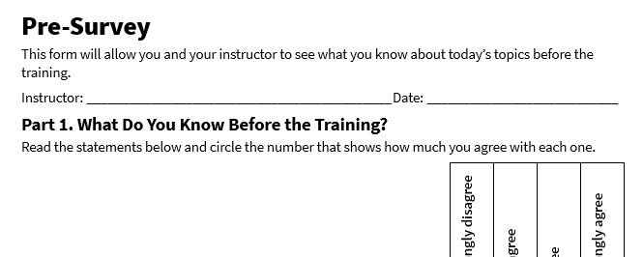
Pre-Survey
See page 1 in your participant guide.

Slide 4
SECTION 1
Capital for Small Business
See page 2 in your participant guide.
4

Slide 5
Capital
Financial assets or resources that a business uses to fund its operations and growth

Slide 6
Discussion
How have you accessed capital to fund your business?

Slide 7
Types and Sources of Funding and Financing
Financing – Borrowing. The funds received need to be repaid, often with interest.
Grants and Gifts – Funds that do not need to be repaid.
Equity Investments – Contributions of capital in exchange for ownership stakes in a business.

Slide 8
Financing
Loans | Revolving Credit
Business installment loans SBA loans Community Development Financial Institutions (CDFIs) Owner’s loans to the business Loans from family and friends | Credit cards Business credit cards Personal credit cards Business lines of credit

Slide 9
Grants
Types of Grants
Places to Look for Grants
Federal, state, and local government grants
Community group grants
Grants.gov
SBA.gov grant listing
State and local economic development agencies
Community foundations and nonprofits
Online grant databases

Slide 10
Gifts
Gifts from friends and family
Crowdfunding
Owner’s personal contributions with no increase in ownership stake

Slide 11
Equity Investments
Venture capital
Angel investors
Investment funds and private equity firms
Family and friends
Owner’s personal contributions with an increase in ownership stake

Slide 12

Try It: Considering Funding Options
See page 6 in your participant guide.

Slide 13
SECTION 2
Types of Small Business Financing
See page 8 in your participant guide.

Slide 14
Financing Characteristics
Loan Term & Repayment Schedule
Interest Rates
Collateral Requirements
Purpose of the Loan
Loan Amount
Application Process & Eligibility Criteria

Slide 15
Types of Small Business Financing
Types
Tips
Business Credit Cards
Business Lines of Credit
Microloans
Short-Term Business Installment Loans
Long-Term Business Installment Loans
Other loan types may be available.
Shop around for a loan.
Interest rates and other details may vary.
Relationships with banks matter.

Slide 16
Business Credit Cards
Characteristic | Details on Business Credit Cards
Term & Repayment Schedule | There typically is a minimum monthly payment that is a small percentage of the loan balance. Cardholders can pay more than the minimum to reduce the time it takes to pay off the card balance.
Interest Rates | May range from 14% to 25% if balances are carried month-to-month.
Collateral Requirements | Typically, none—they are unsecured.
Common Uses | Covering short-term expenses, managing cash flow, purchasing inventory, or handling emergencies.
Amount | Variable based on business needs, up to a borrowing limit.
Sources | Banks, credit unions, and some fintech companies
Application Process | Written or online applications that require business financial information and sometimes personal credit history.

Slide 17
Business Lines of Credit
Characteristic | Details on Business Lines of Credit
Term & Repayment Schedule | You can generally pay more than the minimum monthly payment to reduce the time it takes to pay off the balance. Business lines of credit typically require a minimum monthly payment.
Interest Rates | May range widely, often based on factors such as the perceived creditworthiness of the business, whether the loan is secured by collateral, and market conditions.
Collateral Requirements | Often unsecured, but some lenders may require collateral.
Common Uses | Covering short-term expenses, managing cash flow, purchasing inventory, or handling emergencies.
Amount | Variable based on business needs, up to a borrowing limit.
Sources | Banks, credit unions, online lending fintech companies, and CDFIs.
Application Process | Online or written applications that require business financial information and sometimes personal credit history.

Slide 18
Microloans
Characteristic | Details on Microloans
Term & Repayment Schedule | Generally up to 7 years, with monthly payments.
Interest Rates | May range widely, such as from 6% to 18%.
Collateral Requirements | Often unsecured, but some lenders may require collateral.
Common Uses | Starting or expanding a business, purchasing equipment, working capital, or other business needs.
Amount | Generally smaller amounts, up to $50,000.
Sources | Primarily nonprofit, community development organizations and CDFIs. Some local banks and credit unions may offer microloan programs.
Application Process | Detailed applications that may include business plans, financial statements, and personal credit history.

Slide 19
Short-Term Business Installment Loans
Characteristic | Details on Short-Term Business Installment Loans
Term & Repayment Schedule | Usually less than a year, with weekly, bi-weekly, or monthly repayment schedules.
Interest Rates | May range widely, such as from 6% to 36%.
Collateral Requirements | Can be unsecured or secured.
Common Uses | Covering unexpected expenses, managing cash flow, or bridging financial gaps.
Amount | Generally smaller amounts than long-term loans, typically up to $250,000.
Sources | Banks, credit unions, and some online lending fintech companies.
Application Process | Application length and amount of detail varies.

Slide 20
Long-Term Business Installment Loans
Characteristic | Details on Long-Term Business Installment Loans
Term & Repayment Schedule | Typically between 12 to 60 months, with fixed monthly payments.
Interest Rates | May range widely, such as from 5% to 15%.
Collateral Requirements | Usually secured with collateral, such as a piece of expensive equipment purchased with the loan proceeds.
Common Uses | Financing major purchases, consolidating debt, or investing in business growth.
Amount | Generally larger amounts than short-term loans, but can vary.
Sources | Banks, credit unions, and nonprofit organizations participating in SBA lending programs.
Application Process | Detailed applications requiring comprehensive financial information and credit checks.

Slide 21
SBA Guarantee Programs
Guarantees = Promises to repay a borrower’s debt if they fail to meet their obligations
Financial institutions
May be more willing to lend to small businesses with limited credit histories and collateral that have guarantees
May offer lower interest rates and other favorable terms
Examples:
7(a) Loan Program offers a variety of loan types for a variety of uses
504 Loan Program provides long-term, fixed-rate financing for major fixed assets
Microloan Program provides small loans to help businesses start and expand
Visit sba.gov for more on loan programs and the SBA’s Lender Match referral tool
Explore other public and private organizations may offer loan guarantee programs

Slide 22

Community Development Financial Institutions (CDFIs)
Specialized financial institutions
Offer loans and microloans to small businesses that may not qualify for traditional bank financing
Offer training, coaching, and support to entrepreneurs
Visit cdfifund.gov to find a CDFI that serves your area

Slide 23
Special Loan and Loan Guarantee Programs
Agriculture
Manufacturing
Veteran-owned businesses
Military spouse-owned businesses
Exporter loans
Disaster recovery loans

Slide 24

Try It: Choosing a Type of Financing
See page 12 in your participant guide.

Slide 25
SECTION 3
Getting a Business Loan
See page 14 in your participant guide.

Slide 26
What is a loan package?
Collection of documents and information that a borrower submits to a lender when applying for a loan

Slide 27
Loan Package Contents
Loan Application
Business Plan
Financial Statements
Business Tax Returns
Credit Reports and Scores
Documentation Related to the Loan Purpose
Collateral Information

Slide 28
Collateral
An asset that a borrower pledges as security for a loan

Slide 29
Underwriting
Process by which lenders evaluate the eligibility of a business for a loan
Involves a thorough review of the business's financial health, creditworthiness, and ability to repay the loan

Slide 30
For a Strong Loan Package…
Make sure your financial statement are accurate, consistent, and supported with documentation
Clearly explain how the loan will be used and how it will help the business grow or stabilize
Demonstrate your ability to repay by providing realistic cash flow projections and addressing any credit issues upfront
Include a well-organized business plan that shows your understanding of the market, your customers, and your competitors
Present all materials neatly and completely

Slide 31
The Five Cs of Credit
Capacity
Character
Collateral
Capital
Conditions

Slide 32
Try It: Considering the Five Cs
See page 16 in your participant guide.
Crisanto owns a vintage automobile worth $45,000.
Exercise apps like SweatSync are trending right now.
SweatSync has had steady net income over the past 12 months.
SweatSync’s cash reserves are currently low.
SweatSync does not have a robust credit history.

Slide 33

Apply It: My Readiness to Borrow Self-Assessment
See page 17 in your participant guide.

Slide 34

Try It: Strengthening a Loan Application
See page 18 in your participant guide.

Slide 35
Take Action
What is one goal you will pursue?
What first step will you take toward your goal?
How will you get and give support to other participants?

Slide 36
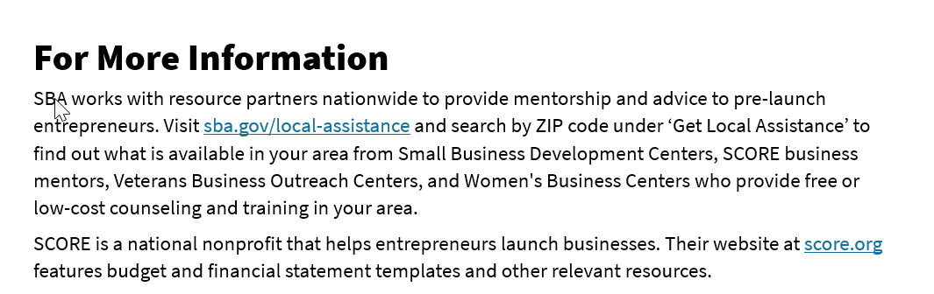
For More Information
See page 20 in your participant guide.

Slide 37
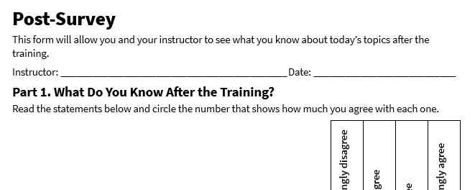
Post-Survey
See page 24 in your participant guide.

Slide 38
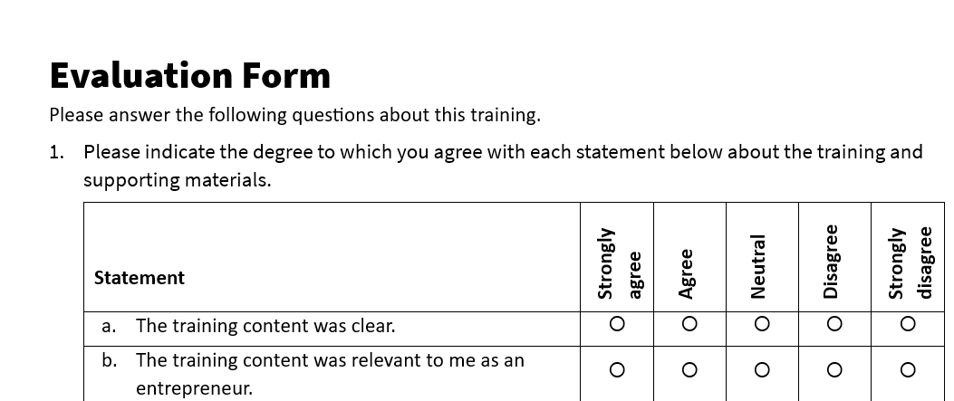
Evaluation
See page 25 in your participant guide.

Slide 39
Thank you!

