Slide 1




Banking Services

Slide 2

Learning Objectives
List the benefits of having a banking relationship
List the products and services that banks offer to small businesses
Develop a list of banking services your business needs
Select a bank based on your business needs
Explain FDIC deposit insurance
Take active steps to bank securely

Slide 3
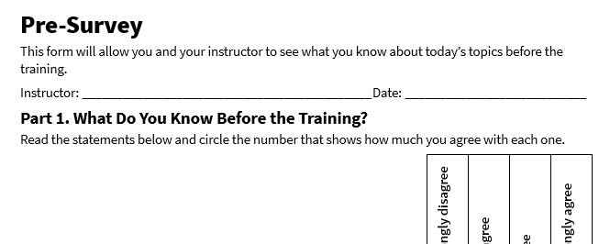
Pre-Survey
See page 1 in your participant guide.

Slide 4

SECTION 1
Banking Services Overview
See page 2 in your participant guide.

Slide 5

Building a Banking Relationship
Why do you think it’s important to have a good relationship with your bank?

Slide 6

Try It: Spotting Myths About Banks
See page 2 in your participant guide.

Slide 7
Myths About Banks
Myth 1: Banks Don’t Want My Business Because My Company Is Too Small
Myth 2: Banks Won’t Consider My Loan Application If It’s Too Small
Myth 3: Banks Require a Perfect Credit History
Myth 4: The Loan Application Process Takes Months
Myth 5: Fees Are Not Affordable

Slide 8

Bank Products and Services for Small Business

Slide 9
Loans and Lines of Credit
Banks provide funds to help businesses grow, manage cash flow, and invest in new opportunities.
Community Development Financial Institutions provide funding options with flexible underwriting standards for small businesses.
Banks offer various financing options tailored to meet the diverse needs of small businesses.
Examples of small business financing include:
Business Loans
SBA Guaranteed Loans
Lines of Credit

Slide 10
Business Checking Accounts
Manage day-to-day transactions, such as paying bills, depositing revenue, and transferring funds
Various fee structures; common fees include
Monthly maintenance fees
Transaction fees
Cash deposit fees
ATM fees
Overdraft fees
Wire transfer fees
Online and mobile banking access provides the convenience of managing your finances anytime, anywhere
May integrate with accounting software

Slide 11

Why have separate business and personal checking accounts?

Slide 12
Reasons to Separate Business and Personal Checking Accounts
Making recordkeeping
more organized
Accepting
different types of payments
Limiting
personal
liability
Getting more
deposit insurance coverage

Slide 13
Debit Cards Linked to Checking Accounts
Allow you to make purchases, withdraw cash, and pay bills directly from your account.
These cards are convenient but require careful management to avoid overdrafts or unauthorized transactions.
What are some best practices for managing a business debit card?

Slide 14
Best Practices for Managing Business Debit Cards Linked to Checking Accounts
Set up
alerts
Establish
spending limits
Limit
card access
Keep your
card details confidential
Review account activity at least monthly
Report lost
or stolen cards immediately

Slide 15

Prepaid Debit Cards
Allow businesses to load a specific amount of money onto the card and use it for purchases up to the preloaded balance
No risk of overdrawing
Limited risk if the card is lost or stolen
Can be especially useful for businesses with multiple employees

Slide 16

Business Savings Accounts
Help small businesses set aside funds for future expenses, emergencies, or growth opportunities
Often earn interest
May have fees
Monthly limit on no-fee transactions is typically much lower than with business checking accounts
May be linked to business checking and savings accounts
What are some reasons you might open a savings account for your business?

Slide 17

Payroll Services
Help small businesses manage employee payments, tax withholdings, and compliance with labor laws
Benefits may include:
Saving time by automating payroll processes
Reducing errors in tax calculations and filings
Ensuring compliance with labor laws and regulations

Slide 18

Cash Management
Help businesses optimize their cash flow by managing receivables, payables, and liquidity
Especially useful for businesses with high transaction volumes
Examples include:
Automated Clearing House (ACH) payments
Lockbox services for processing customer payments
Sweep accounts to maximize interest on idle funds

Slide 19

Merchant Services
Help businesses process payments efficiently and securely
Especially useful for businesses with high transaction volumes
Examples of merchant services include:
Credit Card Processing
Point-of-Sale (POS) Systems
Mobile Payment Solutions
E-commerce Payment Gateways
Fraud Prevention Tools

Slide 20
Additional Banking Products & Services
Financial advisory services
E-commerce integration
Nonbank fintech services
Example: Person-to-person (P2P) payments
Understand the services, fees, and relevant consumer protections
Find out whether stored money is insured

Slide 21
Try It: Considering Banking Needs
See page 7 in your participant guide.

Slide 22

Apply It: My Banking Needs
See page 8 in your participant guide.

Slide 23
SECTION 2
Deposit Insurance and Factors in Selecting the Right Bank
See page 9 in your participant guide.

Slide 24

FDIC Deposit Insurance
Protects your money in the event of a bank failure
Deposits automatically insured to at least $250,000 at each FDIC-insured bank

Slide 25
Key Points About FDIC Deposit Insurance
Provided per depositor, who may be a person or legal entity
Covers all deposit accounts, including checking and savings accounts, money market deposit accounts, and certificates of deposit
Standard insurance amount is to at least $250,000 per depositor, per insured bank, for each account ownership category
For more details see the FDIC’s deposit insurance brochure, “Your Insured Deposits,” at your bank or on the FDIC website: fdic.gov/deposit.

Slide 26

Deposit Insurance for Credit Union Accounts
Deposits in credit union accounts may be insured through the National Credit Union Administration (NCUA), which is another federal government agency.
The NCUA’s insurance rules are similar to the FDIC’s rules, but they may differ in some respects.
For more information on credit union accounts and coverage, go to ncua.gov and search for “Share Insurance Fund.”

Slide 27

Discussion
What factors do you look for in selecting a bank?

Slide 28



Factors in Selecting the Right Bank
Fees
Customer Service
Technology

Slide 29
Fees
Can vary widely between banks
Ask about and consider:
Monthly maintenance fees
Transaction fees for deposits, withdrawals, and transfers
Overdraft fees
Fees for additional services like merchant processing or payroll services
What strategies can you use to reduce or avoid banking fees?

Slide 30
Customer Service
Find a bank that is responsive and understands your needs.
Ask about and consider:
Channels for customer support, such as phone, email, live chat, and in-person assistance
Availability of live customer support at times that work for you
Experience supporting small business customers and options for getting personalized advice from bank employees that understand small business

Slide 31
Technology
Mobile Banking
Reports & Analytics
Security Features
Financial & Credit Education
Access your accounts anytime, anywhere
Features like mobile deposits, bill pay, and account alerts
Tools to track spending and generate other reports and analytics
Integration with accounting software
Two-factor authentication
Fraud alerts
Secure methods for sharing documents and information
Online resources to help you manage your business finances effectively and build a strong credit history

Slide 32
SECTION 3
Banking Securely
See page 11 in your participant guide.

Slide 33
Ways to Bank Securely
Activating Secure Banking Options
Password Management
Remote
Banking Usage
Monitoring and Reconciling
Accounts
Keeping Physical
Cash and Paper Checks Secure

Slide 34
Activating Secure Banking Options
Two-Factor Authentication
Alerts and Notifications
Secure Banking Apps
Fraud Detection Services

Slide 35

Discussion
How secure is your password management?

Slide 36
Password Management
Use Strong, Unique Passwords
Change Passwords Regularly
Implement a Password Manager
Secure Physical Tokens
Regularly Update Security Questions

Slide 37

Remote Banking Usage
Use Secure Internet Connections
Limit Access to Trusted Devices

Slide 38
Monitoring and Reconciling Accounts
Reconcile accounts regularly
Monitor account activity
Implement dual control procedures

Slide 39

How Can You Keep Cash Secure?

Slide 40
Keeping Physical Cash and Paper Checks Secure
Store Cash and Checks Securely
Limit Cash on Hand
Use Safe Transport Methods
Implement Check Handling Procedures

Slide 41

Apply It: My Banking Security Self‑Assessment
See page 12 in your participant guide.

Slide 42
Take Action
What is one goal you will pursue?
What first step will you take toward your goal?
How will you get and give support to other participants?

Slide 43
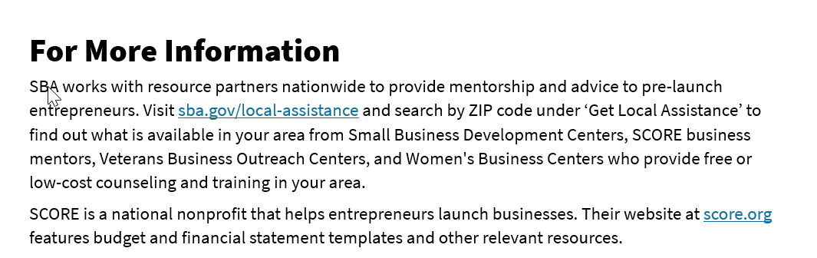
For More Information
See page 15 in your participant guide.

Slide 44
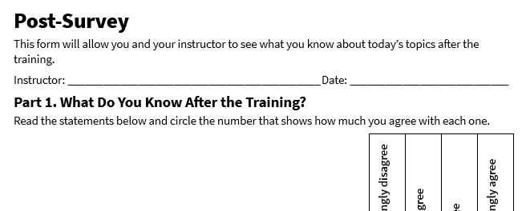
Post-Survey
See page 20 in your participant guide.

Slide 45
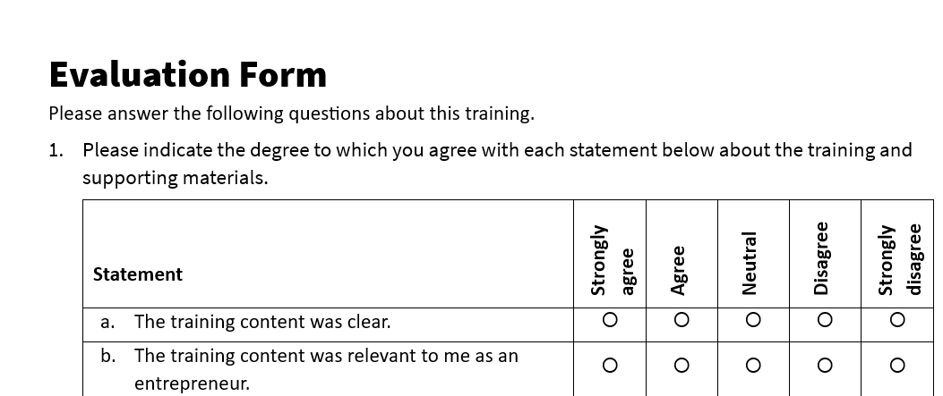
Evaluation
See page 21 in your participant guide.

Slide 46
Thank you!

