Slide 1




Selling, Closing, or Transferring Ownership of Your Business

Slide 2

Learning Objectives
Explain the different strategies for business exit and the benefits of planning ahead.
List steps and considerations for selling a business.
List steps and considerations for transferring ownership of a business.
List steps and considerations for closing a business.

Slide 3
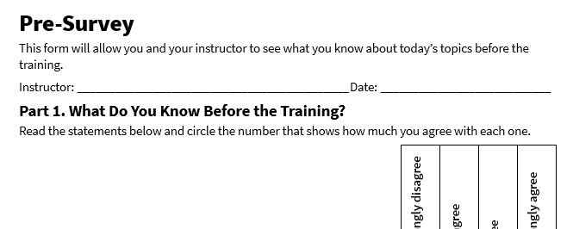
Pre-Survey
See page 1 in your participant guide.

Slide 4
SECTION 1
Strategies for Business Exit
See page 2 in your participant guide.

Slide 5

What might cause you to exit your business?

Slide 6
Common Reasons for Business Exit
Retirement: The owner may be ready to retire and enjoy the fruits of their labor.
Burnout: The owner may be feeling overwhelmed and exhausted from running the business.
Health Issues: The owner's health may be declining, making it difficult to continue managing the business.
Financial Difficulties: The business may be facing financial challenges, such as declining sales or increasing costs.
Lack of Succession Plan: The owner may not have a succession plan in place, making it difficult to transfer ownership of the business.

Slide 7
More Common Reasons for Business Exit
New Opportunities: The owner may have identified new opportunities that they want to pursue.
Change in Lifestyle: The owner's personal circumstances may have changed, making it difficult to continue running the business.
Economic Conditions: Changes in the economy, such as a recession, may make it difficult to sustain the business.
Partnership Disputes: Disagreements among partners may lead to the decision to dissolve the business.

Slide 8
Strategies for Business Exit 2
Selling the Business
  Purchase of the business by an individual or company, including assets and liabilities, or sometimes just assets
Closing the Business
  Legally dissolving the company, settling debts, canceling permits and licenses, and liquidating remaining assets
Transferring Ownership
  Changing the control and rights from one owner to another

Slide 9
Why Sell?
Why might a business owner choose to sell
their business?

Slide 10
Reasons to Sell
To maximize the financial return on their investment
To pursue other opportunities
To retire
To avoid the challenges of closing the business

Slide 11
Why Close?
Why might a business owner choose to close
their business?

Slide 12
Reasons to Close
The business is no longer profitable.
The owner is no longer able to manage the business.
There is no succession plan in place.
The owner wants to avoid the challenges of selling the business.

Slide 13
Why Transfer Ownership?
Why might a business owner choose to
transfer ownership of their business?

Slide 14
Reasons to Transfer Ownership
To keep the business in the family
To reward loyal employees
To ensure the continuity of the business
To minimize tax liabilities

Slide 15
Benefits of Planning Ahead
Maximizing Business Value
Attracting Potential Buyers
Smooth Transition
Reduced Stress
Financial Security

Slide 16

Try It: Choosing a Business Exit Strategy
See page 4 in your participant guide.

Slide 17
Debate! Sell, Close, or Transfer Ownership
Why should Dae select your strategy?
What are the potential benefits of this strategy?
What are the potential drawbacks of this strategy and how can she avoid them?

Slide 18
SECTION 2
Selling a Business
See page 5 in your participant guide.

Slide 19
Determine If a Business is Saleable
Do you have a history of strong profits?
Is your business in an attractive or growing industry?
Does your location support future growth or quick relocation if needed?
Are your equipment and assets in good condition?
Do you have reliable relationships with suppliers?
Are there loyal or long-standing customers who help generate steady income?
Can the business operate successfully without your personal involvement?
Is your balance sheet healthy with manageable debt and collectable accounts receivable?

Slide 20

Apply It: Is My Business Saleable?
See page 5 in your participant guide.

Slide 21

Why is accurate and thorough due diligence so critical for both buyer and seller?

Slide 22

Due Diligence
Establishes trust between buyer and seller
Avoids legal or financial surprises later
Enables fair valuation and smoother negotiations

Slide 23
Perspectives on the
Due Diligence Process
Buyer’s Perspective
Wants to confirm the accuracy of financial statements, customer data, and inventory levels
Wants to understand all liabilities, such as loans or pending lawsuits
Usually requests several years of tax returns and profit and loss statements
May commission their own appraisals
Seller’s Perspective
Wants the sale to move forward
Needs to be transparent and ready to answer detailed questions about operations, finances, and future projections
Should present information in an organized way that reflects positively on the business’s professionalism and value

Slide 24

Determine Your Price

Slide 25
Business Valuation Methods
Asset-based valuation
  Calculates the value of the business based on its assets, such as equipment, inventory, and real estate
Market-based valuation
  Compares the business to similar businesses that have recently been sold
Income-based valuation
  Calculates the value of the business based on its future earnings potential
Discounted cash flow (DCF) analysis
  Estimates the present value of future cash flows

Slide 26
Prepare for Sale
Resolve outstanding issues, such as unpaid accounts receivable, lawsuits, etc.
Clean up your records and have recent financial statements ready.
Secure beneficial relationships with suppliers and customers.
Repair or update equipment and premises.
Improve financial performance by increasing revenue, reducing costs, and managing cash flow effectively.
Decide in advance exactly which assets—such as equipment or intellectual property—are included in the sale.

Slide 27
Look for Prospective Buyers
Business brokers
Industry contacts
Online platforms
Direct outreach
  Working with these professional intermediaries between buyers and sellers can help you find people and organizations interested in buying businesses.
  Networking with industry professionals can lead to potential buyers.
  Listing the business on online business-for-sale marketplaces can reach a wider audience.
  Contacting potential buyers, such as competitors or companies in related industries, directly can start discussions about a sale.

Slide 28

Apply It: Where Might I Find a
Buyer for My Business?
See page 8 in your participant guide.

Slide 29
Negotiating the Deal
Buyer Qualification: Does the buyer have the financial and management capacity to run the business?
Payment Terms: Will there be a lump sum, installments, or seller financing?
Non-Compete Agreement: What are the restrictions on the seller related to competing with the business after it is sold?
Management Assistance: Will the seller stay on for a period as an advisor, paid consultant, or employee to show the new owner how things run?
Sales Agreement Preparation: What are the sale price, sources of financing, provisions for resolving disputes, and other details of the transaction?
Down Payment: How much money is put down upfront?
Collateral: If a loan is required, what assets are at stake if the buyer defaults?

Slide 30
SECTION 3
Closing a Business
See page 10 in your participant guide.

Slide 31

Closing a Business is a Big Decision
It should not be taken lightly.
It is crucial to seek professional advice and carefully consider all options before making a final decision.

Slide 32
Steps for Closing a Business
Follow Instructions in Your Founding Documents
File Dissolution Documents with the State
Sell Business Assets
Cancel Permits, Licenses, and Lease Agreements
Comply with Tax Laws
Resolve Outstanding Issues with Customers, Creditors, and Suppliers
Maintain Records

Slide 33

Try It: Starting a Business Closure
Task List
See page XX in your participant guide.

Slide 34
SECTION 4
Transferring Ownership of a Business
See page 14 in your participant guide.

Slide 35
Benefits of Selecting a Successor Early
Continuity for Employees and Customers
Preservation of Legacy
Reduced Risk and Uncertainty
Time to Build Skills

Slide 36
Family Members, Employees, or Successors from Outside
Family Members | Pros: They know the business history and have a personal stake in preserving its success. Cons: Emotional or familial conflicts can complicate decision-making. Some family members may not have the right skill set or interest.
Employees | Pros: Key employees understand day-to-day operations, customers, and products or services. Cons: Not all employees want ownership responsibility or can secure financing to buy the business, if that is part of the plan.
Successors from Outside | Pros: Outsiders may bring fresh perspectives, new expertise, capital. They may energize business growth. Cons: Cultural fit is not guaranteed. They may need a longer ramp-up time, and trust must be built among employees and customers.

Slide 37

Succession Planning
Succession planning is a complex process that requires careful consideration of various factors.

Slide 38
Issues to Consider in Succession Planning
Finding a Successor | Consider integrating this process into estate planning for a family member Consider an employee who has the right leadership qualities and interest Recruit an external professional for specialized skills
Training a Successor | Share knowledge Provide mentorship Provide hands-on leadership development opportunities
Easing Tax Exposure | Structure ownership transfers in a way that minimizes unnecessary taxes and fees Establish a clear plan for how shares or ownership interests are allocated Address potential probate or estate settlements in the event of an owner’s death

Slide 39
Take Action
What is one goal you will pursue?
What first step will you take toward your goal?
How will you get and give support to other participants?

Slide 40
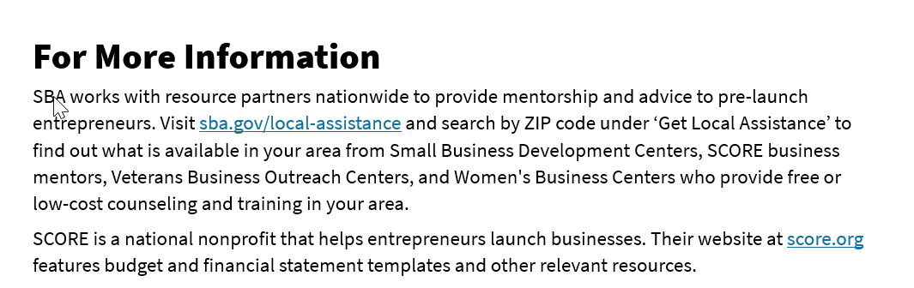
For More Information
See page 16 in your participant guide.

Slide 41
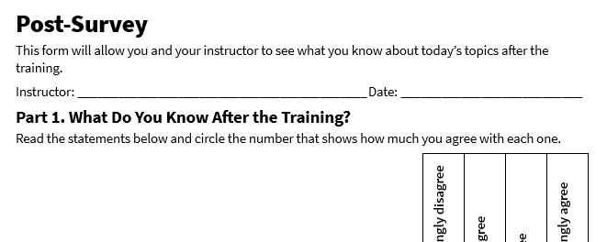
Post-Survey
See page 20 in your participant guide.

Slide 42
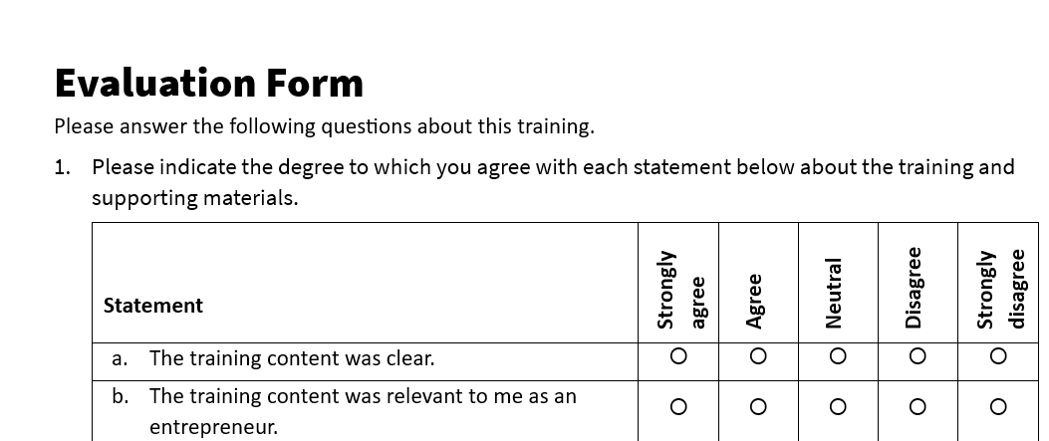
Evaluation
See page 21 in your participant guide.

Slide 43
Thank you!
Thank you!

