Slide 1




Module 10 Buying a Car
Risk Management

Slide 2

Learning Objectives
Define risk management and give examples of risk management strategies
Identify internal risks to a small business
Identify external risks to a small business
Conduct a systematic risk assessment for a small business
Develop a risk management plan for a small business

Slide 3
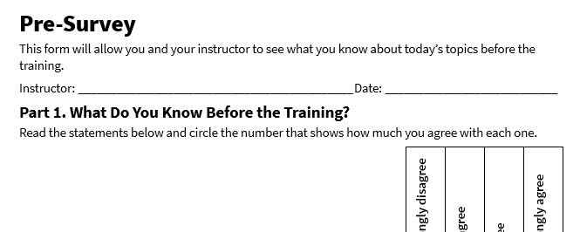
Pre-Survey
See page 1 in your participant guide.

Slide 4

SECTION 1
Introduction to Risk Management
See page 2 in your participant guide.

Slide 5

Risk
The potential to experience
loss or harm

Slide 6
Internal and External Risks
Internal Risks
  Originate from within the business
  Related to factors that the business can control
External Risks
  Originate outside of the business
  Typically related to factors beyond the business’s control

Slide 7

Try It: Spotting Risks
See page 2 in your participant guide.

Slide 8
Try It: Spotting Risks – Answer Key
Event | Risk | Risk Type
Her primary cleaning solution supplier just announced a 15% price increase | Increase in supply costs | ◻ Internal ☑ External
Two clients reported minor furniture damage during recent cleaning jobs | Damage to client property due to accidents | ☑ Internal ◻ External
One of her newer vans needed unexpected repairs last month | Unplanned maintenance costs for equipment and other assets | ☑ Internal ◻ External
Three days of appointments were canceled last week due to severe storms | Severe weather or natural disasters | ◻ Internal ☑ External
A new carpet cleaning company opened nearby, advertising 20% lower prices | Competition | ◻ Internal ☑ External

Slide 9

Risk Management
Taking action to minimizing the effects of risks on your business

Slide 10

What actions can business owners take to manage risks?

Slide 11
Actions Business Owners Can
Take to Manage Risks
Insurance
Pricing to remain competitive
Contingency plans for severe weather
Scheduled maintenance
Employee training

Slide 12
SECTION 2
Internal Risks
See page 4 in your participant guide.

Slide 13
Types of Internal Risks
Human Risks
Financial Risks
Equipment
Risks
Workplace Risks
Information Technology Risks
Fulfillment Risks

Slide 14
Managing Human, Financial, and Equipment Risks
Human Risks
Financial Risks
Equipment Risks
  Cross-training
  Employee engagement
  Succession planning
  Cash flow management
  Budgeting and forecasting
  Diversification of revenue streams
  Tax planning
  Regular maintenance
  Equipment upgrades
  Insurance coverage

Slide 15
Managing Workplace, Information Technology, and Fulfillment Risks
Workplace Risks
Information Technology Risks
Fulfillment Risks
  Safety protocols
  Regular inspections
  Emergency preparedness
  Improvements
  Cybersecirty measures
  Data backup
  Employee training
  Backup systems
  Inventory management
  Supplier relationships
  Procedures
  Quality control

Slide 16

Try It: Managing Internal Risks
See page 7 in your participant guide.

Slide 17
SECTION 3
External Risks
See page 9 in your participant guide.

Slide 18

Types of External Risk and Risk Management Strategies

Slide 19
Competition, Cost Increases, and Changes In Customer Habits
Competition
Cost Increases
Changes in Customer Habits
  Market research
  Innovation
  Customer loyalty programs
  Supplier negotiation
  Cost efficiency
  Price adjustments
  Customer feedback
  Trend analysis
  Flexible marketing

Slide 20
Policy Changes, Brand Perception, and Severe Weather and Natural Disasters
Policy Changes
Brand Perception
Severe Weather and Natural Disasters
  Compliance monitoring
  Legal advice
  Online presence
  Customer service
  Public relations
  Emergency preparedness
  Insurance coverage
  Business continuity planning

Slide 21
Demographic Changes and
Supply Chain Risks
Demographic Changes
Supply Chain Risks
  Market segmentation
  Targeted marketing
  Supplier diversification
  Inventory management
  Supplier relationships

Slide 22
SECTION 4
Risk Management Tools and Strategies
See page 13 in your participant guide.

Slide 23
Apply It: Using SWOT Analysis to Identify Risks
SWOT: A method you can use to identify internal and external factors that can impact your business’s success
Strengths
Weaknesses
Opportunities
Threats
 | Positive | Negative
Internal | Strengths | Weakness
External | Opportunities | Threats

Slide 24
Tips for a Strong SWOT Analysis
Invite trusted employees, mentors, and fellow entrepreneurs to contribute to the SWOT analysis
Be honest and objective in your assessment of the business
Review data as part of the SWOT analysis

Slide 25
SWOT Analysis: Internal Factors
Strengths: Things your company has and can do that help you sustain operations and grow, even when there is uncertainty and risk
Weaknesses: Ways your company may face internal risks and be underprepared for the unexpected
 | Positive | Negative
Internal | Strengths | Weakness

Slide 26
SWOT Analysis: External Factors
Opportunities: External factors that your company can leverage to grow and improve its operations
Threats: External factors that pose risks to your business, including the PESTLE factors:
  Political: Changes in regulations, taxes, trade policies
  Economic: The overall economy, recession, interest rates, inflation
  Social: Changing demographics, shifts in consumer preferences
  Technological: Disruptive technologies or new social media trends
 | Positive | Negative
External | Strengths | Weakness
  Legal: Lawsuits, changes in employment laws, new zoning or licensing requirements
  Environmental: Natural disasters, climate shifts, resource shortages

Slide 27

Risk Management Plan
A documented strategy that outlines how your business will manage risks through both prevention and response measures

Slide 28

Apply It: My Risk Management Plan
See page 15 in your participant guide.

Slide 29
Take Action
What is one goal you will pursue?
What first step will you take toward your goal?
How will you get and give support to other participants?

Slide 30
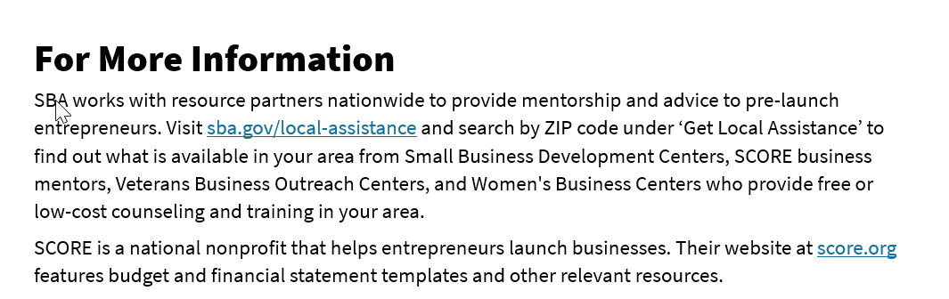
For More Information
See page 16 in your participant guide.

Slide 31
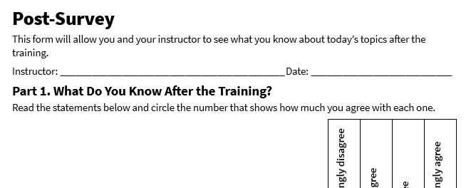
Post-Survey
See page 21 in your participant guide.

Slide 32
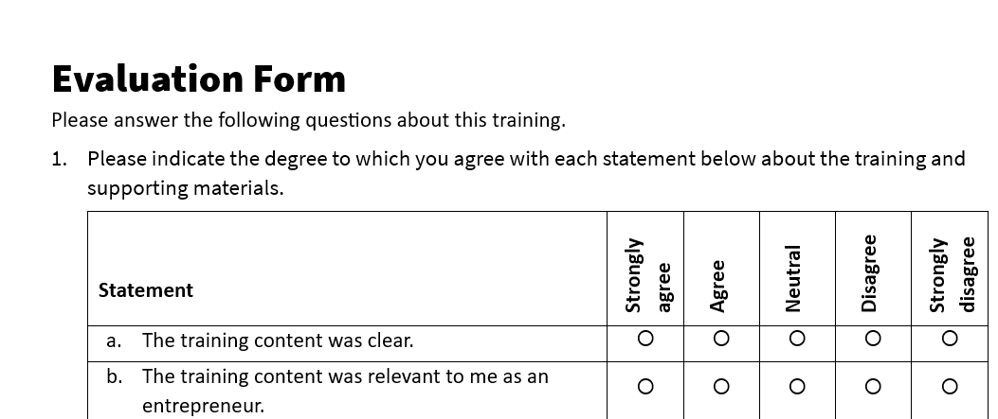
Evaluation
See page 22 in your participant guide.

Slide 33
Thank you!

