Slide 1
FDIC Banking Research Conference
The Environment for
Environmental Lending
Peter Tufano
Baker Foundation Professor, Harvard Business School
Senior Advisor, Salata Institute for Climate and Sustainability
Lead Convener, Financial Economics of Climate and Sustainability

Slide 2
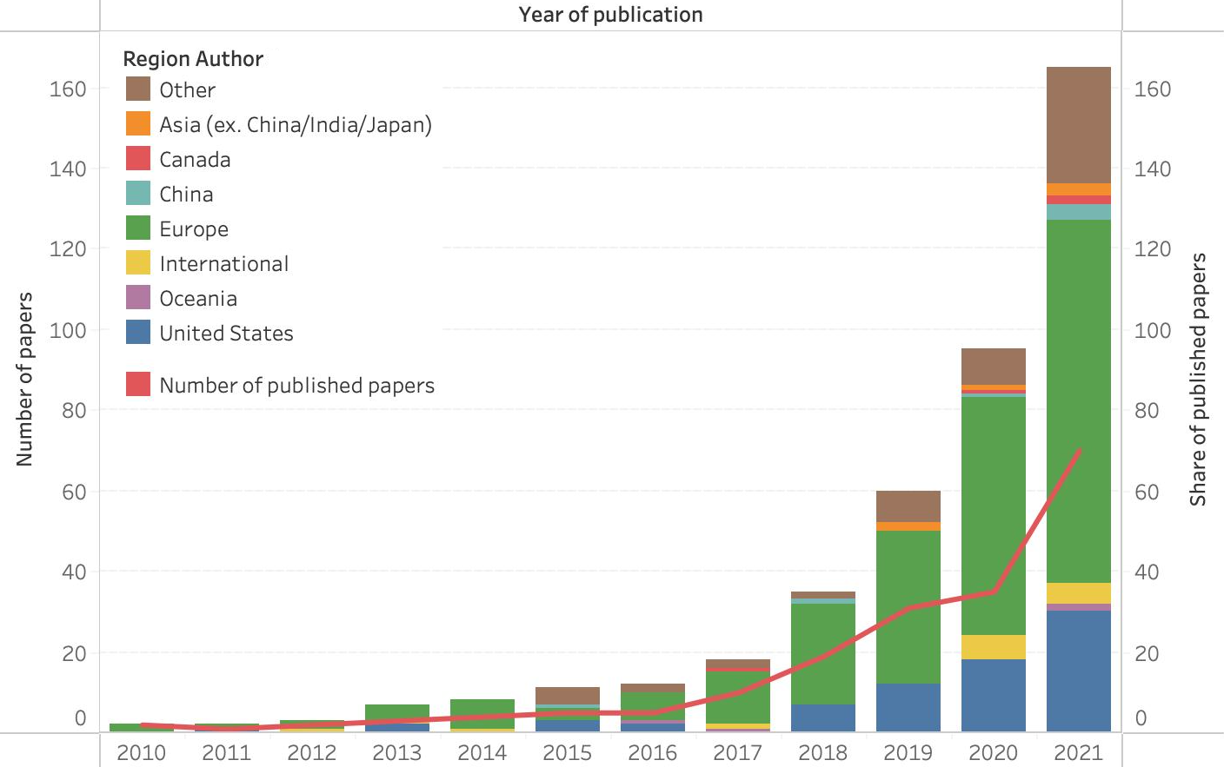
Context: The academic field of climate finance
Academic research on climate finance literature has increased dramatically, especially since 2018
Number of published and unpublished papers since 2010
M. Gasparini and P. Tufano, “The Evolving Academic Field of Climate Finance”, January 2023 Working Paper

Slide 3
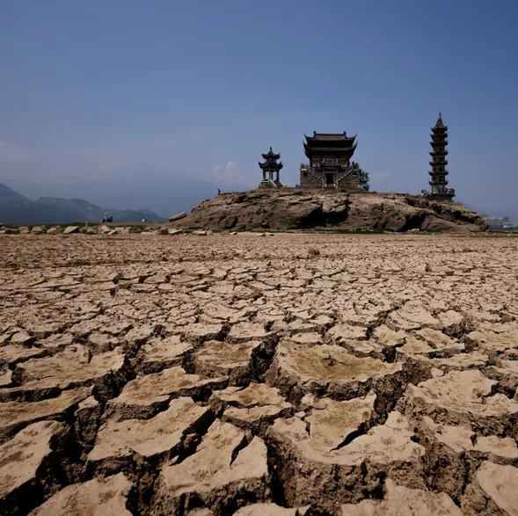
Very brief background:
Climate science

Slide 4
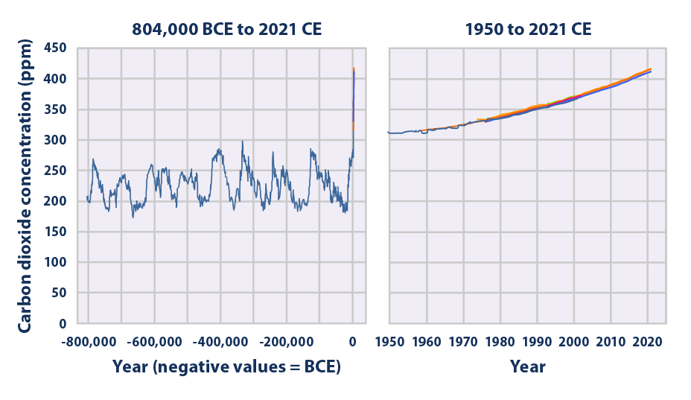
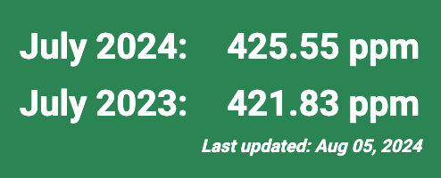
Human emissions and rising GHG concentration
Flows GHGe:
57.4 GtCO₂e
(2022)
https://www.unep.org/resources/emissions-gap-report-2023
Level CO₂:
https://gml.noaa.gov/ccgg/trends/
https://www.ipcc.ch/report/sixth-assessment-report-working-group-ii/
https://www.epa.gov/climate-indicators/climate-change-indicators-atmospheric-concentrations-greenhouse-gases
https://www.bgs.ac.uk/discovering-geology/climate-change/what-causes-the-earths-climate-to-change/#:~:text=Geological%20records%20show%20that%20there,carbon%20dioxide%20(CO2).

Slide 5
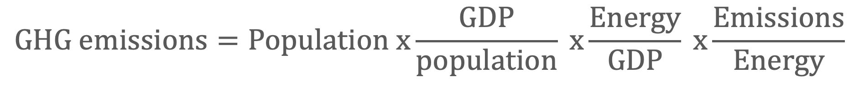
Kaya Identity: decomposing emissions drivers
$$GHG emissions=Population x\frac{GDP}{population} x\frac{Energy}{GDP} x\frac{Emissions}{Energy}$$
Energy
Intensity
Emissions
Intensity

Slide 6
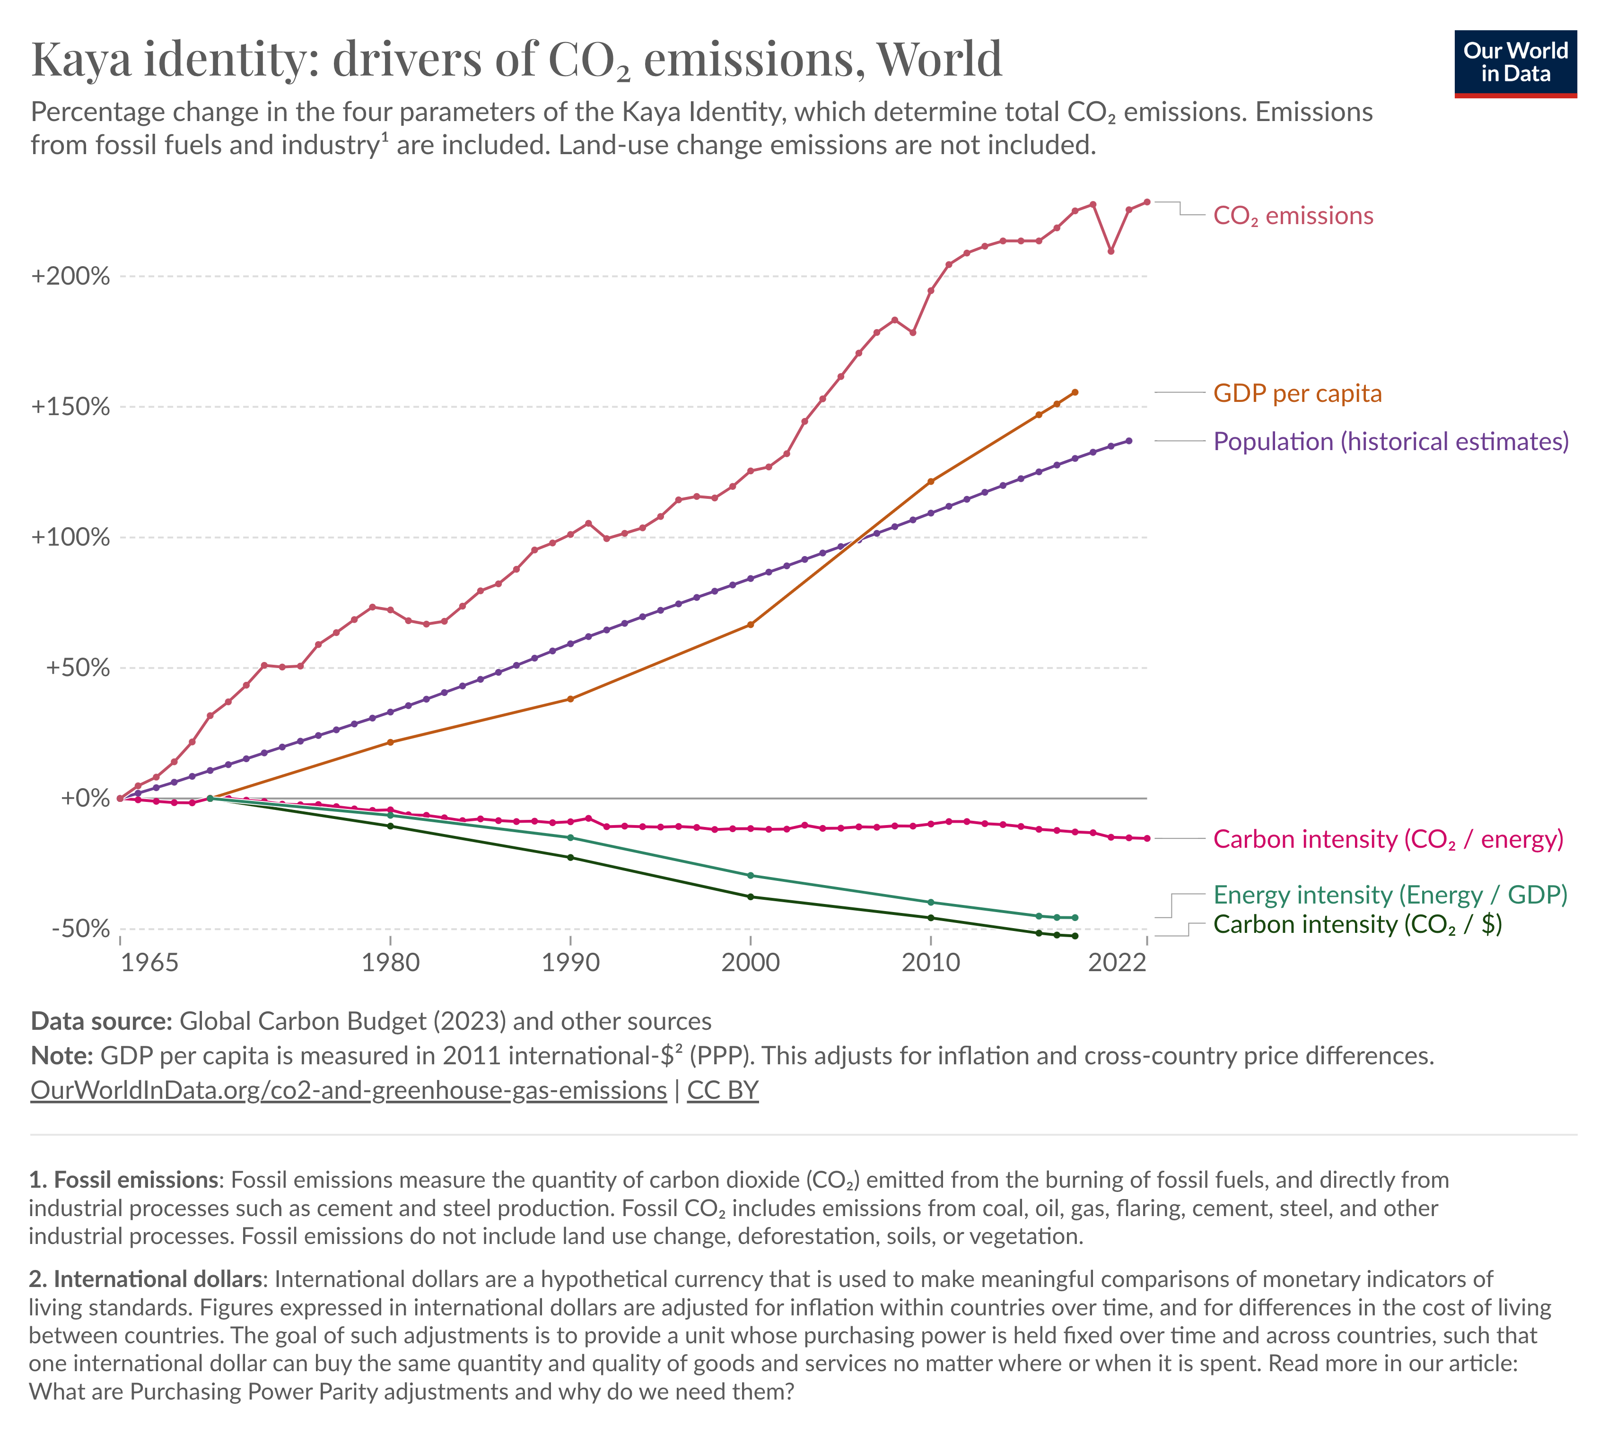
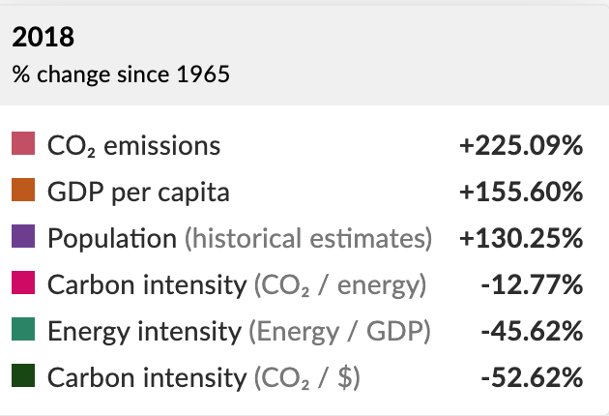
Global contributors to rise in GHGs, 1965-Now

Slide 7
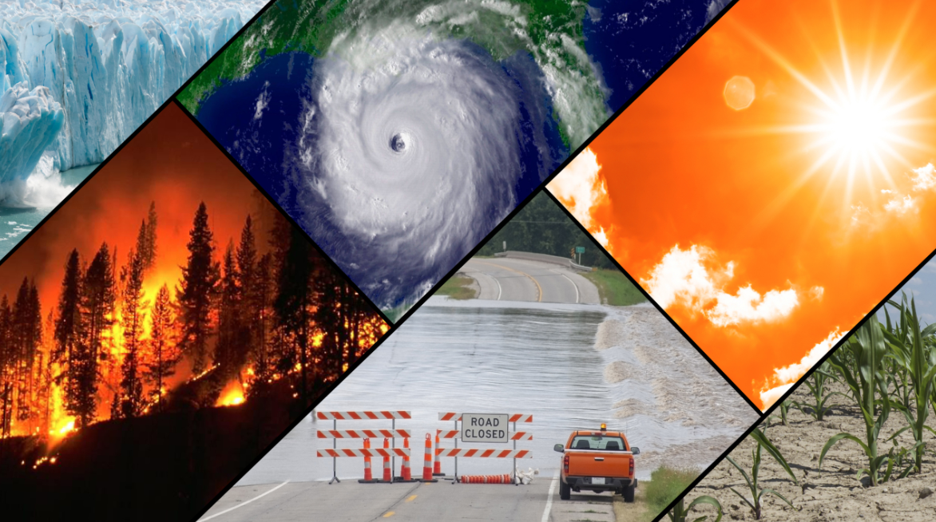

Slide 8
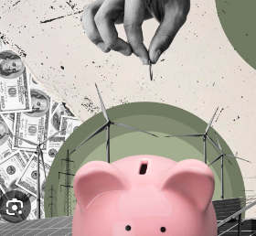
Climate finance background

Slide 9
What is the economic cost of global warming?
What are the economic losses associated with an incremental rise (one tonne) in CO2 emissions?
What discount rate should we use to bring these losses to a present figure?
Social Cost of Carbon

Slide 10
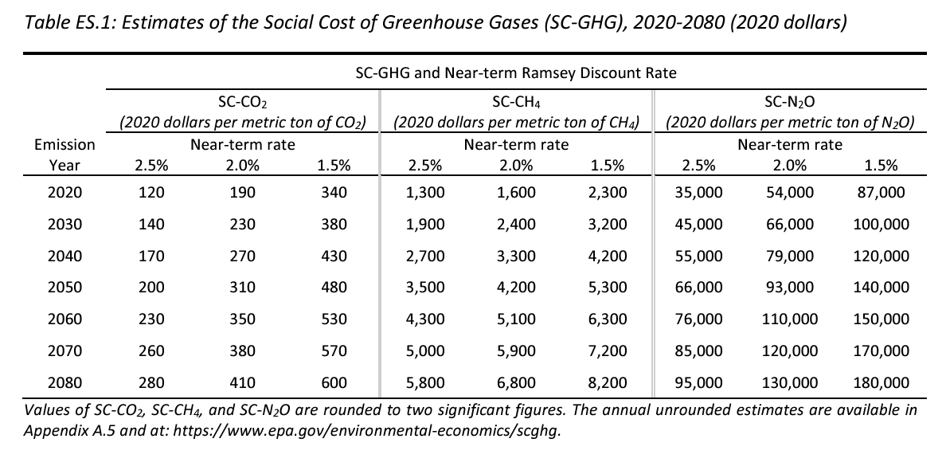
Range of SCC estimates - EPA 2023
https://www.epa.gov/system/files/documents/2023-12/epa_scghg_2023_report_final.pdf

Slide 11
If it were all marginal…
2023 GHGe emissions: 57.4 gigatons
1,000,000,000 (billion) metric tonnes per gigaton
$190 SCC per metric tonne
Social cost of 2023 emissions: $34.3 trillion
Compare with Global GDP (year end 2023, IMF estimate): $105 trillion

Slide 12
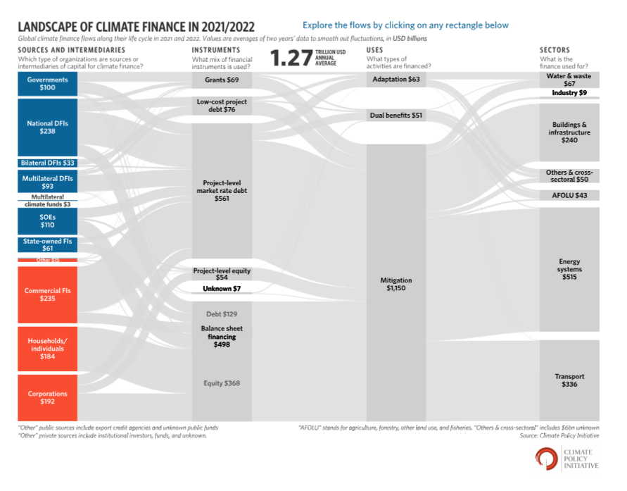
Current spending on Climate Finance: $1.27 T.
https://www.climatepolicyinitiative.org/publication/global-landscape-of-climate-finance-2023/

Slide 13
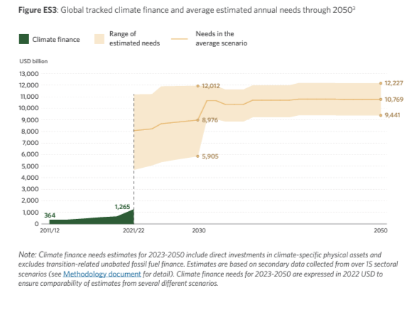
How much do we need to finance climate action?
A lot, relative to existing spending
https://www.climatepolicyinitiative.org/publication/global-landscape-of-climate-finance-2023/

Slide 14
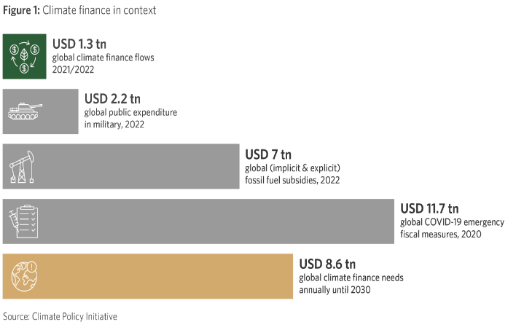
How much do we need to finance climate action?
A considerable amount…but done before
https://www.climatepolicyinitiative.org/publication/global-landscape-of-climate-finance-2023/

Slide 15
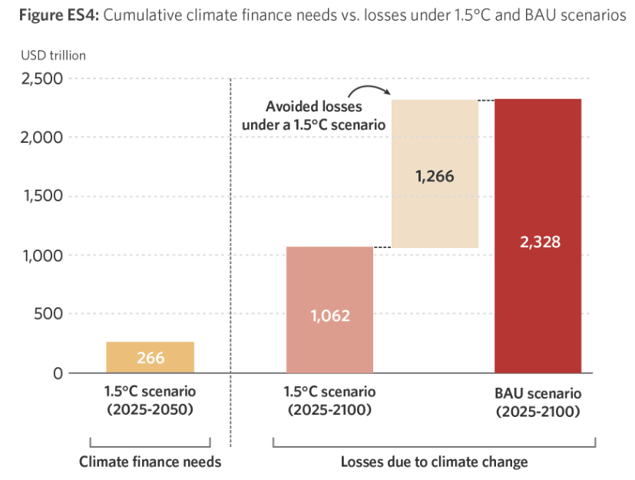
How much do we need to finance climate action?
A little, relative to benefits
https://www.climatepolicyinitiative.org/publication/global-landscape-of-climate-finance-2023/

Slide 16

Doing that would take an incremental $2.4T in annual investment
Annual energy and land use investments to be on track for net zero by 2030 ($ trillion)
Continued spending on high-emissions assets
Continued spending on low emissions assets
New spending on low-emissions assets
Total annual investment required to be on track for Net Zero
McKinsey Estimates, courtesy of Daniel Stephens

Slide 17
Where is that additional $2.4 T going to come from between now and 2030?
One potential illustrative mix (through 2030)
ILLUSTRATIVE
Note that not all of these conditions are necessarily feasible, but this gives us a sense of the magnitude of what would have to happen
Private equity
Equity capital markets
Carbon markets
Government grants
Government loans
MDBs
Bank balance sheet lending
Debt capital markets
Total incremental capital
Equity
Debt
McKinsey Estimates, courtesy of Daniel Stephens

Slide 18
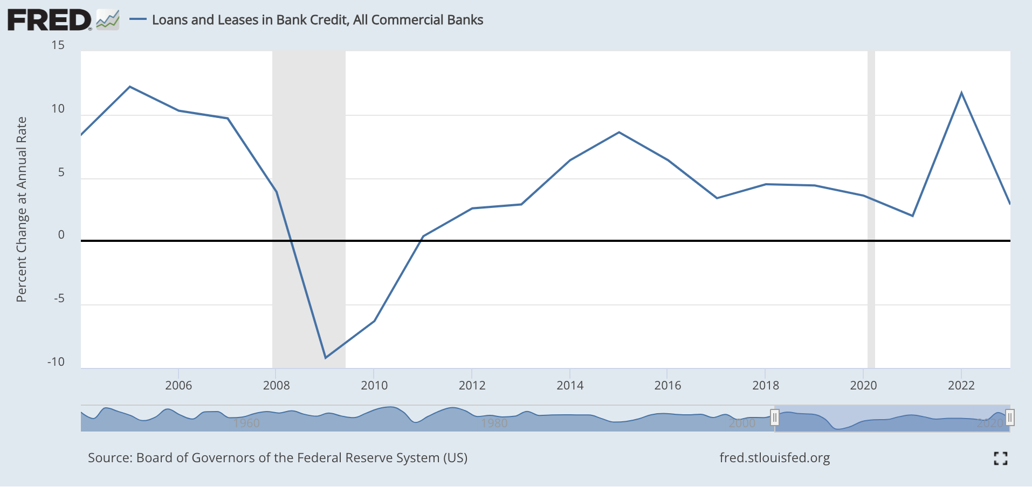
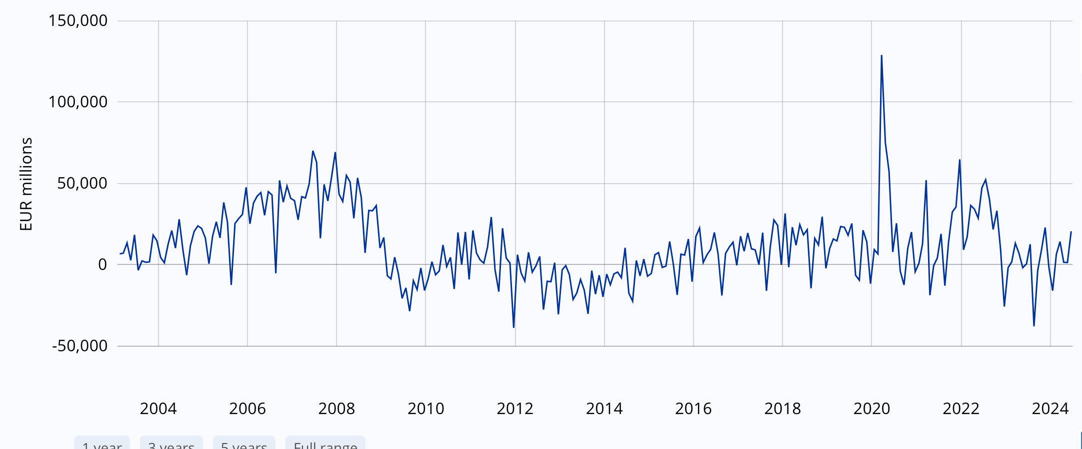
Incremental $600 b. bank lending annually…
Stock of all loans
US banks--All loans (July 2024): $12.4 T
Eurozone banks—all loans (2024): € 5.2 T
Flows?

Slide 19

Our papers today

Slide 20
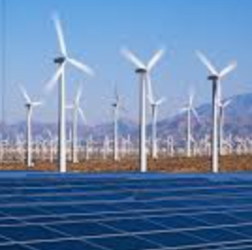
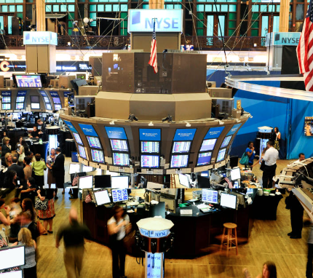
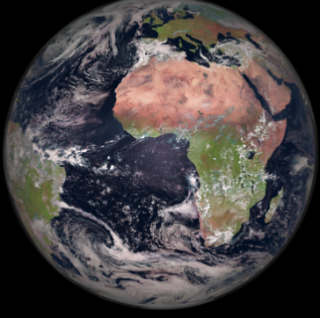

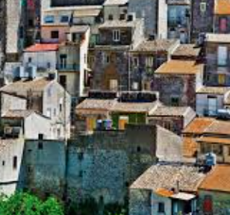
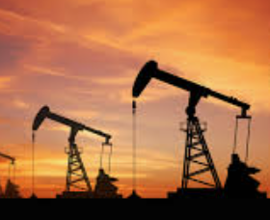
A map of climate finance (banking) work

Slide 21
Impacts of financing on climate
Impact of financing
Financed emissions
Solution and transition financing
Impact of (withholding) financing
Determinants of financing choices
Capital and other reg requirements
Politics
Enforcement activities

Slide 22
Impacts of climate on financial institutions
Risk exposures of banks
Transition risk
Physical risk
Litigation risk
Indirect risk (e.g., insurance)

Slide 23
Why these papers?
Climate change is global
Anthropogenic impacts include not only GHG emissions and global warming, but also nature and biodiversity
Show concern for impact of climate on banking—and banking on climate
Begin to trace out influences on bank lending
Solid approaches, given data limitations
Begin to ask more interesting, harder questions

Slide 24
Quick recap of the three papers
“Bank competition and strategic adaptation to climate change”
”Do banks price environmental risk? Only when local beliefs are binding”
“Banking on deforestation—the cost of nonenforcement”
Examine determinants of bank environmental lending
Consider different types of environment-related lending
Careful empirical specifications with new data, mostly diff-in-diff
Suggest how bank, managerial, political, social/community forces (the broader environment) might be at play

Slide 25
Unique contributions of the three papers
“Bank competition and strategic adaptation to climate change”
”Do banks price environmental risk? Only when local beliefs are binding”
“Banking on deforestation—the cost of nonenforcement”
US context
Flood risk and Hurricane Henry
Primarily about how physical risk considerations affect learning and lending
Environmentally risky borrowers pay more
Competition affects risk assessment or pricing
US context, syndicated loans
Broad range of environmental factors including biodiversity
Banks may charge more to lenders with greater env. impact and exposure
Financial strength, local beliefs, Trump, and local enforcement/degregulation affect pricing
Brazilian, syndicated loans
Specifically look at brown loans in the Amazon that support deforestation
Shock: massive 2019 cut in enforcement
Corresponding increase in brown lending…and deforestation. Reallocate capital for short term profits

Slide 26
Complex questions raised by all three papers
What are the privately-optimal and socially-optimal benchmarks against which to judge bank lending behavior?
Can competition make us “dumber?” Conversely, can coordination make us ”smarter?”
Despite a belief in “profit maximization,” how much are business decisions conditioned on local social and market beliefs? On societal impacts? Science?
Is biodiversity really being acknowledged/priced? Or is it something else?
How much can we expect the banking/private sector to do on its own?
How much should bank regulators demand? (How) Should banking authorities incorporate the long-term social costs of environmental damage into rules? Or only the short-term risks to safety and soundness?

Slide 27
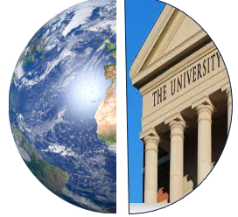
An invitation:
Learn more

Slide 28
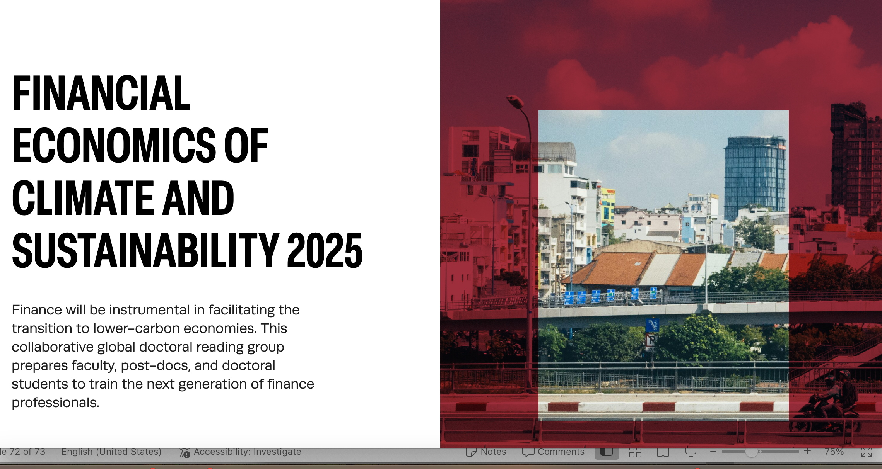
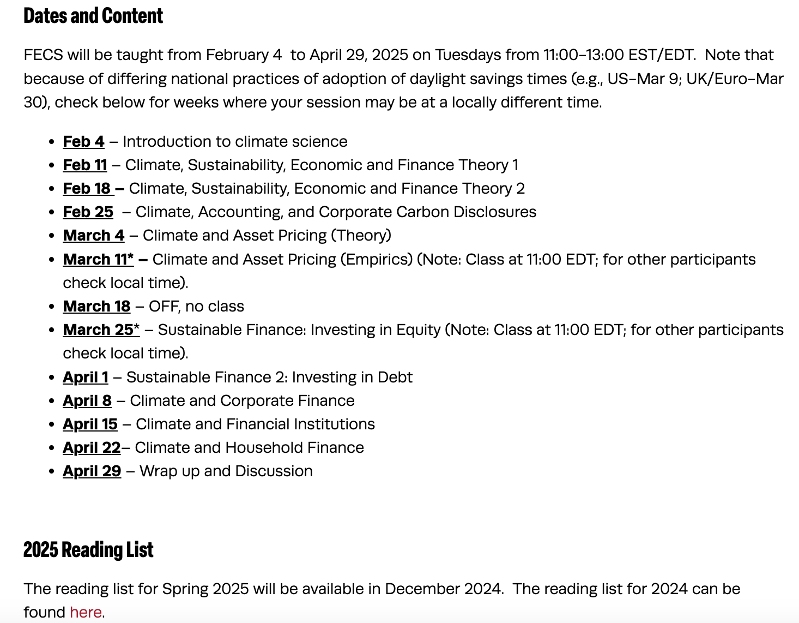
https://salatainstitute.harvard.edu/financial-economics-of-climate-and-sustainability-2025/

Slide 29

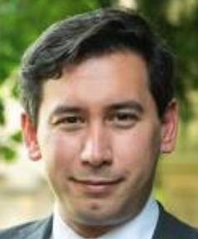

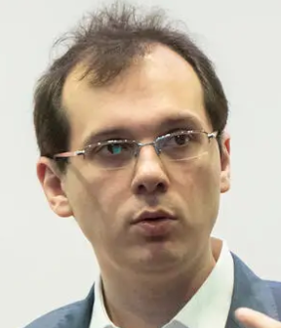















Core session faculty
Patrick
Bolton
Imperial
Ben
Caldecott
Oxford
Caroline
Flammer
Columbia
Stefano
Gilglio
Yale
Geoffrey
Heal
Columbia
Marcin
Kacperczyk
Imperial
Stefan
Reichelstein
Stanford
and Mannheim
Laura Starks
Texas
Johannes
Stroebel
NYU
Peter Tufano
Harvard
© PeterTufano, 2024

Slide 30
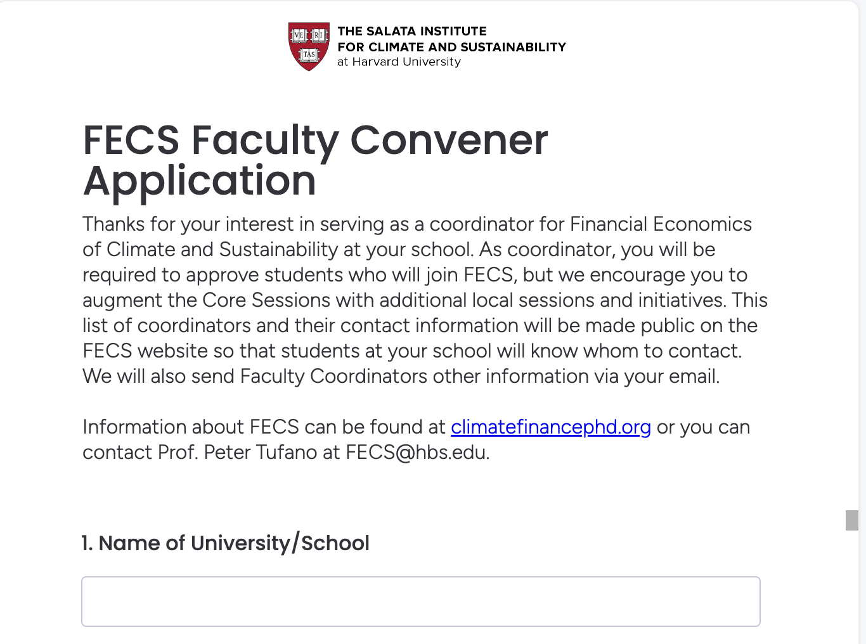
Join us: Sign up at climatefinancephd.org

Slide 31
FDIC Banking Research Conference
The Environment for
Environmental Lending
Peter Tufano
Baker Foundation Professor, Harvard Business School
Senior Advisor, Salata Institute for Climate and Sustainability
Lead Convener, Financial Economics of Climate and Sustainability
https://salatainstitute.harvard.edu/financial-economics-of-climate-and-sustainability-2025/

