Slide 1
Does “Systemically Important Bank” Status Affect Loan Performance ?
FDIC Annual Bank Research Conference (Sept 2025)
by Sriniwas Mahapatro
Shashwat Agrawal
(Boston College)
Nishant Kashyap
(IIM Ahmedabad)
Sriniwas Mahapatro
(Rochester Institute of Technology)
Prasanna Tantri
(Indian School of Business)

Slide 2
Motivation
2008 Global Financial Crisis
  Revealed systemic fragility of large, interconnected banks
  “Too Big To Fail (TBTF)” problem
Regulatory response
  FSB and BCBS introduce “SIB framework” for TBTF banks
  Higher capital requirements and monitoring
  Designed to prevent failure of large systemic banks

Slide 3
Motivation
Key Question: Can SIB designation induce moral hazard?
Anecdotal evidence: Collapse of Credit Suisse, in 2023
  Persistent losses from poor asset management, poor risk management, and scandals
  Eventually led to govt orchestrated acquisition by UBS

Slide 4
Summary of Findings
Research Question:
Does SIB designation create perverse incentives that worsen loan performance ?
Main Findings:
Within borrower-year and between banks tests suggest that loan delinquency increases due to SIB designation
Increase in loan delinquency is due to decline in monitoring by SIBs

Slide 5
SIB & loan performance – An empirical question !
On one hand, loan performance may deteriorate
Perceived safety net of TBTF induces moral hazard and reduces monitoring (Dewatripont & Maskin, 1995; Qian & Roland, 1998)
Higher capital requirements can encourage riskier investments due to search for yield (Jimenez et al., 2017)
On the other hand, loan performance may improve
Higher capital requirement increases skin-in-the-game and reduces risk-taking (Holmstrom & Tirole, 1997; Bhat & Desai, 2020)
Increases regulatory scrutiny can increase loan monitoring efforts by banks

Slide 6
Global
SIB framework
(developed by BCBS and FSB)
Identification of G-SIBs on rule-based methodology using five criteria: size, interconnectedness, substitutability, cross-jurisdictional activity, and complexity
Designated SIBs are subject to higher capital surcharges (1% - 3.5% CET1) depending on their composite scores
FSB publishes the list of G-SIBs and national regulators enforce them
Objective is to reduce probability and systemic impact of failure of SIB.

Slide 7
Domestic
SIB framework
BCBS introduced SIB framework for member countries to extend SIB rules to domestic banks
Identification methodology is similar: size, interconnectedness, substitutability, and complexity

Slide 8
Institutional setting
Following BCBS guidelines, Reserve Bank of India (RBI) introduced the SIB framework in India in 2016
A setting where moral hazard effects are amplified (information asymmetry and slower judicial processes)
Availability of bank-firm-time level lending and delinquency data

Slide 9
Identification Problems
Empirical Methodology
Use of firm-bank-time level dataset
Use of staggered difference-in-differences (DiD) design
Within borrower-time-level tests to absorb any firm-time level shock that could impact loan repayment behavior (Khwaja & Mian, 2008)

Slide 10
Data
Annual loan level and loan restructuring data from Ministry of Corporate Affairs (MCA) website.
Loan performance data from TransUnion CIBIL, the largest credit information company in India
Matching of firm and bank names between MCA and CIBIL, to create the firm-bank-year panel data.
Accounting information, financial statements of banks and firms from CMIE prowess.
Data about loan recovery legal cases filed in Debt Recovery Tribunals (DRT) from DRT website.

Slide 11
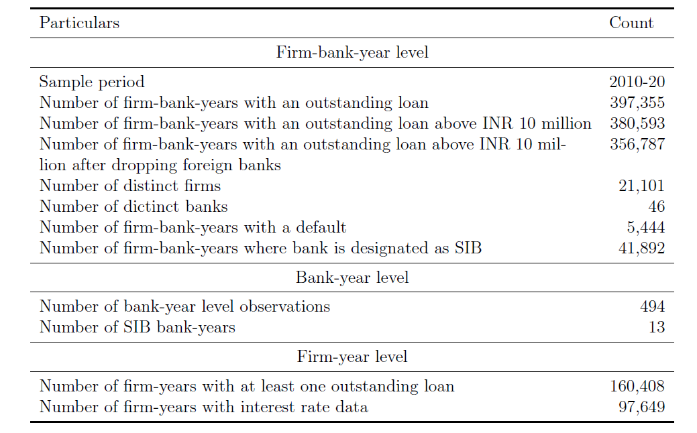
Sample Construction

Slide 12

Empirical Specification
default_{(i,j,t)} – denotes whether firm “i” has defaulted on loan repayments to bank “j” in year “t”.
SIB_{(j,t)} – DiD variable that denotes whether bank “j” is designated as SIB in year “t”
ϒ_{(i,t)} – firm X year fixed effect
δ_{(i,j)} – firm X bank fixed effect
X_{(j,t)} – vector of bank-year controls: NPL, capital adequacy, and ROA

Slide 13
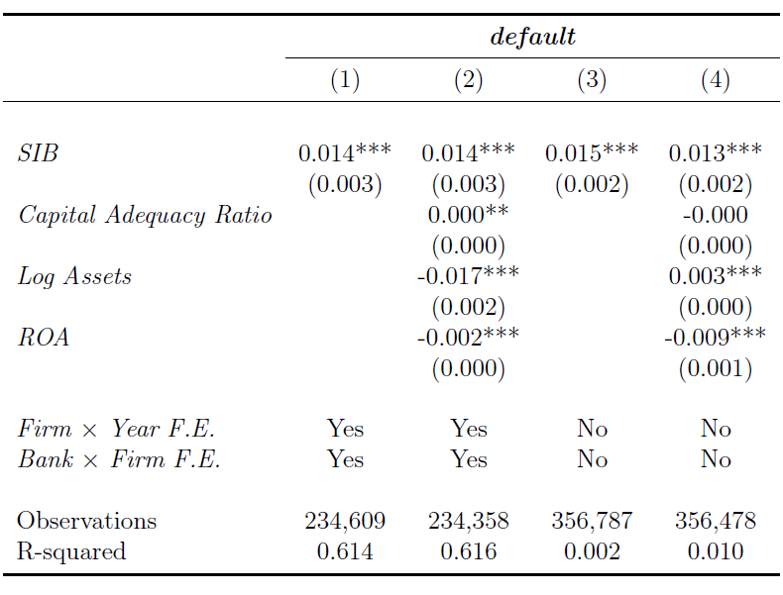
Main results
Within firm-year 1.4 percentage points more likely to default on SIBs
70% increase in delinquency rate compared to unconditional mean

Slide 14
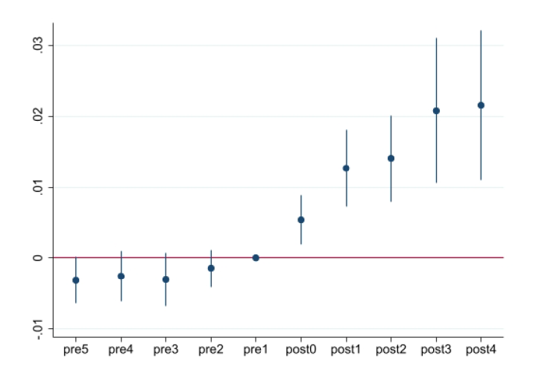
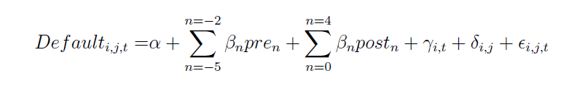
Pre-trend test

Slide 15
Underlying Mechanism

Slide 16
Lax monitoring channel
Implicit guarantees associated with SIB induces moral hazard on part of lenders in monitoring borrowers
Monitoring includes ex-post activities and efforts involving supervision, management, and loan-recovery efforts
Loss recognition channel
Prompt recognition of losses driven by increased monitoring efforts due to higher capital requirements (Bhat & Desai 2020)

Slide 17
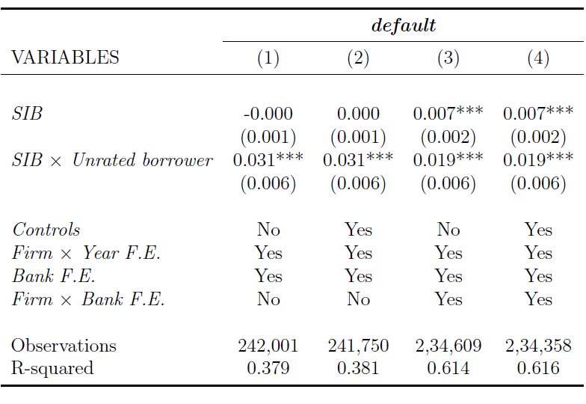
Mechanism
Unrated borrowers
Borrowers without external credit ratings require higher monitoring (Sufi, 2007; Ball et al., 2008; Christensen & Nikolaev, 2012)

Slide 18
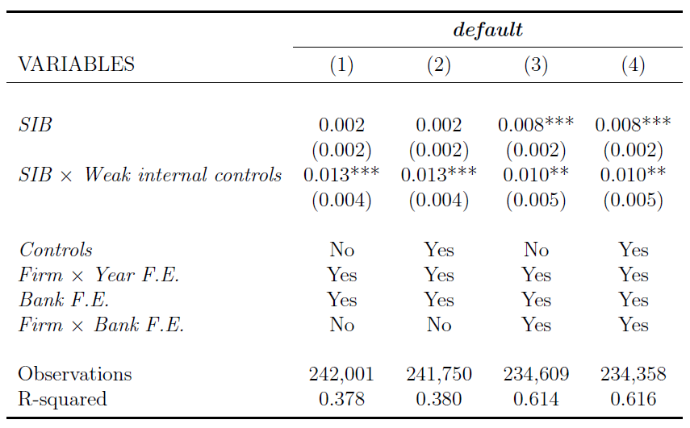
Mechanism
Borrowers with weak internal controls
Borrowers with weak internal control require higher monitoring efforts by lenders (Costello & Wittenberg-Moerman, 2011)

Slide 19
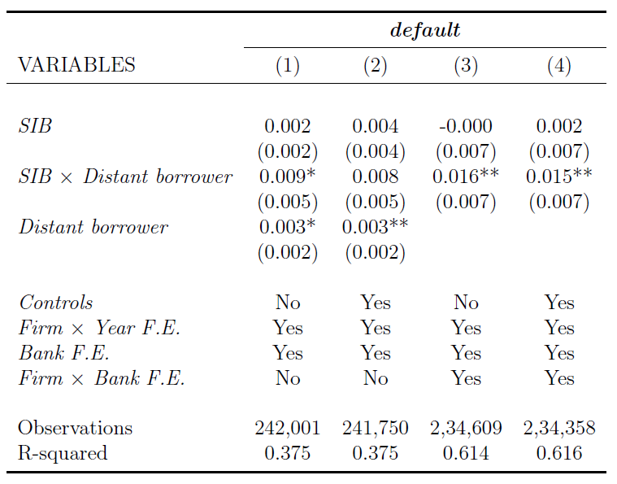
Mechanism
Distant borrowers
Geographical distance between borrower and lender increases information asymmetry (Bushman and Wittenberg-Moerman, 2012; Granja et al.,2022).

Slide 20
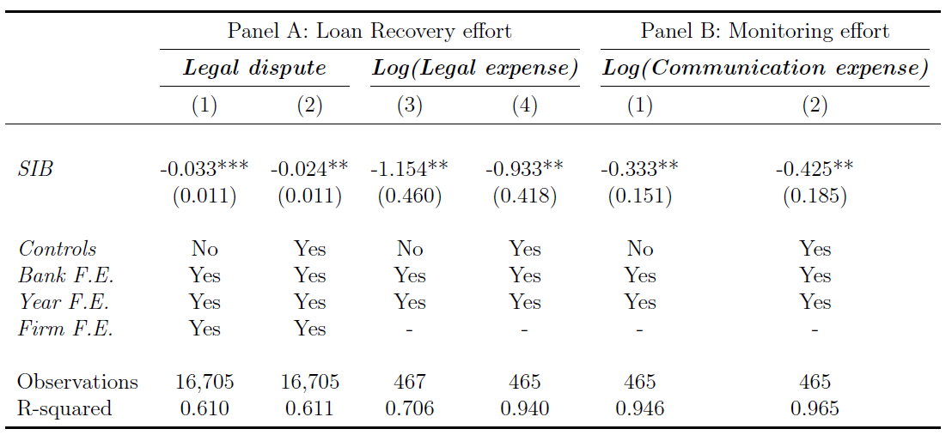
Mechanism – Loan recovery efforts
Loan recovery efforts (Vig, 2013) decline
Legal expenses incurred by banks (proxy for loan recovery efforts) decline
Evidence consistent with ‘lax monitoring’

Slide 21
Mechanism – Monitoring costs
Communication expenses (proxy for borrower monitoring) declines
Evidence consistent with ‘lax monitoring’

Slide 22
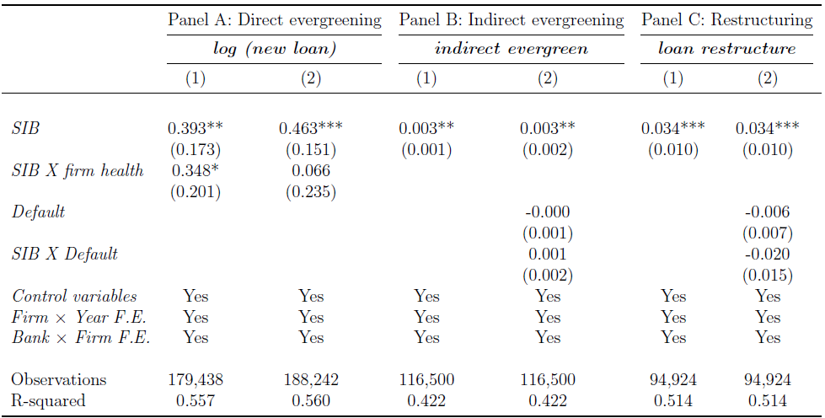
Mechanism – loan evergreening
Under-capitalized banks engage in rik-shifting through loan evergreening (Caballero et al., 2008; Tantri 2021, Faria-e-Castro et al., 2024)
SIBs witness increase in evergreening – consistent with ‘Lax monitoring’

Slide 23
Robustness tests
Results are not due to changes in lending policies due to SIB
Results are consistent after restricting control set of banks to large banks that are closest to SIBs in size
Robust to cox-hazard regression model
Robust to implementation of corrections suggested by Sun & Abraham (2021)
Free from bias introduced by negative weights in two-way fixed effects estimation (Goodman-Bacon, 2021)
Effects not due to presence of government controlled banks.

Slide 24
Conclusion
Policy of explicitly identifying large banks as SIB can lead to deterioration in loan performance
Evidence suggests forces of moral hazard on part of lenders
At least part of moral hazard manifests from lower monitoring efforts by SIBs

Slide 25
Thank You

