Slide 1
Lending Across the Financial Spectrum 24th Annual Bank Research Conference
Discussant: Liu Yang
University of Maryland
September 2025

Slide 2
Credit Market Frictions and Intermediation
The Central Question:
How do consumers and small firms get credit, at what cost, and with what frictions?
The three papers in this session span a spectrum of financial intermediation:
Credit cards: formal, regulated, heavily intermediated
Small firms: mixed bank + nonbank lenders, partial intermediation
Reddit loans: no collateral, no intermediation, no regulation

Slide 3
Paper 1 – Credit Card Banking (Dreschsler, Jung, Peng, Supera, and Zhou)
Question: Why are APRs (23%) so high for credit cards?
Credit cards are the most “bank-like”: issued by large, regulated banks, with fixed APRs and strong payment infrastructure
Comprehensive Data
Near-universe coverage: 330 million accounts (90% of all outstanding credit card balances)
Granular information: borrowers (revolvers) vs transactors, interest income, non-interest revenues, rewards, and operating costs
Time series: follow cohorts originated in 2015-2017 through 2023

Slide 4
Main Findings
APR spreads exceed expected default losses
Net spreads remain 6-12% after adjusting for charge-offs
Rewards are large, but not the driver
Rewards are largely funded by positive interchange fees
High operating costs
4-5% of balances (vs. 2% for general banking)
Marketing costs > 10 x other banks
Banks with higher operating costs also charge higher spreads
Positive alpha after risk adjustment
Credit card banks earn 1.17% to 1.44% abnormal returns relative to the overall banking sector

Slide 5
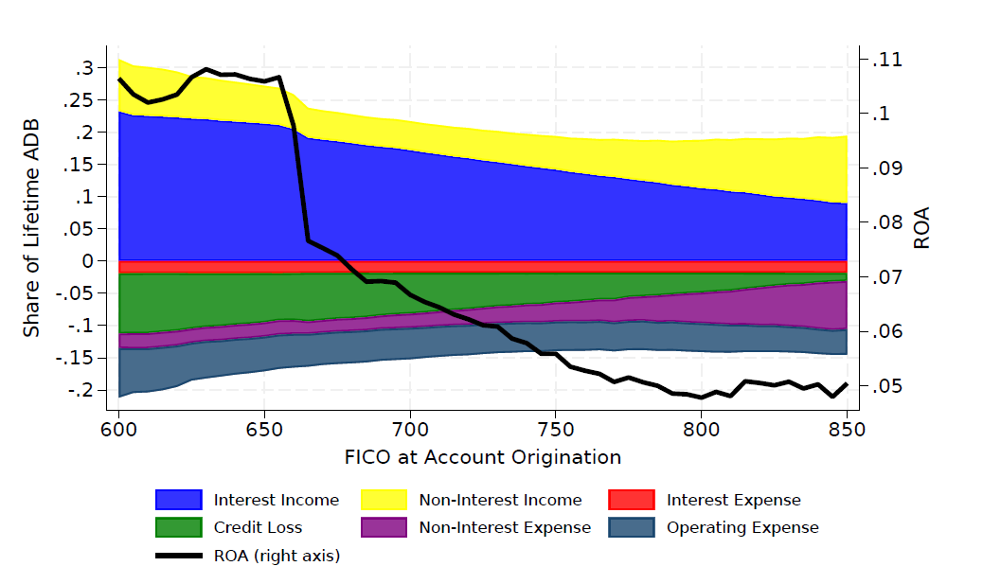
Profitability by Borrower Type
Low-FICO borrowers generate the highest returns for banks.
Even after adjusting for risk, these borrowers deliver positive alpha.
→ Vulnerable borrowers are the most profitable

Slide 6
If alpha is so high, why isn’t there more competition?
Strong network effects: Visa/Mastercard duopoly
Funding edge: cheap deposits for banks
Marketing scale: billions spent per issuer
High fixed costs: IT, compliance, fraud system, etc.
Brand power: loyalty, reputation, and data

Slide 7
Paper 2 – Small Firms’ Debt Financing (Chernenko & Wang)
Question: Where do small firms get debt?
Empirical Settings
Bankruptcy filings in Florida (2019-2021)
Covers all debt types and lenders
Credit cards, equipment loans, term loans, mortgages, receivable financing, lines of credit, SBA loans
Banks, non-banks, individuals, and government
Selection Concerns
Bankrupt firms may differ from healthier small businesses
Near bankruptcy, firms often draw heavily on revolving credit for liquidity and face reduced willingness from banks to extend unsecured loans

Slide 8
Main Findings
Small firms borrow from multiple sources
Only 29% of firms borrow solely from banks, and 34% of the firms never borrow from banks
Market structure matters
In areas with higher bank concentration and large banks, firms are more likely to borrow from nonbanks.
Racial Disparities
Minority-owned firms have less access to banks and are more likely to borrow from non-banks

Slide 9
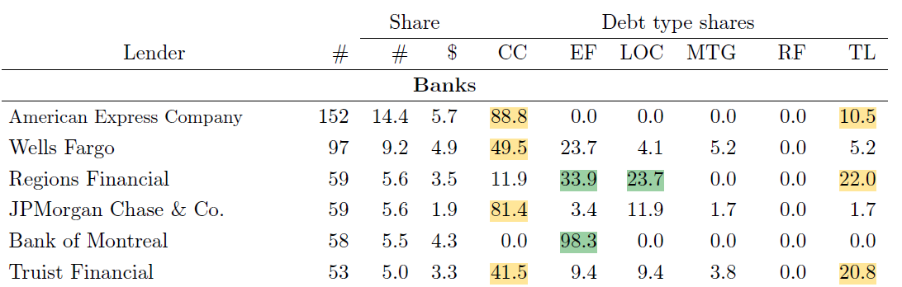
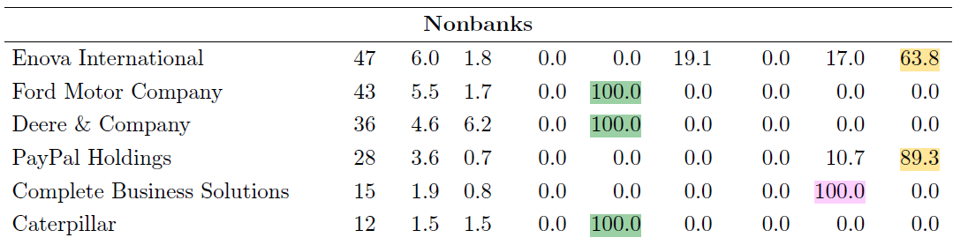
Banks lend mostly through credit cards (CC), with some term loans (TL).
Nonbanks are different, even among themselves
Some exclusively focus on equipment financing (EF)
Some offer term loans(TL), looking more like banks
Where/how do those bank-like non-banks compete with banks?

Slide 10
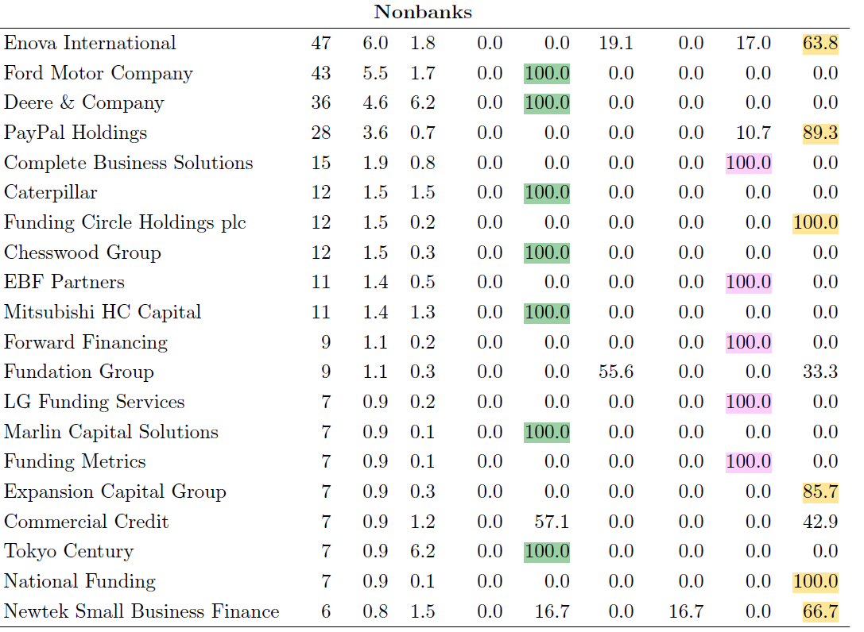

Slide 11
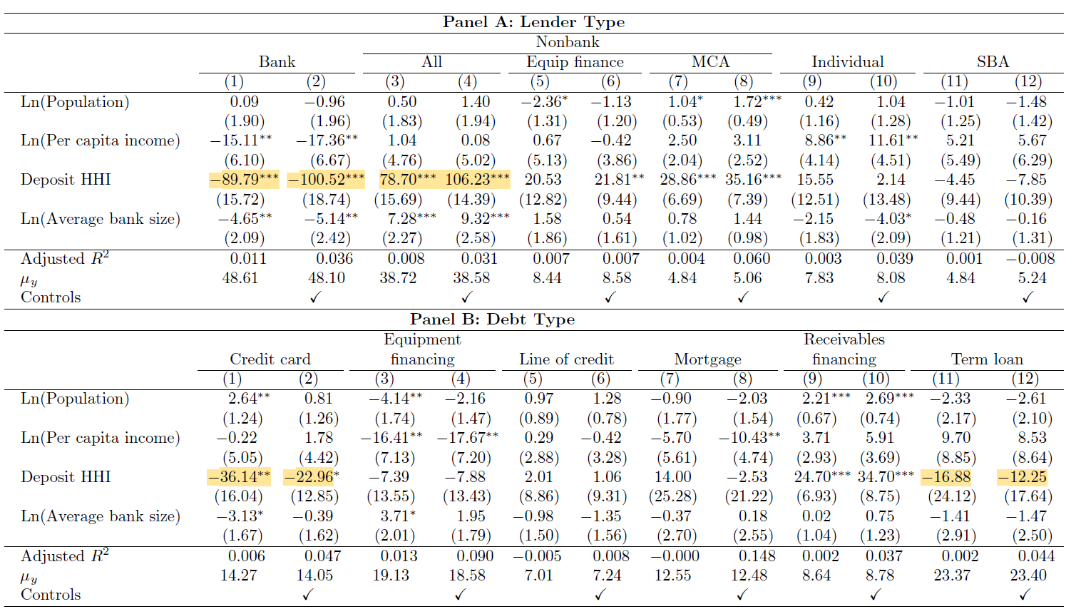
Bank financing is less likely in areas with high bank concentration
Do we see more alternative “bank-like” lenders in those areas?
Non-bank: Other
Term loans

Slide 12
Do firms benefit from competition from non-banks?
Do nonbanks extend credit access to constrained firms?
Do nonbanks provide different products to serve niche markets?
Do nonbanks charge lower costs in concentrated markets?
Studying where nonbanks succeed against banks can shed light on how to expand access while keeping efficiency.

Slide 13
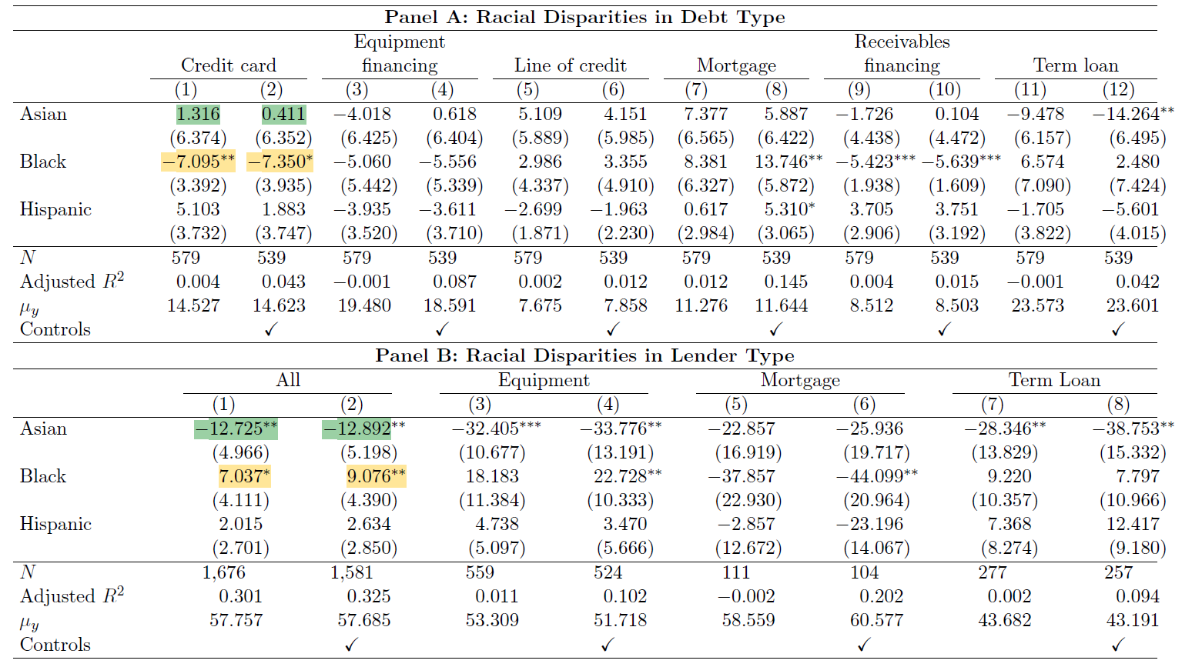
The racial part of the analysis is somewhat unclear
Black-owned firms:
Less likely to get credit cards (bank-only products).
Conditional on debt type, more likely to receive financing from banks
Asian-owned firms:
No effect on the credit cards.
Conditionally on loan type, less likely to get loans from banks. Through what channel?

Slide 14
Paper 3 – Reddit Loans (Correia, Martins, and Waikel)
Question: What happens without intermediaries?
Pure peer-to-peer lending on a platform
No banks, no regulation, no collateral. Purely reputation-based
Borrowers post requests; lenders decide to fund loans; borrowers repay
Offers rare micro evidence on how credit markets function without financial intermediation
Sample
2016-2021, 35,000 funded loans, about $7.5 million in credits

Slide 15
Main Findings
Borrowers face high interest rates (45-57% per month), and default rates are high, too (68% annualized)
Very small loans ($261) with short maturity (25 days)
Most lenders lose money
A small, skilled group earns large profits, owing to their skill in screening risky borrowers. They offer lower interest rates and have much lower defaults.
Social ties matter
Broader overlap in Reddit activity → higher chance of funding
Stronger overlap → higher repayment probability
Trust and reputation within the community substitute for formal contracts.

Slide 16
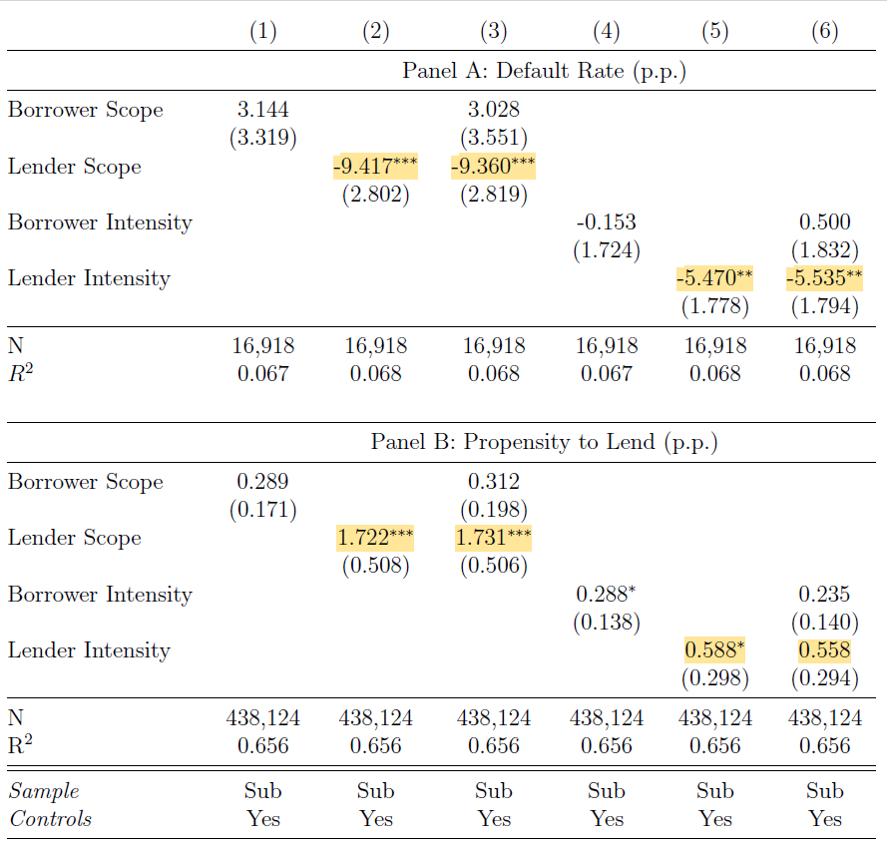
Lenders’ social ties matter most
Evidence supports an information channel rather than a reputation channel
Open question: What information are lenders really using?
Borrowers’ activity on the platform (comments, posting frequency, etc.)?
Here, social activity acts as a substitute for the screening and monitoring that banks usually provide.

Slide 17
Lending through the Financial Spectrum
Credit Card Banking (Full intermediation)
Banks keep high spreads and extract rents through market power
Returns are especially high from low-FICO borrowers
Small Firms Financing (Partial intermediation)
Small firms borrow from both banks and nonbanks
Nonbanks fill gaps where banks are less competitive and for minority borrowers.
Reddit Lending (No intermediation)
Peer-to-peer lending expands access without banks.
But it comes with very high interest costs and default rates, and most participants lose, except for a small skilled group

Slide 18
Discussion: Access vs. Efficiency
Across the spectrum – for banks to nonbanks to peer lending, we see the same trade-off:
Efficiency comes with rents
Access comes with costs
Open Question
How can we broaden access and maintain efficiency, without placing the greatest burden on the most vulnerable borrowers?
Technology? Regulations? Innovation? What else?

