Slide 1
FDIC Banking Research Conference – Credit Allocation and Real Effects
Discussion: Janet Gao
September 2024

Slide 2
Overview
Housing Speculation, GSEs, and Credit Market Spillovers
Government Litigation Risk and the Decline in Low-Income Mortgage Lending
Two very interesting papers! Both papers study important policy questions and are very well executed.
Both studies demonstrate incredible data efforts and produce very interesting results.
Both examine the effects of policy implemented by U.S. government agents on the credit supply of mortgage lenders.
Government Policies/Regulations
Lenders (intermediaries)
Households & Businesses

Slide 3
Overview
Collectively, these studies suggest that policies have important impacts on credit markets and generate real effects
Policies are effective (to a certain extent): Tighter/More restrictive regulations lead to reduced lending by the regulated entities
Imperfect substitution of credit supply from other, unaffected lenders
Households and small businesses face reduced credit
Highlight the difficulty of designing policies that protect government agencies from risk exposures and maintain financial inclusion/access
Government Policies/Regulations
Lenders (banks/nonbanks)
Households & Businesses

Slide 4
Housing Speculation: Outline of Findings
Policy: Reduction in the GSE purchasing cap of speculative & risky mortgages
Background: During the 2008 financial crisis, Fannie Mae and Freddie Mac were taken into government control. In 2021, the U.S. treasury and FHFA announced purchase caps for those agencies:
%risky home purchase single-family mortgage <6%
%risky refinance mortgage <3%
%speculative mortgages <7%
These purchase caps, if binding, would create obstacles for lenders to finance risky mortgages (i.e., a negative financing shock to the lenders)
Lots of results!
The policy drastically reduced the origination and sale of speculative mortgages, but not risky ones.
The policy also increased the origination of safe mortgages

Slide 5
Housing Speculation: Outline of Findings
Interestingly, lenders still choose to sell riskier loans within the limit of the policy
Interest rates increase by 10 basis points
Some real effects
Less speculative housing transactions
Reduced transaction volume and prices
However, no evidence the reduction in credit supply lead to changes in wages and employment

Slide 6
Housing Speculation: Empirical Comments
With lender-quarter FE, the baseline specification is a within-lender comparison across Speculative, Risky, and Safe mortgages. Safe mortgages are the “benchmark” group
What is the correct counterfactual? Speculative housing investment (second homes or investment homes) during pandemic
So the authors use the origination/sale of safe mortgages to proximate the counterfactual, i.e., origination/sale of speculative mortgages absent the policy
Reasons why speculative housing investment may decline more than “regular” house purchases:
As the pandemic disrupts labor and product markets, households refrain from making frivolous purchases (demand-side effect)
With the disruption in global supply chains comes frequent delays in construction, and surging construction cost. Both households and lenders may be more concerned of the risk of housing investment

Slide 7
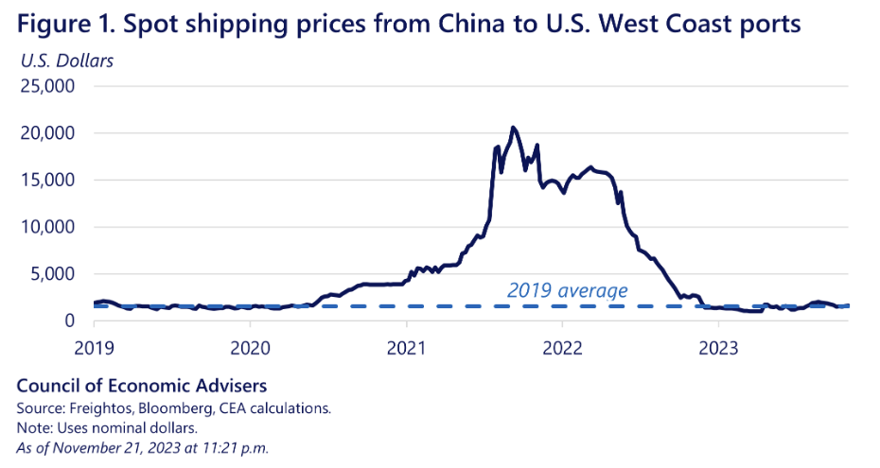
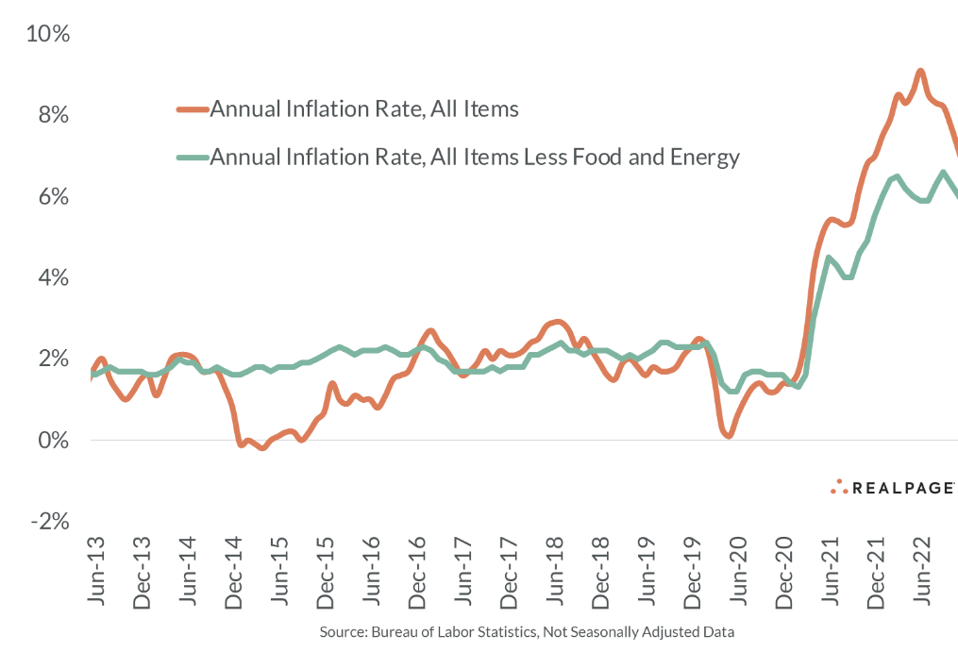
Housing Speculation: Empirical Comments
During the sample period, many macro conditions shifted, which could affect housing investment
With sharp changes in macroeconomic conditions affecting income and construction costs, second homes and investment homes are the most elastic margins of adjustment, this could explain why speculative mortgages respond more than risky ones

Slide 8
Housing Speculation: Literature
Many studies have shown that financing/liquidity shocks to banks, esp. those induced by government policies, affect credit supply
In particular, Loutskina and Strahan (2009, Securitization and the Declining Impact of Bank Finance on Loan Supply: Evidence from Mortgage Originations) look at bank liquidity shock, induced by Fannie Mae and Freddie Mac’s inability to purchase jumbo mortgages. Then examine its differential effects on the origination of jumbo mortgages relative to non-jumbo ones
Loutskina (2011) finds that banks’ ability to securitize loans facilitates lending
The authors explain that they “provide the most direct evidence that GSE subsidies affect mortgage credit supply”
What is special about this regulation? Or in other words, why would we not expect the policy to affect lending?
What can we learn about the inner works of banks, or financial markets, from this policy shock? Is it about the uniqueness or irreplaceability of GSEs?

Slide 9
Housing Speculation: Policy Implications
Overall, how do we evaluate the policy?
Clear evidence that the policy affected how banks financed conforming mortgages
The policy affected housing market transactions and loans to small businesses
Very interesting to see that the policy spilled over to the small business lending sector
Does the cost of financing increase for banks? But cost of financing is contingent on the type of loans they make
No detectable effects on employment and wages:
The effects of the policy may have been overwhelmed by the concurrent macro shocks, such as the government subsidies (e.g., tax relief act, American Rescue Plan, PPP in late 2020, etc.)
Also possible because this is a market indirectly affected by the policy

Slide 10
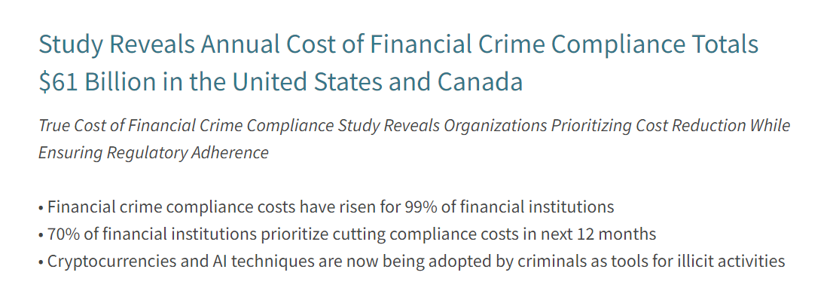
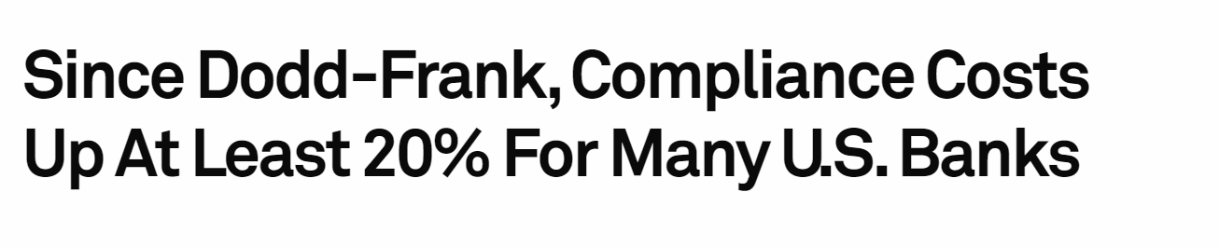
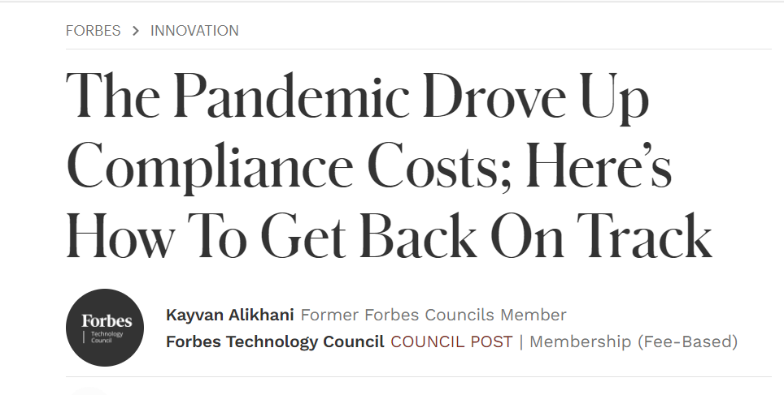
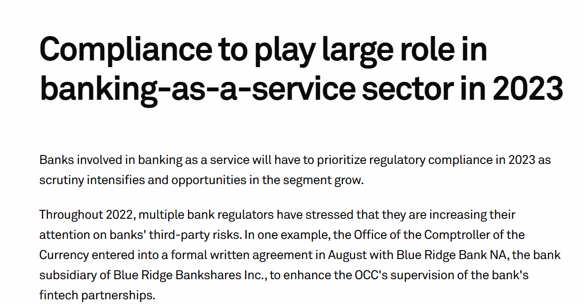
Government Litigation Risk: Background
Compliance costs have increased substantially over the past few years
Even breeds an industry developing technologies for bank compliance

Slide 11
Government Litigation Risk: Overview
This study examines a specific aspect of compliance, eligibility to FHA insurance in a high-risk mortgage market
Policy shock: The Department of Justice and HUD launched a series of lawsuits against 31 large lenders for fraud among FHA-insured mortgages, with fines totaling $5 billion
How do government lawsuits, as well as the threat of lawsuits affect credit provision to low-income households?
Main takeaways:
Targeted banks exited the FHA market, leading to a sizable reduction in loan provision, with no change in average default risk
Smaller banks do not seem to fill in the void
Ultimately, this leads to a reduced access to financing and home ownership for low-income households
Policy questions: Are the lawsuits “too heavy-handed”? Do the regulators to punish FHA fraud too much?

Slide 12
Government Litigation Risk: Outline of Findings
The paper first shows that litigation is not correlated with loan performance in prior years.
After the lawsuits, large lenders reduced the amount of lending in the FHA markets.
This effect could be driven by the actual litigation, or the threat of future litigation, or the concern for increased screening costs going forward
Counties that have more such lenders present have fewer loans originated
Interestingly, when lenders retreated, they did not cut out the riskiest loan applications. Quality of loans does not improve.
There is no change in the overall interest rates, but a small increase in concentrated markets
Loan officers’ misconduct rates increased

Slide 13
Government Litigation Risk: Credit Quantities
Define all large (top 5%) lenders as “treated”, not just the litigated ones, because even the untargeted lenders may fear lawsuit.
The results essentially reveal the deviation of large lenders vs. small lenders in their participation in the FHA markets. But mechanisms are unclear
Are the results coming from litigated lenders or non-litigated ones?
The former indicates the effect of fines + enhanced regulatory scrutiny
The latter indicates the anticipation of lawsuits
Are there reasons to believe that only large lenders feared government litigations?
Small and mid-sized banks face greater compliance burden (relative to their income).

Slide 14
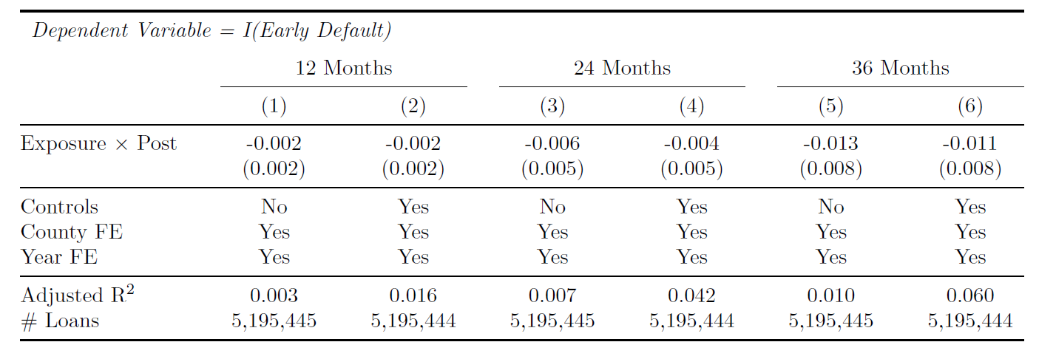
Government Litigation Risk: Credit Standards
The study finds no effect of the lawsuits on borrower characteristics (FICO, DTI), and no effect on delinquency. Interpretation: there is no change in credit standards.
While statistical significance is low, the coefficients are all negative and the magnitudes may be meaningful (Should discuss in the paper)
Is it possible that the loan quality did improve, but the test does not have sufficient power to capture it?

Slide 15
Government Litigation Risk: Credit Standards
Is it also possible there is an adverse-selection effect?
Borrowers may be adverse to litigation outcomes, so they do not apply for FHA mortgages. The only ones remaining are the lower-quality borrowers. So even if top lenders have tightened their lending standards along some observables (such as DTI and FICO), we do not observe an increase in loan quality
(Imperfect) Suggestions for the delinquency analysis:
Given that the sample is at the loan level, you can directly compare the outcome of loans originated by treated vs. control banks, instead of highly vs. lowly exposed counties (may need to match HMDA data with loan performance data)
This also allows you to better control for observables and compare changes in delinquency within observables

Slide 16
Government Litigation Risk: Supply vs. Demand
The DOJ lawsuits likely discouraged FHA demand and supply.
In an average market, FHA loan quantity reduced but interest rate did not change.
It is possible that both the supply curve and the demand curve shifted to the left, leading to little changes in prices (even in low-competition areas, there’s only small increase in interest --- again, should discuss magnitudes)
Is there a way to separate the two and gauge how much each side contributes to the policy effect?
R
S
D
Q

Slide 17
Government Litigation Risk: Identification
In the lender-level analysis, the main specification uses lender and county-year FE. It compares the origination of FHA loans from top 5% lenders vs. non-5% lenders.
What is the correct counterfactual? Should we be comparing Citigroup and JP Morgan Chase to local banks and credit unions?
You can narrow the comparison by looking at top 5% lenders to the top 5-10% lenders. While the latter is also affected by lawsuit risk to a certain degree, the intensity of treatment should be lower, and they are arguably more similar to the top 5% lenders
Use a matched sample based on lender characteristics
Can also look at within-lender differences, by imposing lender-year fixed effects (“portfolio tilt”)
Again, it would be helpful to use more granular data for the delinquency analysis

Slide 18
Government Litigation Risk: Policy Implications
What do we learn about policy-making in this study?
The study shows that
The policy “squashed” the FHA origination by large lenders, via several potential channels: the cost of fines, the threat of litigations, and the anticipation of higher underwriting costs
FHA lenders do not tighten lending standards after the shock
Low-income households receive less credit
The lack of changes in credit standards is the key, which would suggest
Large lenders did not originate loans that were too risky prior to the lawsuits
The lawsuits ended up “punishing” low-income households, whom the FHA was meant to support
However, lending standards may have tightened in other dimensions (other than FICO and DTI), and delinquency risk could also change if the counterfactual changes

Slide 19
Conclusion
Papers in this session study the effects of policies and regulations in the mortgage market.
Housing Speculation examines a policy that creates obstacles for lenders to securitize (finance) speculative loans
Government Litigation Risk examines the effect of lawsuit concerns regarding FHA insurance eligibility
Both policies achieved the intended effects, but also had unintended consequences.
Lenders seem to “over-react” to policies and cut lending “too much.” The policy can have spillover effects across regions and markets.
In recent work (Algorithmic Underwriting in High Risk Mortgage Markets), my coauthors and I discovered that an FHA policy that relaxed lending standards not only led to a substantial credit expansion to low-income households, but also enabled households to move to better neighborhoods (i.e., better schools)
The effect, however, is muted for Black borrowers and lower-income borrowers among the affected group.
Altogether, research highlights the tricky balance between financial inclusion and risk-avoidance.

Slide 20
Conclusion
For the research on bank policy shocks and real effects
We have learned in many contexts that shocks to banks, either through financing channels or regulatory restrictions, affect lending, which in turn generates real effects
What are the main points of innovation/contribution?
Effects of the study unveil frictions (market or institutional)
Whether the policy is effective depends on the importance of the mechanism that is altered by the policy
Whether the credit market is sufficiently competitive
The elasticities of supply/demand in the credit market as well as the labor market
Government Policies/Regulations
Lenders (intermediaries)
Households & Businesses

