Slide 1

Consumer Credit Without Collateral, Regulation, or Intermediaries
Filipe Correia (U Georgia) António Martins (ISEG - U Lisbon) Anthony Waikel (U Georgia)
Bank Research Conference 2025
September 26th, 2025

Slide 2
4.2% of US Households are Unbanked
Primary reason: “not having enough money to meet minimum balance requirements” (FDIC, 2023)
This leaves millions of people without access to credit, having to mitigate liquidity needs outside the traditional financial intermediation system.
But: what is the value of financial intermediaries?

Slide 3
4.2% of US Households are Unbanked
Primary reason: “not having enough money to meet minimum balance requirements” (FDIC, 2023)
This leaves millions of people without access to credit, having to mitigate liquidity needs outside the traditional financial intermediation system.
But: what is the value of financial intermediaries?
Intermediaries have their own incentives and can become predatory (Fang et al., 2015; Duygun et al., 2021)
They may lower transaction and search costs, and lead to efficient capital allocation (Harris et al., 2018; Crawford et al., 2018; Braggion et al., 2018)

Slide 4
Evidence on the Role of Intermediation is Vast
Private equity: intermediaries harm performance (Fang et al., 2015)
Persistent performance in venture capital funds (Harris et al., 2018)
Small business credit: less bank market power lowers prices and default (Crawford et al., 2018)
Collateral mitigates adverse selection and moral hazard for firm credit (Ioannidou et al., 2022)

Slide 5
Evidence on the Role of Intermediation is Vast
Private equity: intermediaries harm performance (Fang et al., 2015)
Persistent performance in venture capital funds (Harris et al., 2018)
Small business credit: less bank market power lowers prices and default (Crawford et al., 2018)
Collateral mitigates adverse selection and moral hazard for firm credit (Ioannidou et al., 2022)
This paper: How would consumer credit unfold without intermediaries, collateral or regulation?

Slide 6
Evidence on the Role of Intermediation is Vast
Private equity: intermediaries harm performance (Fang et al., 2015)
Persistent performance in venture capital funds (Harris et al., 2018)
Small business credit: less bank market power lowers prices and default (Crawford et al., 2018)
Collateral mitigates adverse selection and moral hazard for firm credit (Ioannidou et al., 2022)
This paper: How would consumer credit unfold without intermediaries, collateral or regulation?
Unique data from online informal credit market allows for: (Correia et al., 2022)
Descriptive evidence on prices and default
Assessing the role of lender skill
Determining how lenders screen borrowers

Slide 7
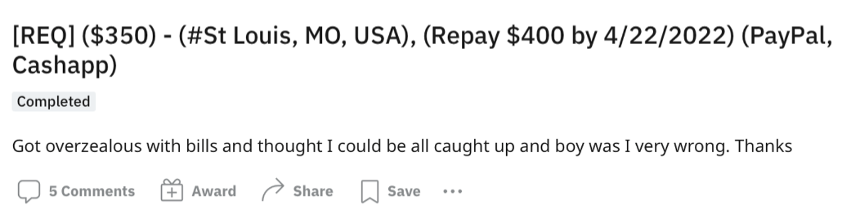
Borrower Requests a Loan
Requested Amount
Borrower Location
Repayment Amount
Repayment Due Date
Request Flag

Slide 8
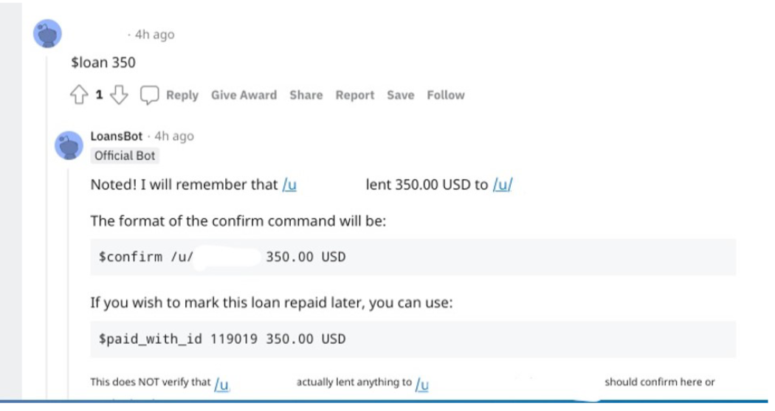
Lender Funds Loan
The loan is now outstanding and goes on a public ledger

Slide 9
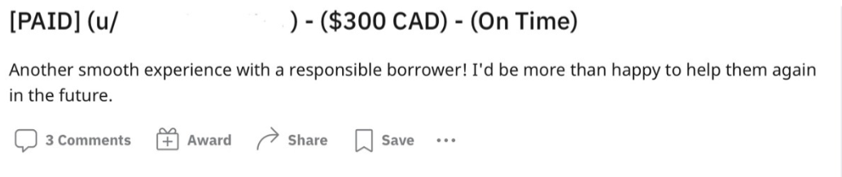
Loan Repayment is Due
Lender publicly reports repayment status, and ledger is updated

Slide 10
Descriptive Evidence

Slide 11
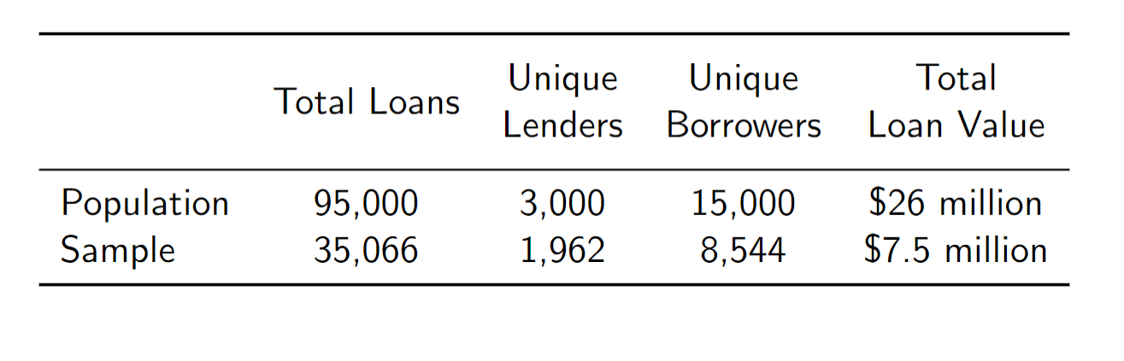
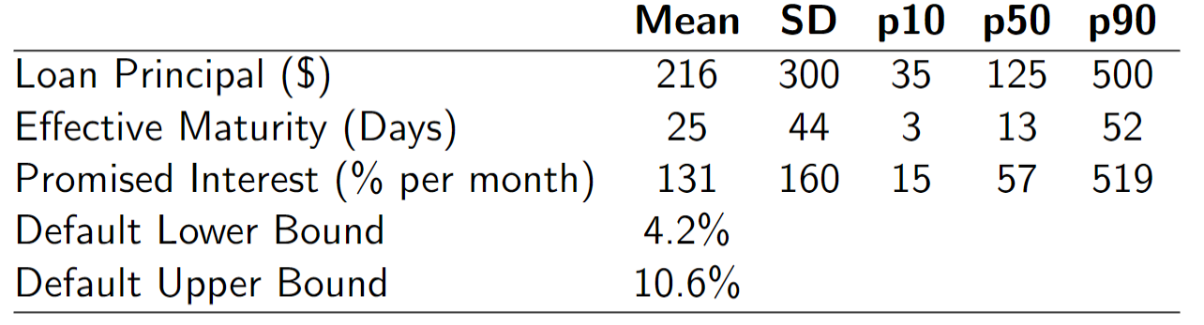
We Have Data on This Market for 2016-2021

Slide 12
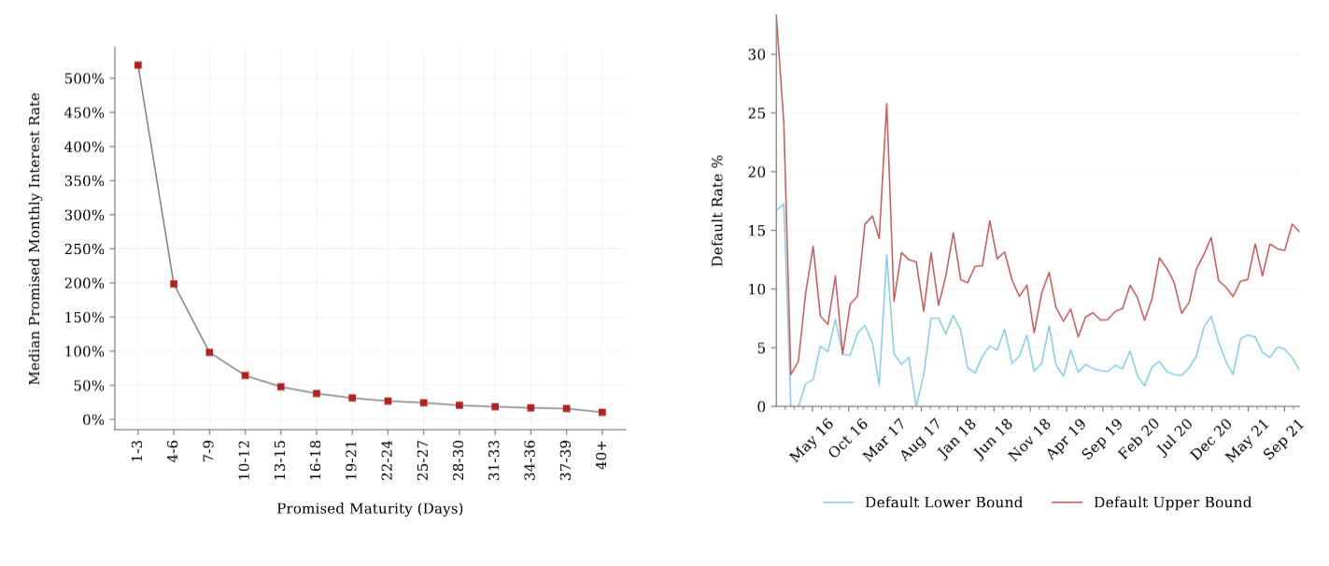
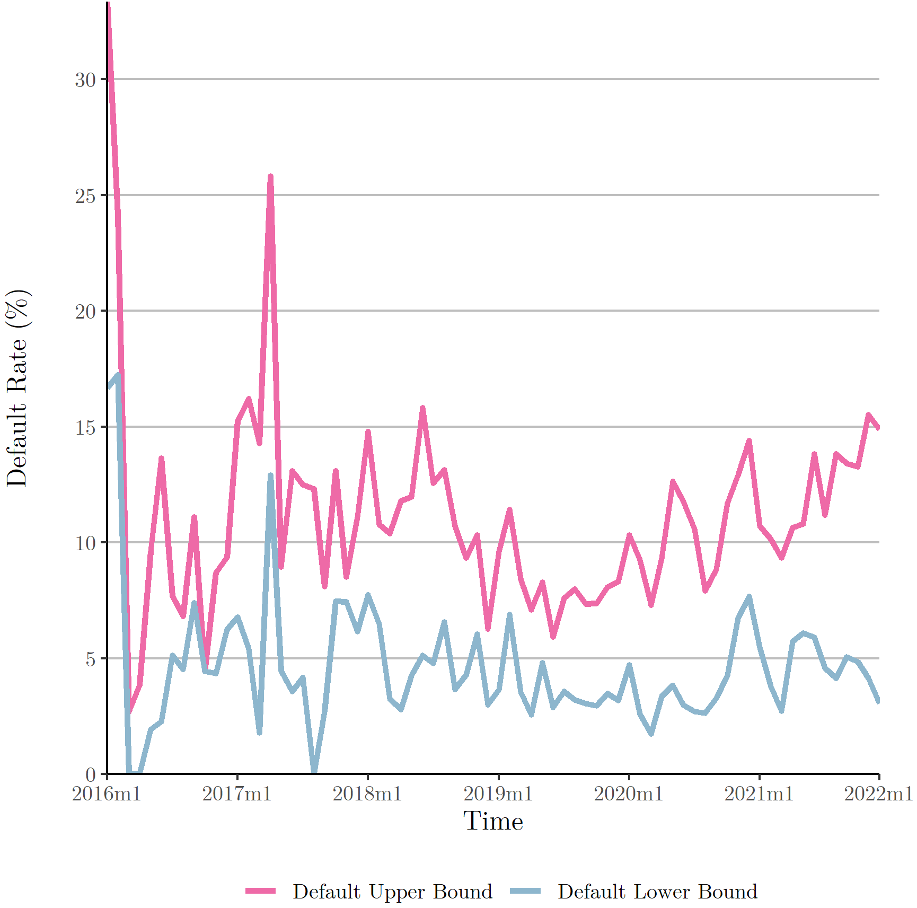
Result #1: High Default, High Loan Prices

Slide 13
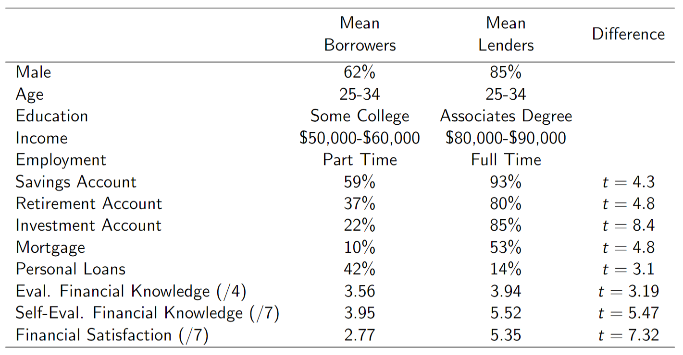
Borrowers Are More Vulnerable Than Lenders

Slide 14
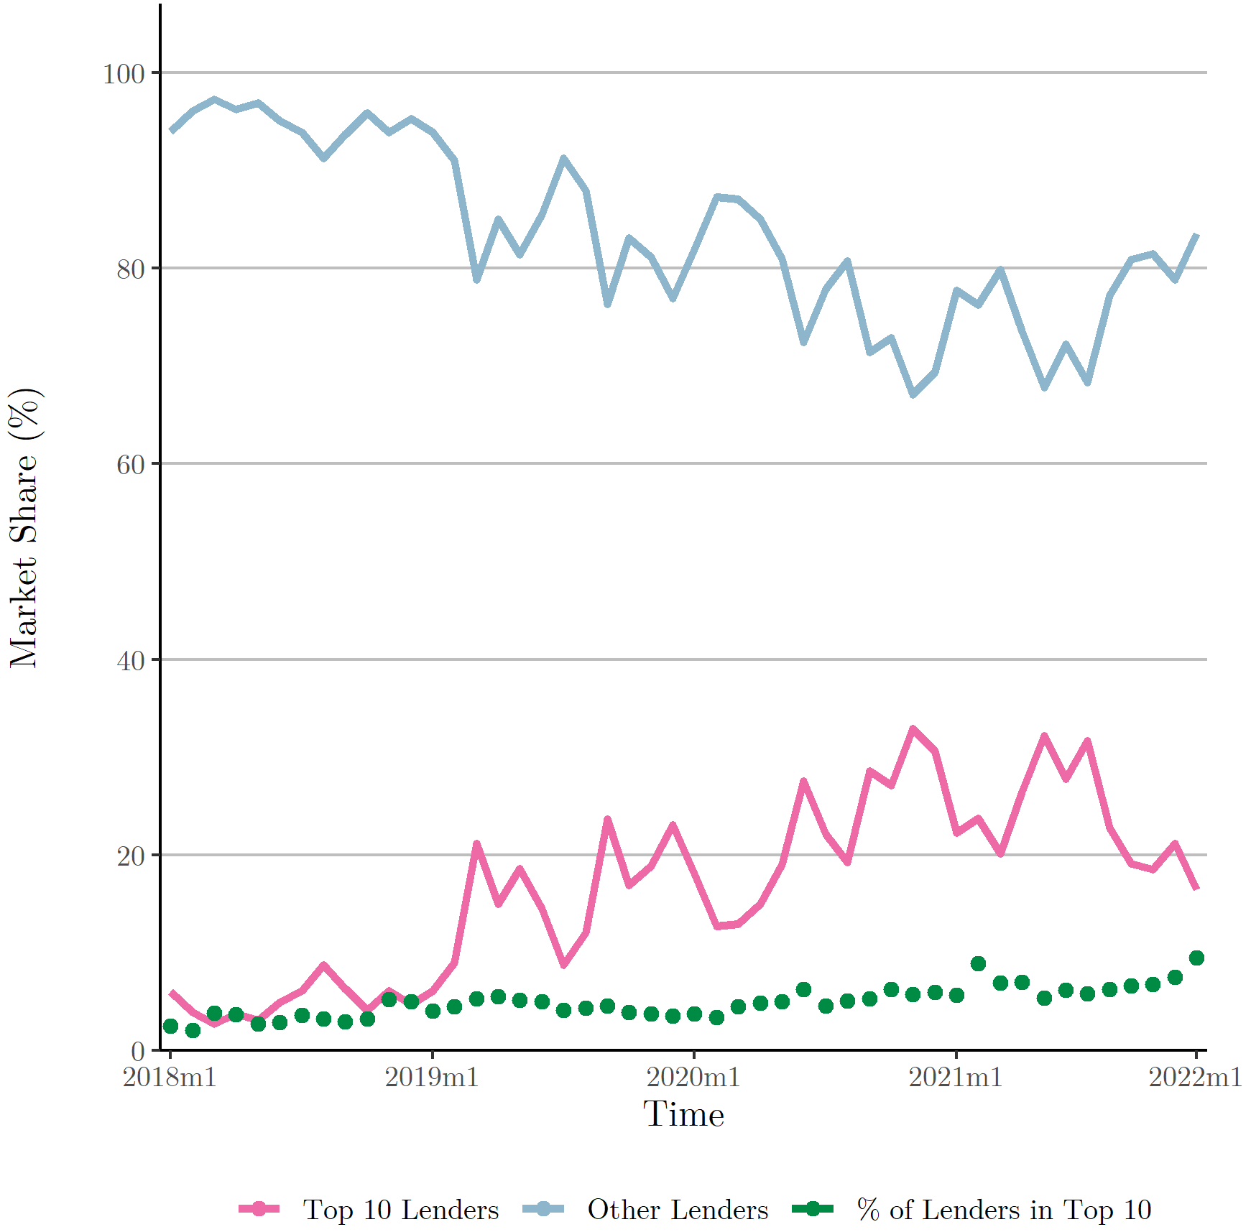
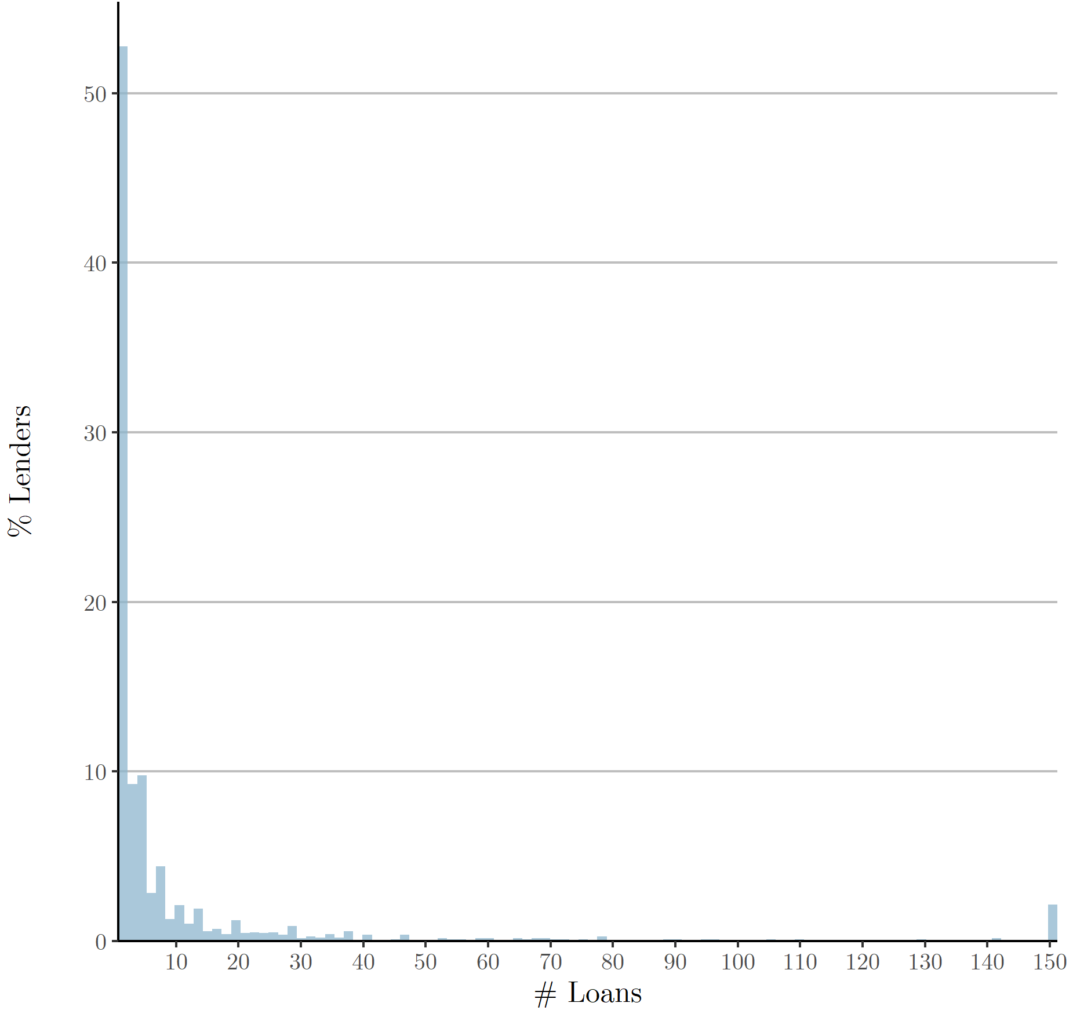
Result #2: Minority of Powerful Lenders

Slide 15
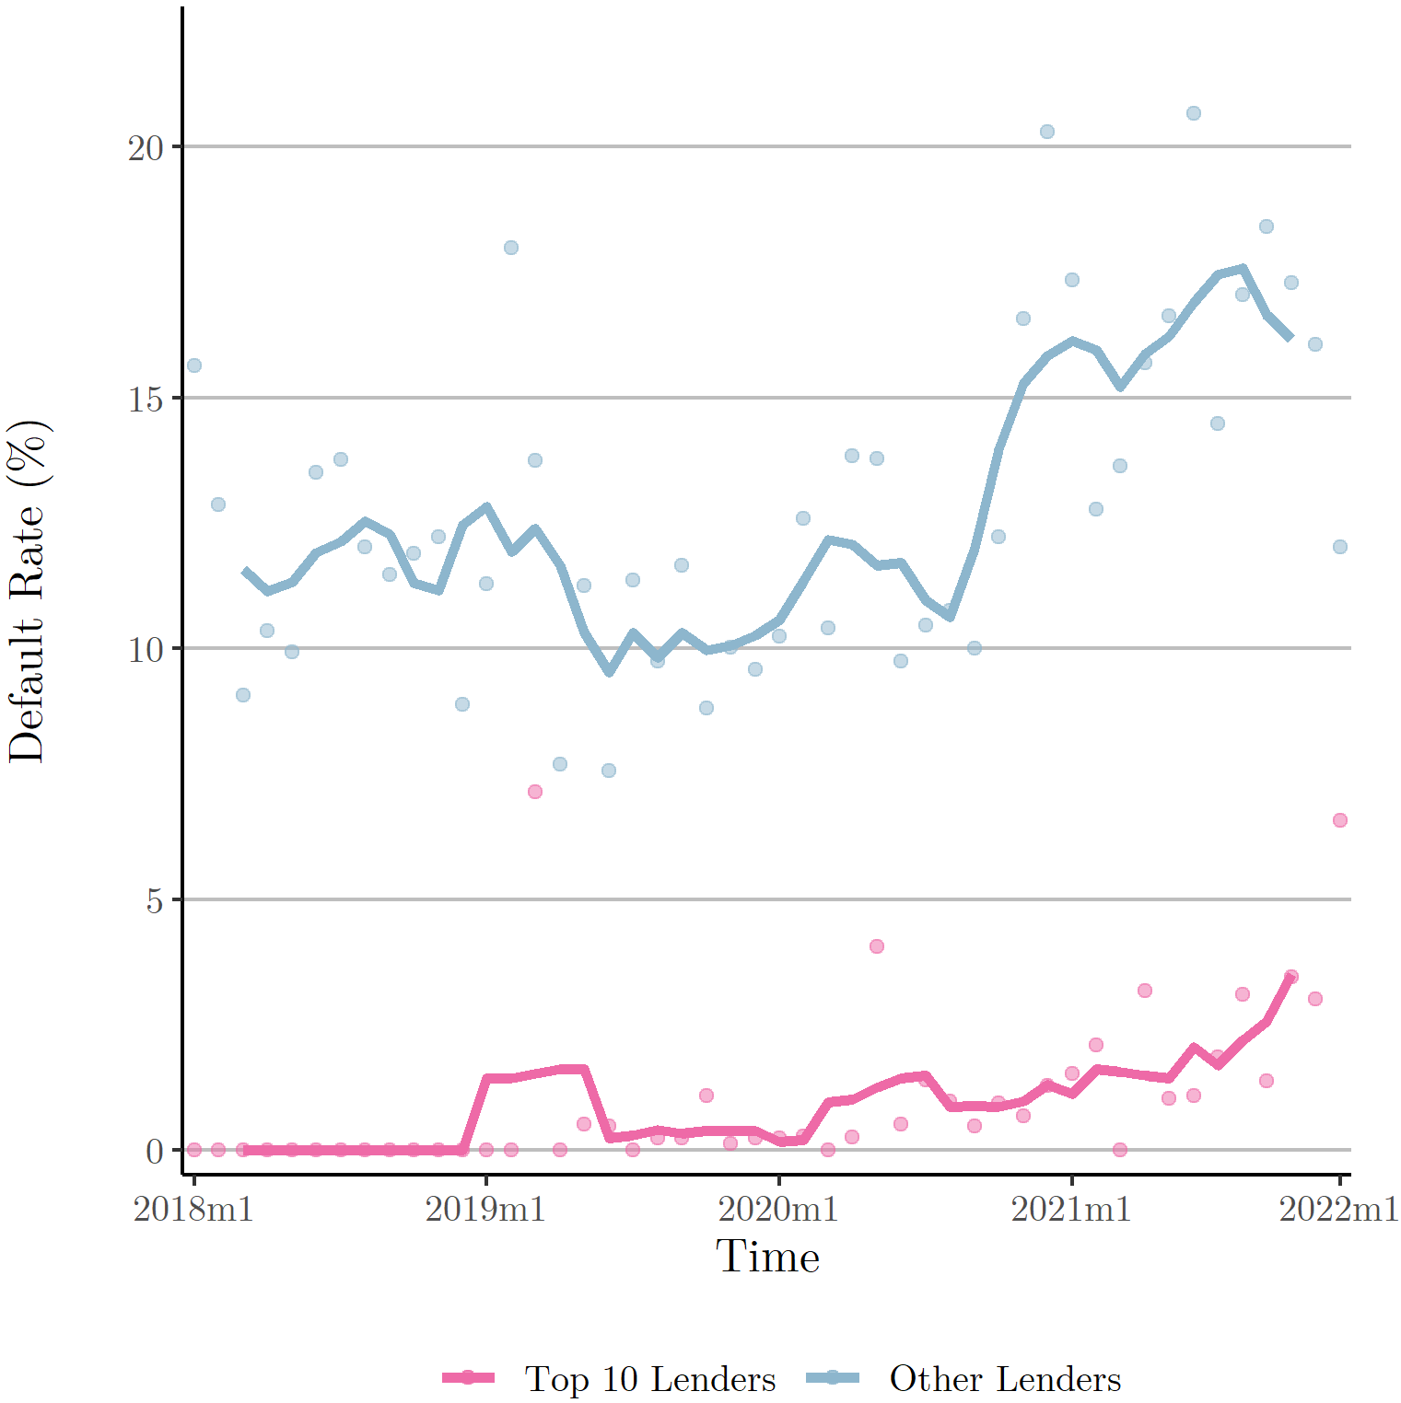
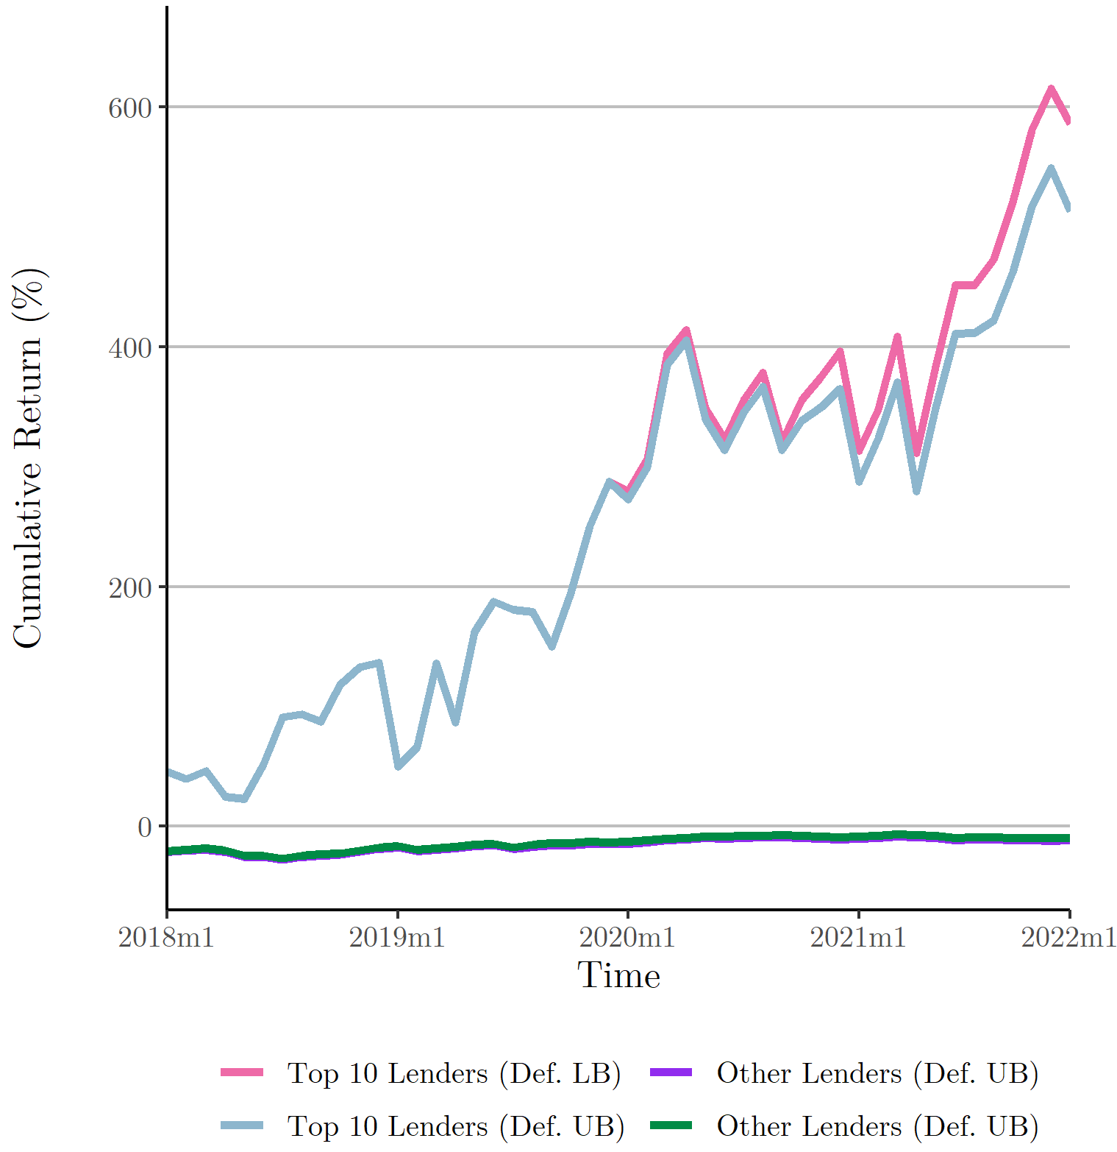
Result #2: Minority of Powerful + Profitable Lenders
Notes:
Our descriptive evidence suggests that each loan individually is very risky, but pooled, these loans pay a rate substantially higher than the break-even rate. This opens space for intermediation to create value, and efficiently pool risk and allocate financial resources. Additionally, a small and sophisticated fraction of lenders exhibits outstanding performance, stemming from a differential ability for credit risk management and screening. Other lenders do not enjoy the same stability and profitability in their portfolios. The financial system provides screening and risk management tools that individuals in this market do not have access to. Lastly, we can speculatively elaborate on the role of collateral. Intermediaries provide a legal and institutional framework for collateral to be posted. Collateral diminishes losses given default, attenuating credit pricing. It also acts as a monitoring device, lowering default.

Slide 16
Experience vs. Skill

Slide 17

Result #3: Lender Experience Matters
We hypothesize that as lenders gain experience in this market, their origination costs decrease.
Measure experience as cumulate loans given and estimate:
$$y_{i,l,b,t}=α+ β_{1}{CumulativeLoans}_{l,t}+φX_{b,t}+θX_{i}+ε_{i,l,b,t}$$
Notes:
would accept loans with lower promised interest rates, experience less default and exhibit a higher propensity to lend, on average. The origination burden, we argue, decreases as the lender becomes more acquainted with the workings of the market, and as they learn the credit risk evaluation and due diligence processes.

Slide 18
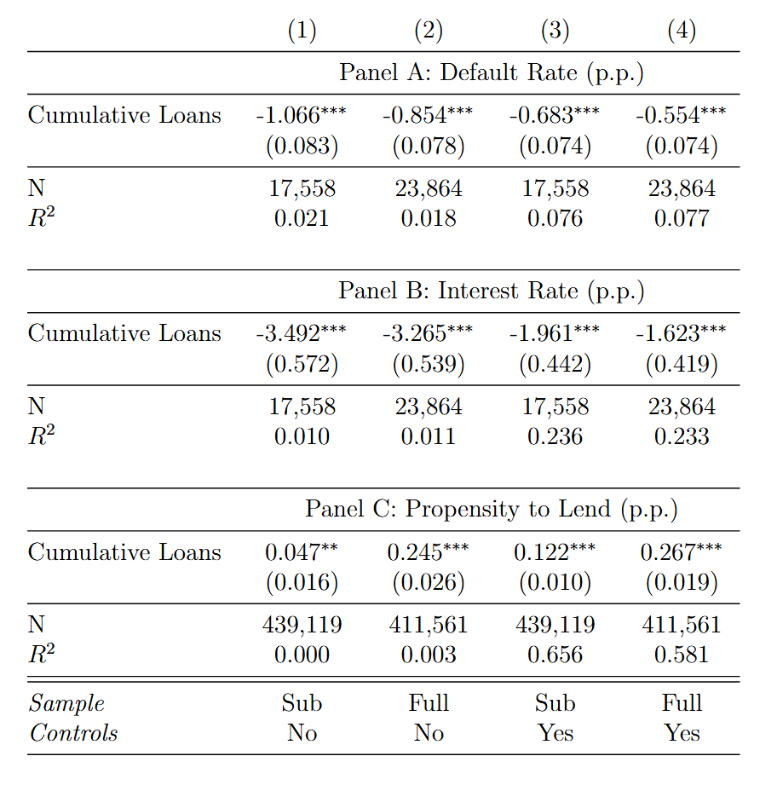
Experience Matters
Notes:
But what drives these results – gaining experience or coming in with skill?
Experience – Become more familiar with the market and how to evaluate borrowers
Skill – Better abilities to obtain information from the start

Slide 19
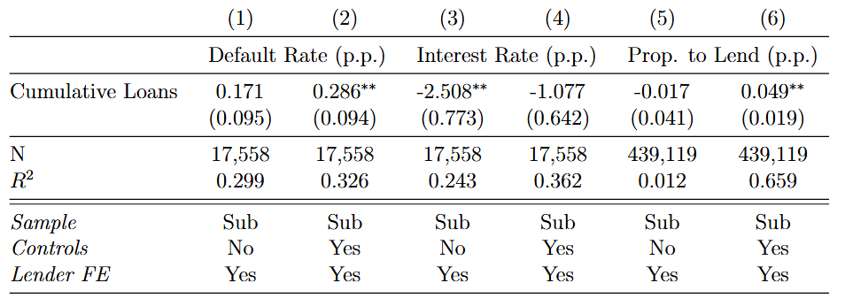
Lender Experience
Add lender fixed effects to study variation of the same lender along the time series
Notes:
Default result is mechanical but rejects a negative relation between lender experience and default
No result on interest
Results hold on propensity to lend but significance is lower and magnitude is much lower
An advantage of intermediated credit, relative to a market like the one we analyze is human capital. Financial intermediaries employ highly skilled and financially literate staff and use complex models to undertake loan origination, credit pricing, and funding decisions.

Slide 20
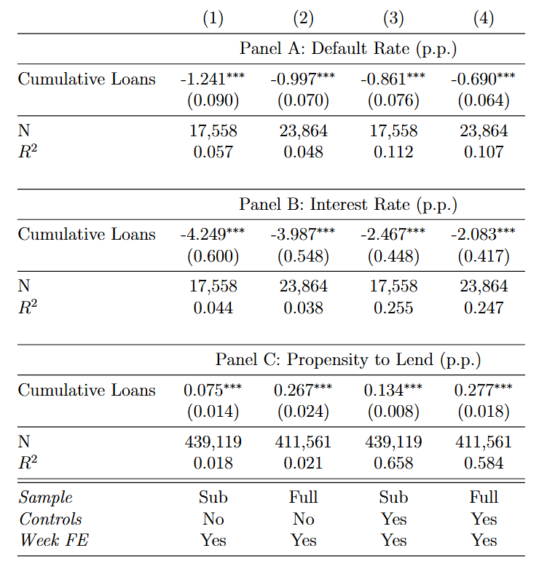
Lender Skill
Add week fixed effects to eliminate lender specific time variation in lending activity, shutting down the experience channel
Notes:
cross-sectional differences in past lending activity drive our results

Slide 21
Borrower-Lender Connectedness

Slide 22
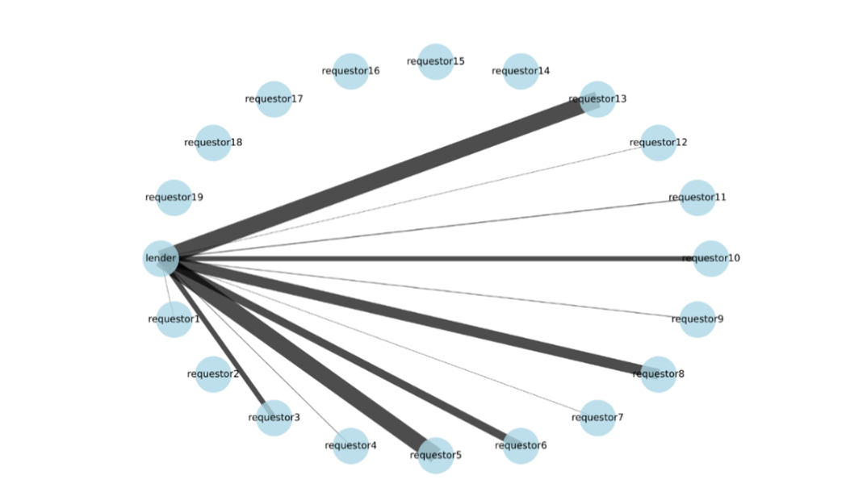
Measuring Connectedness
Data comes from an online forum: we measure the overlap in posts and comments on other communities for each pair of borrower and lender:

Slide 23
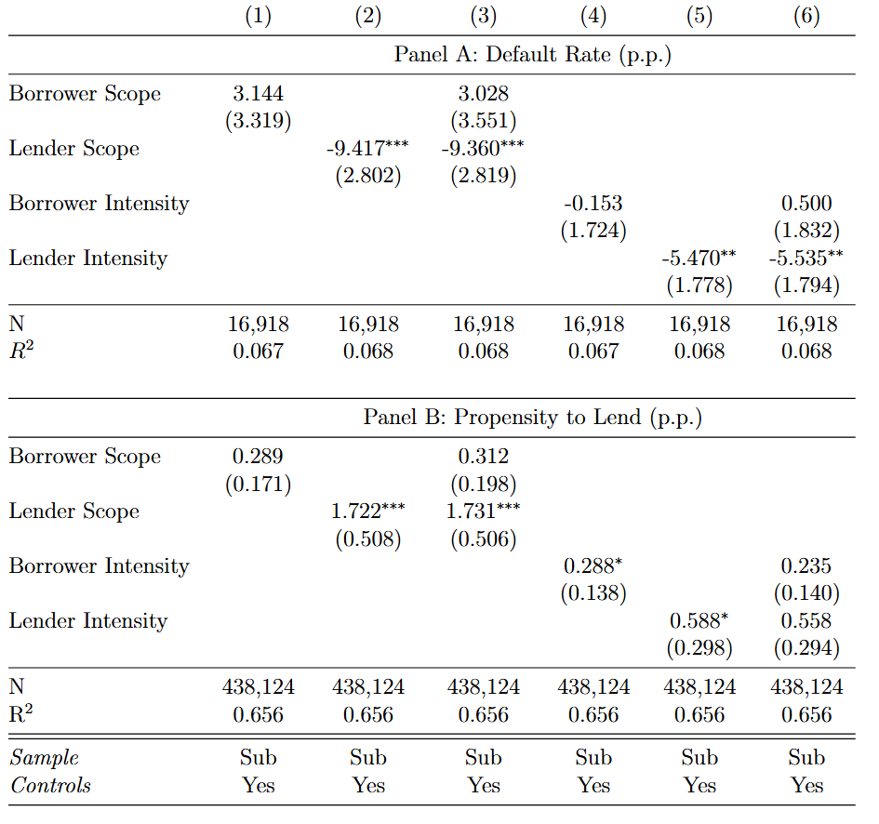
Result #4: Connectedness Improves Market Outcomes
We run the same specification on connectedness:
Notes:
Since there are no credit scores how do you evaluate borrowers? Looking at their activity and interests seem to matter

Slide 24
Conclusion
Intermediaries play a vital role in consumer credit markets
Without them (and without collateral posting mechanisms and regulation):
High default rates
High credit prices
Vulnerable players pay rents to powerful players
Reputation becomes key, and so does connectedness
Bill Gates once said “banking is necessary, banks are not”
We would rephrase it to “good banks are necessary”

Slide 25
Thank you!
Questions?

