Slide 1

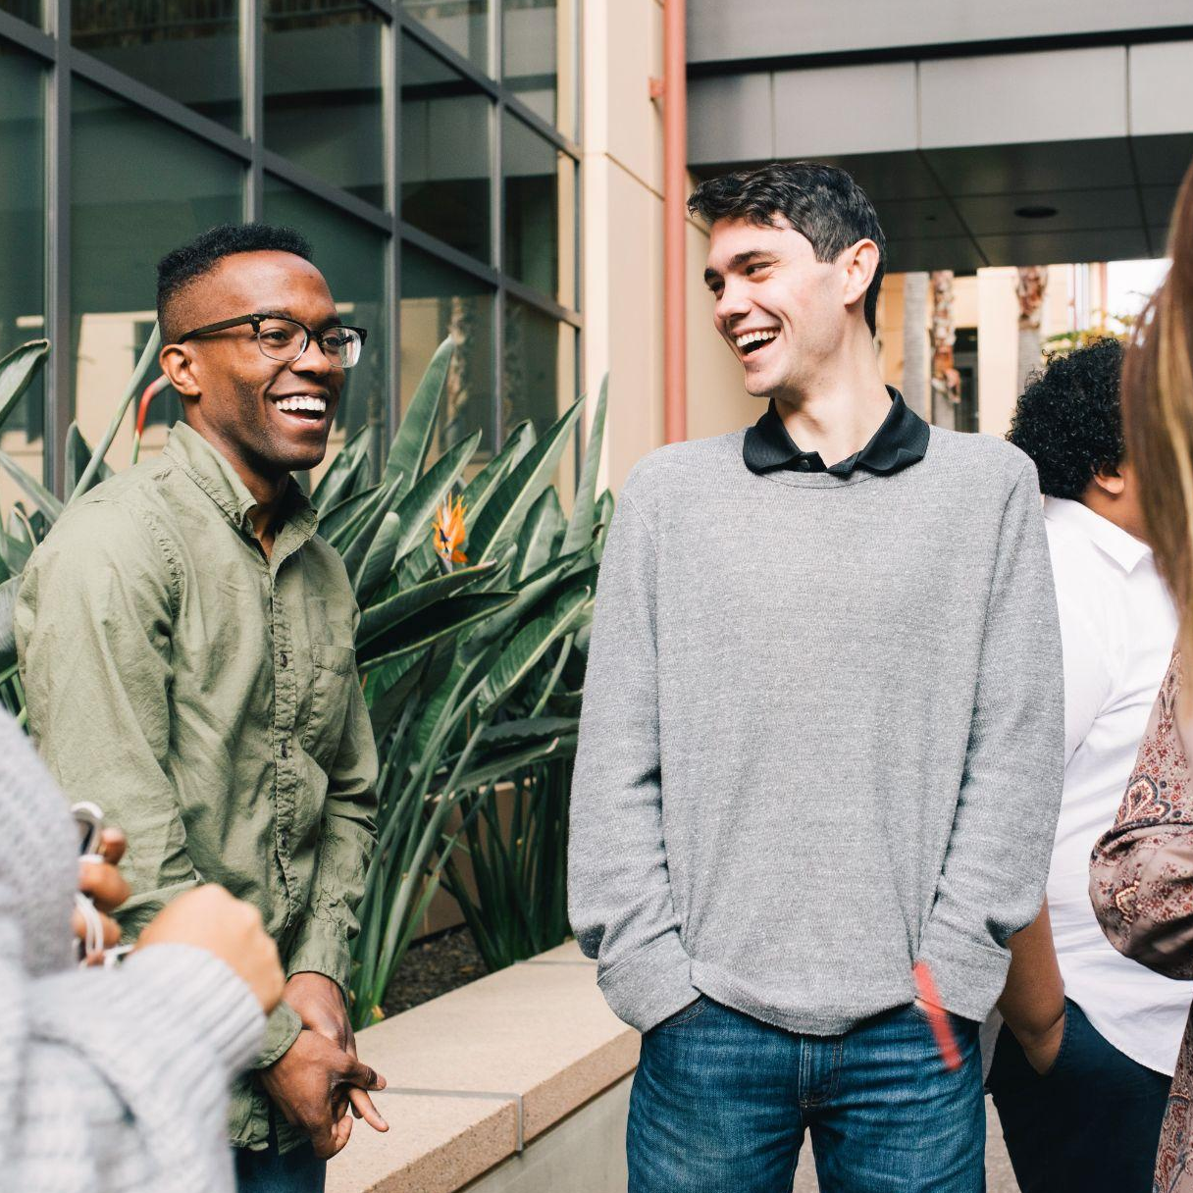

The Importance of Financial Literacy: Lessons from Seven Years of P-Fin Index Data
Annamaria Lusardi
Senior Fellow, SIEPR
Professor of Finance (by courtesy), Stanford GSB
Director, Initiative for Financial Decision-Making
FDIC, Consumer Research Symposium
March 15, 2024

Slide 2
Main topics I will cover
Main topics I will cover
    Personal finance knowledge (with a focus on inflation)
    Gaps in financial knowledge
    Financial knowledge and its link to behavior
    Using these data to inform teaching, policy and programs

Slide 3
_________________________________________________________________________________________________
The importance of data and measurement
    Data is the new currency
    From the Big Three to 28 questions
    A financial check-up

Slide 4
Measuring financial literacy: The ABCs of personal finance
Measuring financial literacy: The ABCs of personal finance
These are the questions I designed jointly with Olivia Mitchell, known as the “Big Three.” One question is about inflation:
The Big 3
“Suppose you had $100 in a savings account and the interest rate was 2% per year. After 5 years, how much do you think you would have in the account if you left the money to grow?”
“Imagine that the interest rate on your savings account was 1% per year and inflation was 2% per year. After 1 year, with the money in this account, would you be able to buy…”
“Do you think the following statement is true or false? Buying a single company stock usually provides a safer return than a stock mutual fund.”
✔
    More than $102
    Exactly $102
    Less than $102
    Don’t know
    Refuse to answer
    More than today
    Exactly the same as today
    Less than today
    Don’t know
    Refuse to answer
✔
    True
    False
    Don’t know
    Refuse to answer
✔

Slide 5
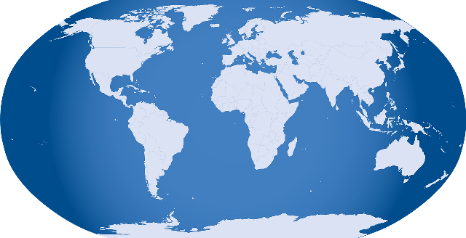
Financial Literacy around the World (Flat World)
Financial Literacy around the World (Flat World)
Evidence from 15 countries and counting:
  Australia
  France
  Switzerland
  Romania
  Chile
  Finland
  Canada
  USA
  Germany
  The Netherlands
  Italy
  Russia
  Sweden
  New Zealand
  Japan
We have data available on financial literacy at the national level

Slide 6
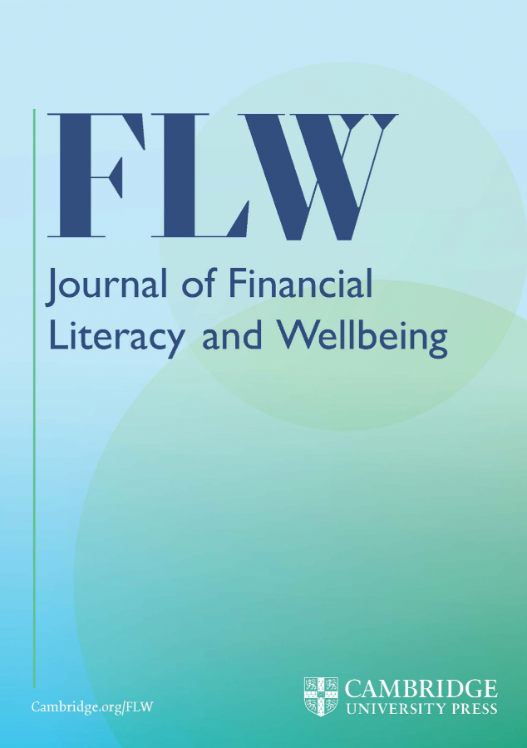
Financial Literacy around the World (Flat World), cont.
Financial Literacy around the World (Flat World), cont.
Evidence from other countries and updating the evidence with a focus on inflation (special issue of the Journal of Financial Literacy and Wellbeing, 2023)
  USA
  Latin America (Peru and Uruguay)
  Eastern Europe (9 countries)
  Singapore
  Finland
  Italy
  Japan

Slide 7
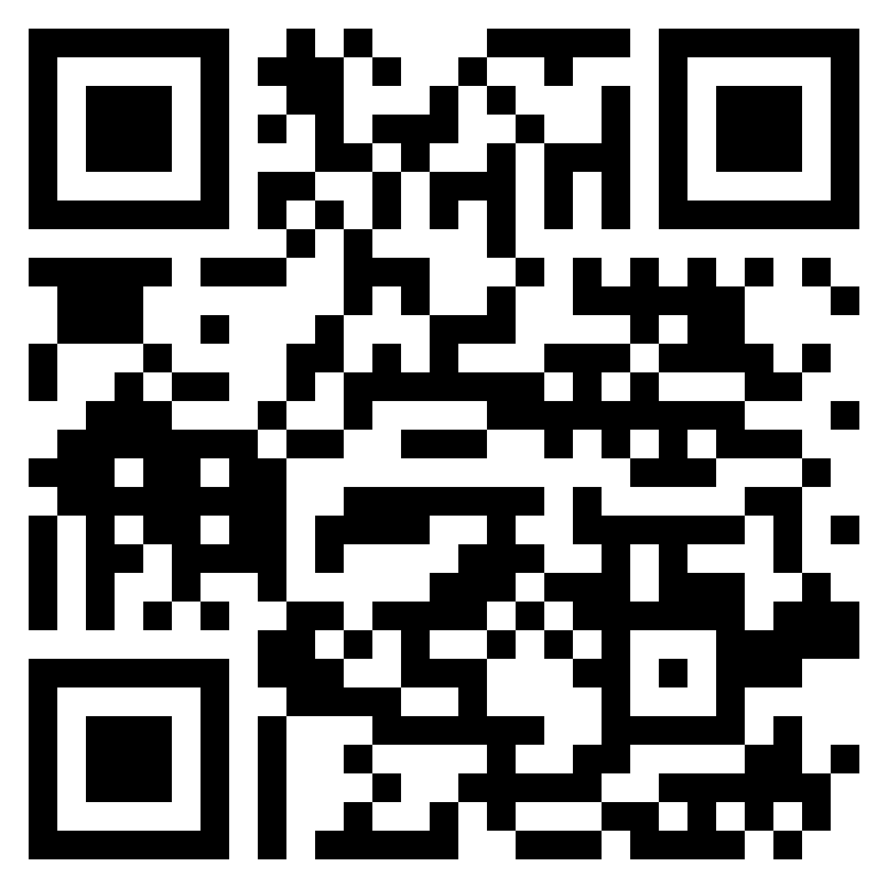
Measuring personal finance knowledge
Measuring personal finance knowledge
    The TIAA-Institute-GFLEC Personal Finance Index (P-Fin Index) is an annual measure of knowledge and understanding which enable sound financial decision-making and effective management of personal finances among U.S. adults.
    The P-Fin Index relates to common financial situations that individuals encounter and can be viewed as a gauge of “working knowledge.”
    In addition to personal finance knowledge it provides information on financial well-being indicators.
    Data is now collected on a representative sample of about 3,500 respondents (age 18+).
    Data collection started at the end of 2016.

Slide 8

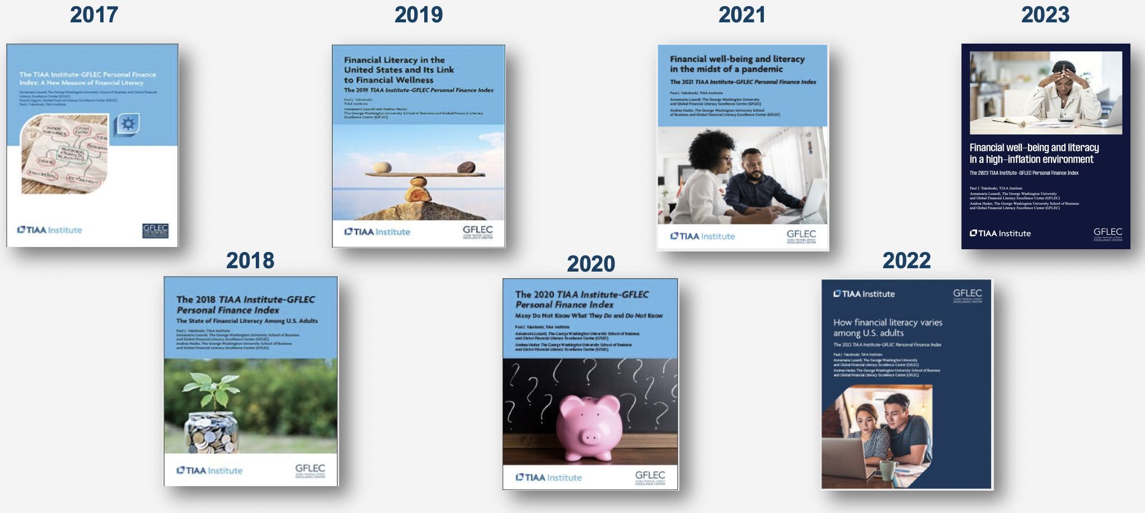
Seven years of P-Fin Index data (2017-2023)
Seven years of P-Fin Index data (2017-2023)

Slide 9
What is unique: 8 functional areas of personal finance
What is unique: 8 functional areas of personal finance
The index is based on responses to 28 questions, with three or four questions for each of the eight functional areas (from the National Standards for Financial Literacy).
The P-Fin Index’s 28 questions cover eight functional areas:
  1. Earning
  2. Saving
  3. Consuming
  4. Investing
  5. Borrowing
  6. Insuring
  7. Comprehending risk
  8. Go-to information sources

Slide 10
An example question
An example question
Anna saves $500 each year for 10 years and then stops saving additional money. At the same time, Charlie saves nothing for 10 years but then receives a $5,000 gift which he decides to save. If both Anna and Charlie earn a 5% return each year, who will have more money in savings after 20 years?
    Anna
    Charlie
    Anna and Charlie will have the same amount
    Don’t know
    Refuse to answer
Results:
Correct 47%
Incorrect 28%
Don’t Know 25%
No Answer 0%
Source: TIAA Institute-GFLEC Personal Finance Index (2023).

Slide 11
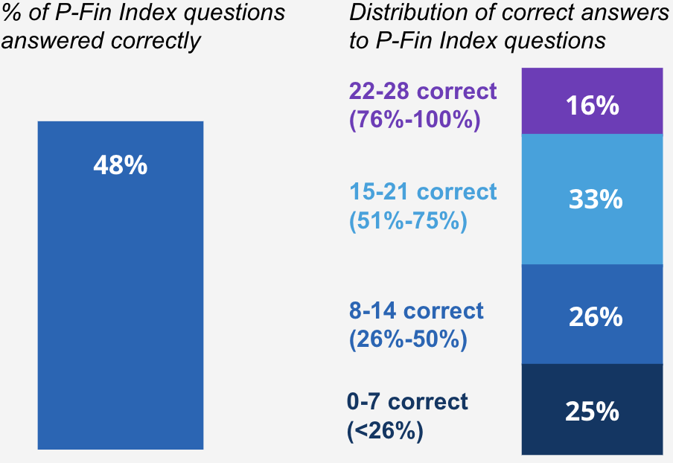
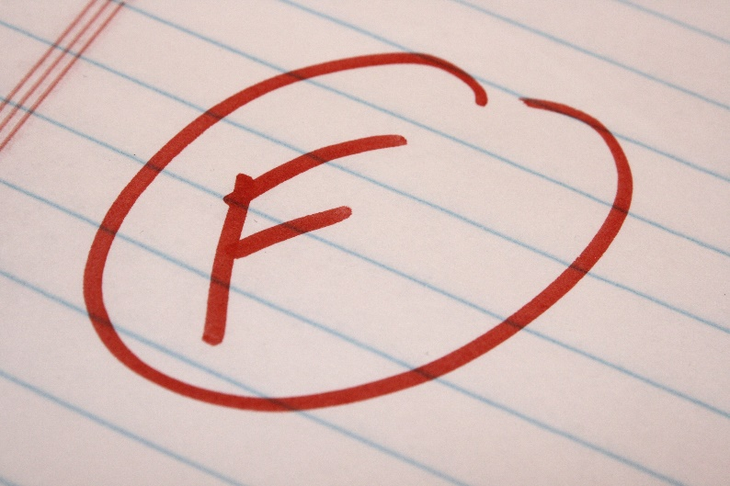
Financial literacy: A failing grade
Financial literacy: A failing grade
Source: TIAA Institute-GFLEC Personal Finance Index (2023).

Slide 12
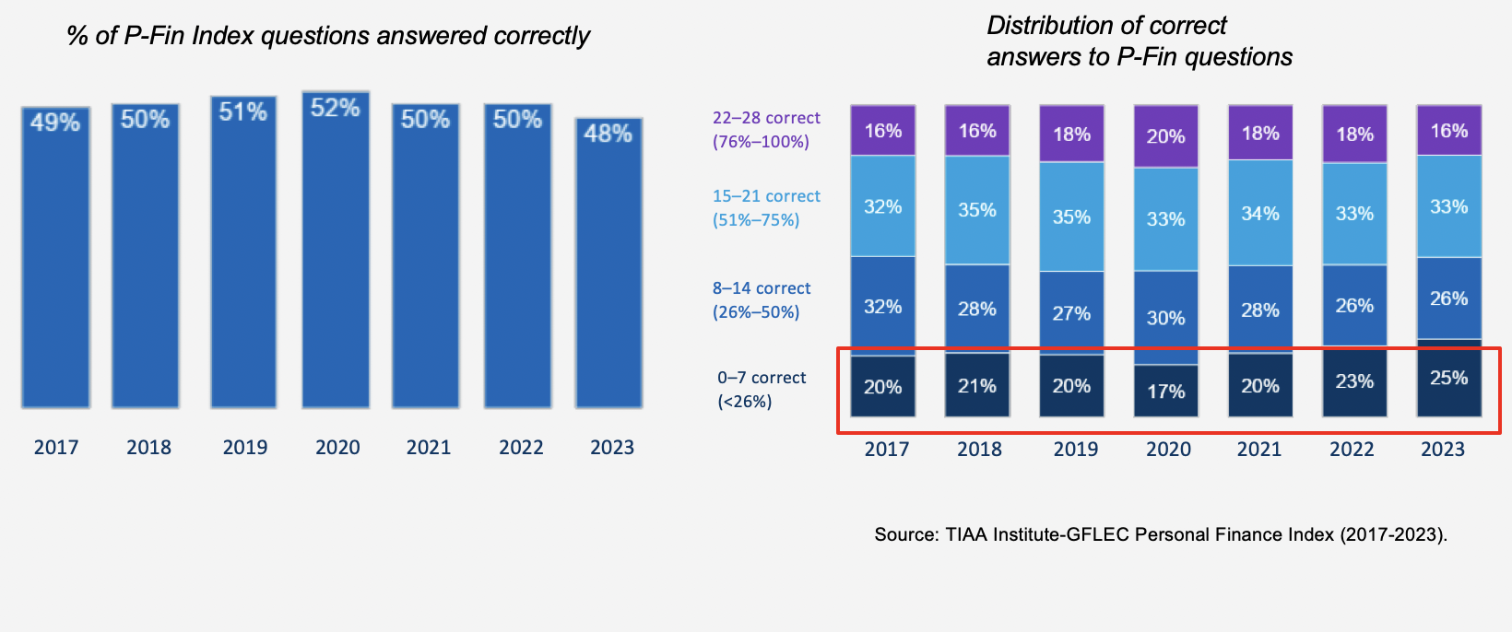
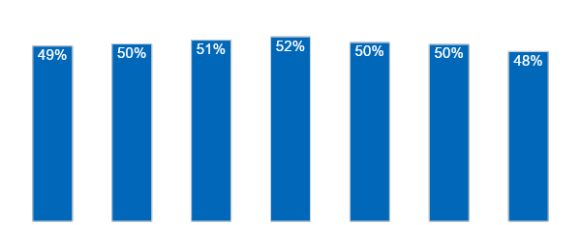
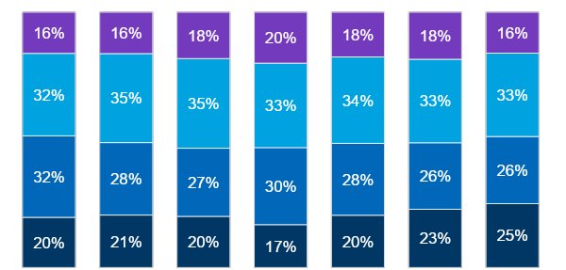
Financial (il)literacy is holding steady: 2017-2023
Financial (il)literacy is holding steady: 2017-2023
22–28 correct
(76%–100%)
15–21 correct
(51%–75%)
8–14 correct
(26%–50%)
0–7 correct
(<26%)
2017
2018
2019
2020
2021
2022
2023
2017
2018
2019
2020
2021
2022
2023
Source: TIAA Institute-GFLEC Personal Finance Index (2017-2023).

Slide 13
What do people know the most and the least
What do people know the most and the least
Borrowing
Saving
Consuming
Go-to info sources
Earning
Investing
Insuring
Comprehending risk
Source: TIAA Institute-GFLEC Personal Finance Index (2023).

Slide 14
Zooming in: Inflation knowledge
Zooming in: Inflation knowledge
Akiko has $1,000 in savings that earns a 2% rate of return over the course of the year. The inflation rate during the year is 3%. Which statement is true?
    She can afford to buy fewer things at the end of the year
    She can afford to buy more things at the end of the year
    It’s not clear whether she can afford to buy more things or fewer things at the end of year
    Don’t know
    Refuse to answer
Results:
Correct 55%
Incorrect 17%
Don’t Know 27%
No Answer 1%
Source: TIAA Institute-GFLEC Personal Finance Index (2023).

Slide 15
Inflation knowledge, by gender
Inflation knowledge, by gender
% who answered inflation question correctly
Source: TIAA Institute-GFLEC Personal Finance Index (2023).

Slide 16
Inflation knowledge, by age
Inflation knowledge, by age
% who answered inflation question correctly
Source: TIAA Institute-GFLEC Personal Finance Index (2023).

Slide 17
Inflation knowledge, by race/ethnicity
Inflation knowledge, by race/ethnicity
% who answered inflation question correctly
Source: TIAA Institute-GFLEC Personal Finance Index (2023).

Slide 18
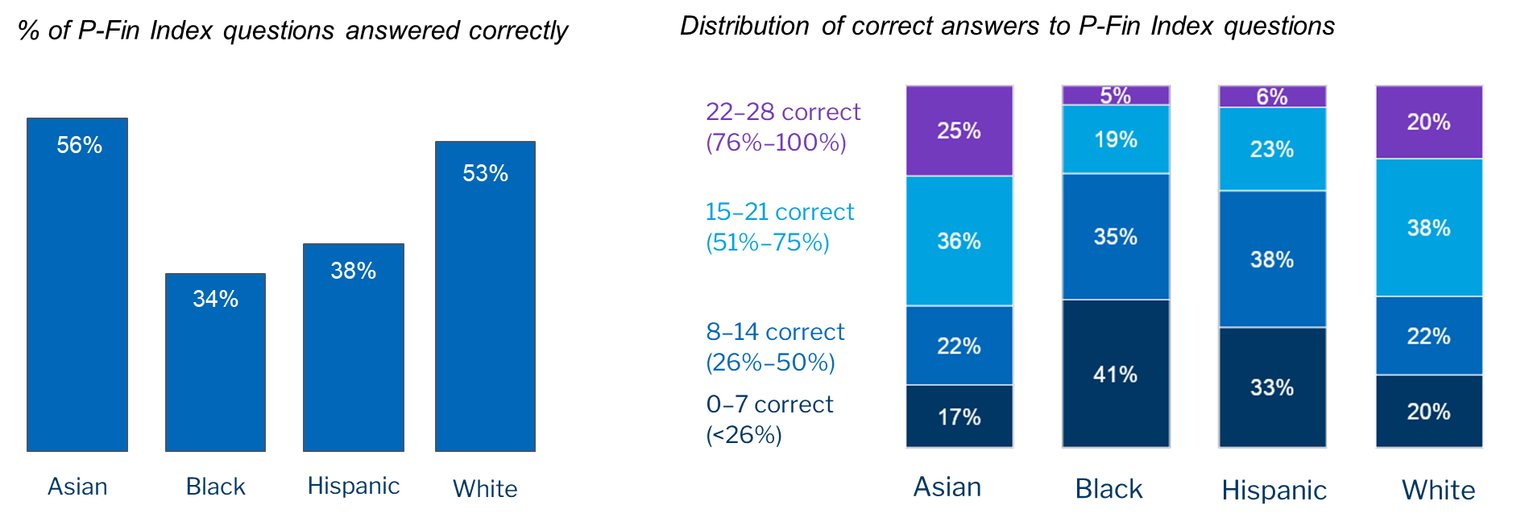
Gaps in financial knowledge: Racial/Ethnic groups
Gaps in financial knowledge: Racial/Ethnic groups
Source: TIAA Institute-GFLEC Personal Finance Index (2023).

Slide 19
Gaps in financial knowledge: Age groups/cohorts
Gaps in financial knowledge: Age groups/cohorts
% of P-Fin Index questions answered correctly
Distribution of correct answers to P-Fin questions
22–28 correct
(76%–100%)
53%
15–21 correct
(51%–75%)
43%
8–14 correct
(26%–50%)
0–7 correct
(<26%)
18-29
30-44
45-59
60+
18-29
30-44
45-59
60+
Source: TIAA Institute-GFLEC Personal Finance Index (2023).

Slide 20
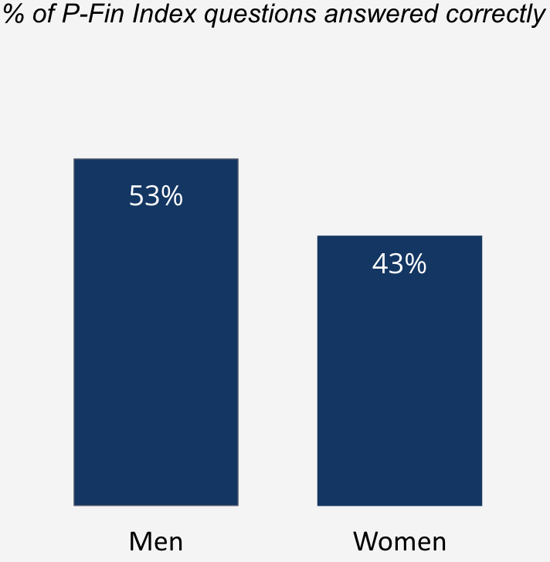
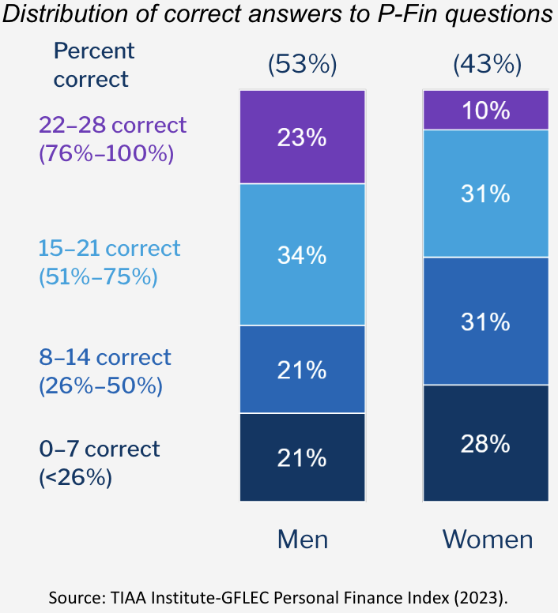
Financial knowledge gaps: Women and men
Financial knowledge gaps: Women and men

Slide 21
Financial literacy gender gap in each topic...
Financial literacy gender gap in each topic...
Borrowing
Saving
Consuming
Go-to info sources
Earning
Investing
Insuring
Comprehending risk
Source: TIAA Institute-GFLEC Personal Finance Index (2023).

Slide 22
...and in answering “Do not know”
...and in answering “Do not know”
Borrowing
Saving
Consuming
Go-to info sources
Earning
Investing
Insuring
Comprehending risk
Source: TIAA Institute-GFLEC Personal Finance Index (2023).

Slide 23
Focusing on gender differences
Focusing on gender differences
What happens if we take away the “do not know” option?
This is what we did in a project with data from the Dutch Central Bank using the Big Three.
The gender difference shrinks but does not go away
Women know more than they think they do, but they are not confident about their knowledge
Both knowledge and confidence matter for financial behavior (investing in the stock market)

Slide 24
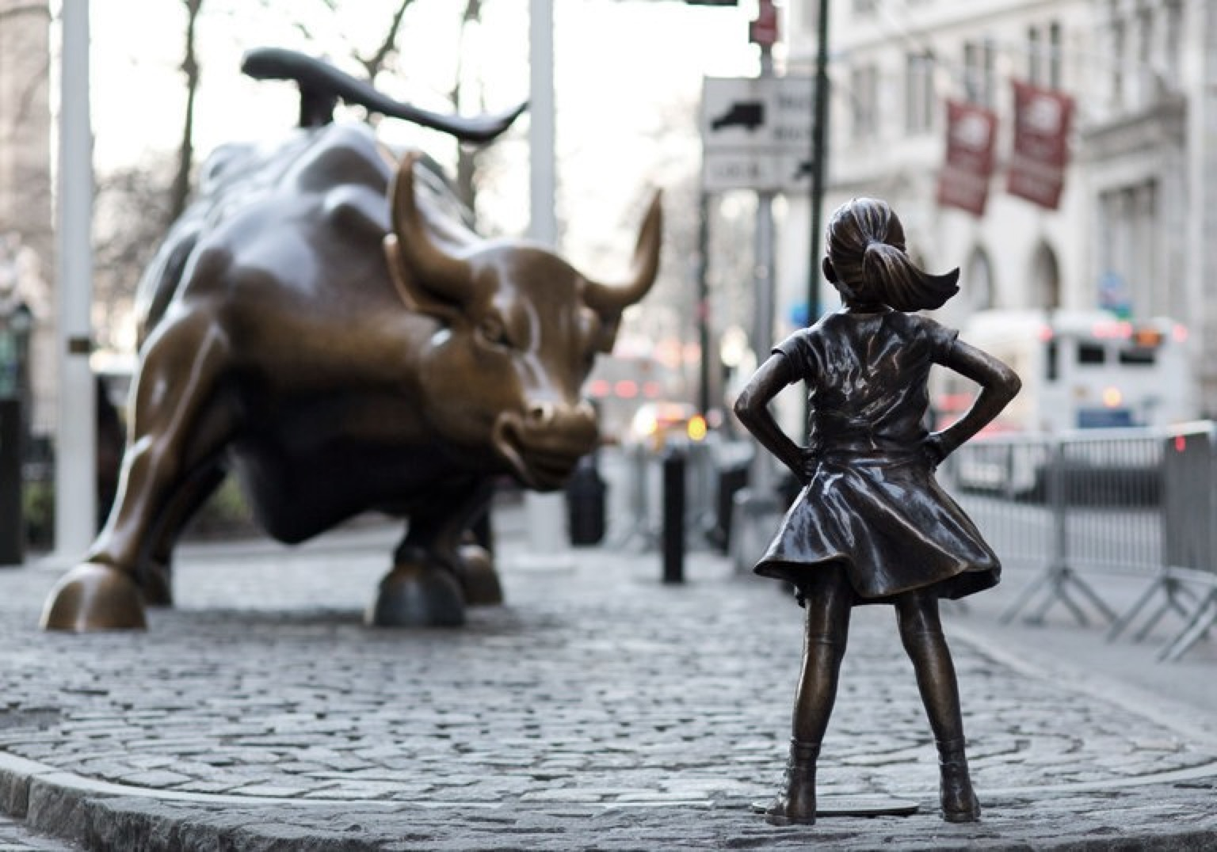
Fearless Woman: Financial Literacy and Stock Market Participation
Fearless Woman: Financial Literacy
and Stock Market Participation
Tabea Bucher-Koenen (ZEW, U of Mannheim)
Rob Alessie (U of Groningen)
Annamaria Lusardi (The George Washington
University and GFLEC )
Maarten van Rooij (DNB)

Slide 25
The P-Fin index and the Big Three
The P-Fin index and the Big Three
Similar findings
- Low levels of financial literacy
Comprehending risk
- Risk is a difficult concept to grasp
Many “do not know” responses
- They provide useful information
Gaps in financial literacy
- Similar findings

Slide 26

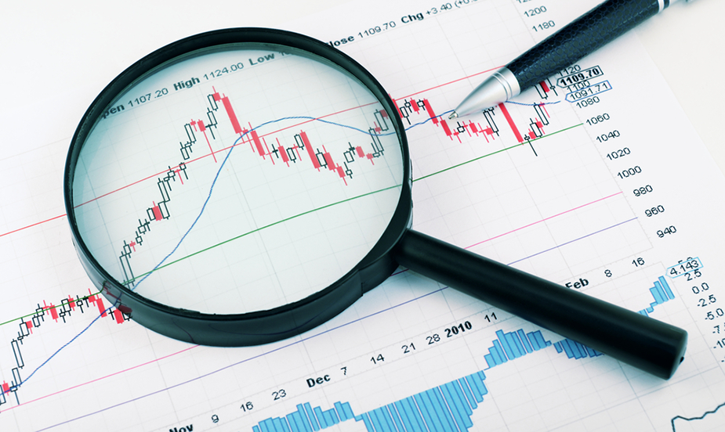
Turning to financial wellbeing
Turning to financial wellbeing

Slide 27
A simple measure of the cost of financial illiteracy
A simple measure of the cost of financial illiteracy
People spend an average of 8h per week thinking about and dealing with financial issues and problems. An average of 4h per week occur at work.
Source: TIAA Institute-GFLEC Personal Finance Index (2023).

Slide 28
Measuring financial fragility (Lusardi, Schneider and Tufano, BPEA, 2011)
Measuring financial fragility (Lusardi, Schneider and Tufano, BPEA, 2011)
How confident are you that you could come up with $2000 if an unexpected need arose within the next month?
  I am certain I could come up with the full $2,000.
  I could probably come up with $2,000.
  I could probably not come up with $2,000.
  I am certain I could not come up with $2,000.
  Don’t know.
  Prefer not to say.
Respondents are classified as financially fragile.

Slide 29
Financial fragility: what does it measure?
_________________________________________________________________________________________________
  Indicates lack
  of borrowing capacity of highly leveraged households
  Is a symptom of lack of assets

Slide 30
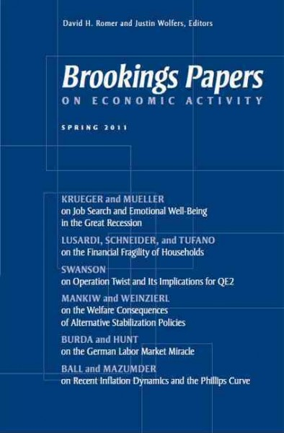
Financial fragility before and after the pandemic
Financial fragility before and after the pandemic
Source: 2009 TNS data, 2012, 2015 and 2018 NFCS data, 2020 & 2023 P-Fin data

Slide 31
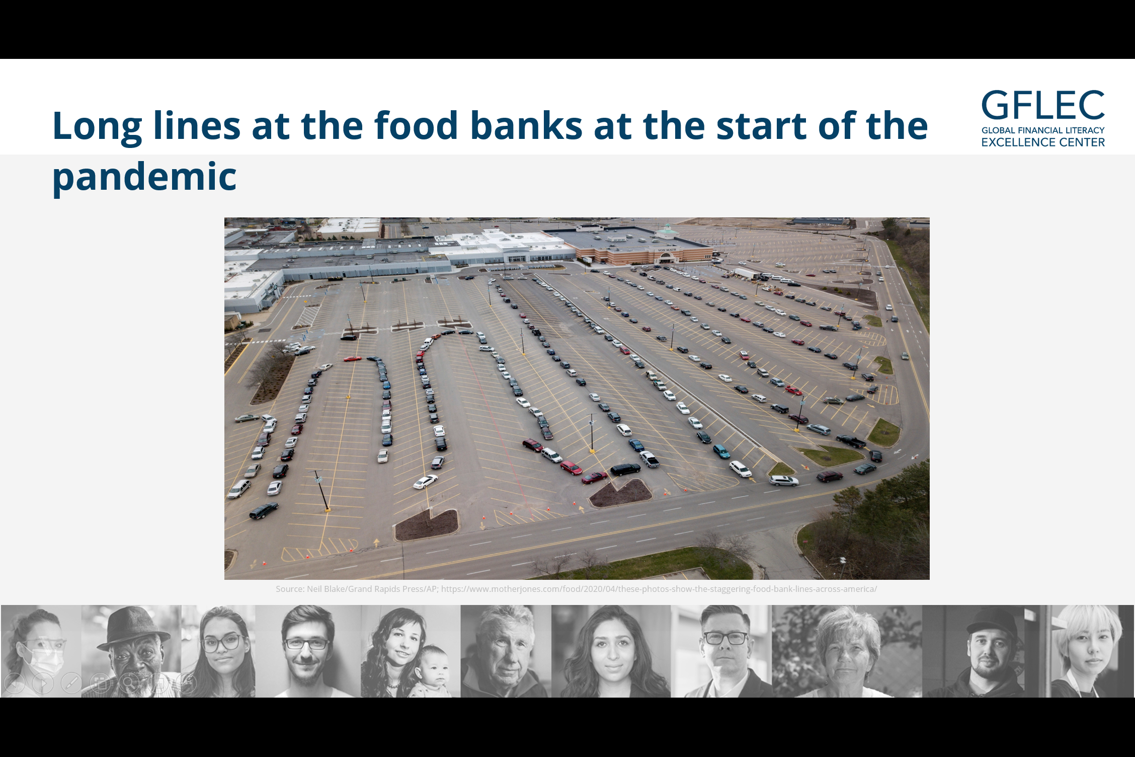
Financial fragility in America
_________________________________________________________________________________________________
Long lines at the food banks at the start of the pandemic!

Slide 32
Financial literacy and financial fragility
Financial literacy and financial fragility
% who could certainly come up with $2,000 if an unexpected need arose within the next month
76%
60%
Those with greater financial literacy are less likely to be financially fragile.
39%
28%
<26%
26%-50%
51%-75%
76%-100%
% of P-Fin questions answered correctly
Source: TIAA Institute-GFLEC Personal Finance Index (2023).

Slide 33
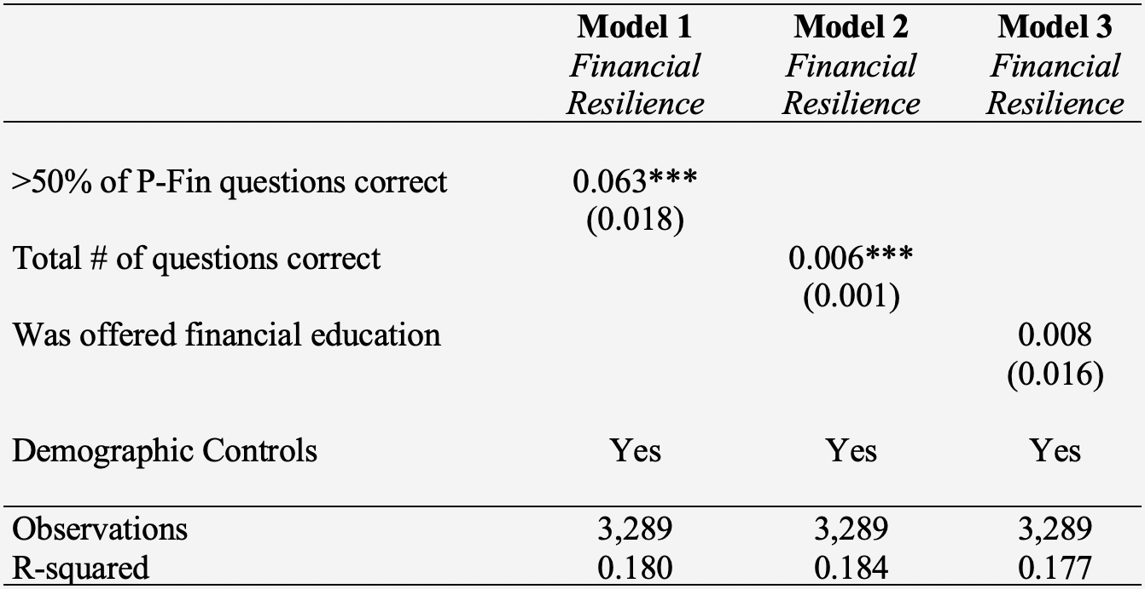
The relationship between financial resilience (being able to cope) and financial literacy
_________________________________________________________________________________________________
Source: TIAA Institute-GFLEC Personal Finance Index (2023).

Slide 34
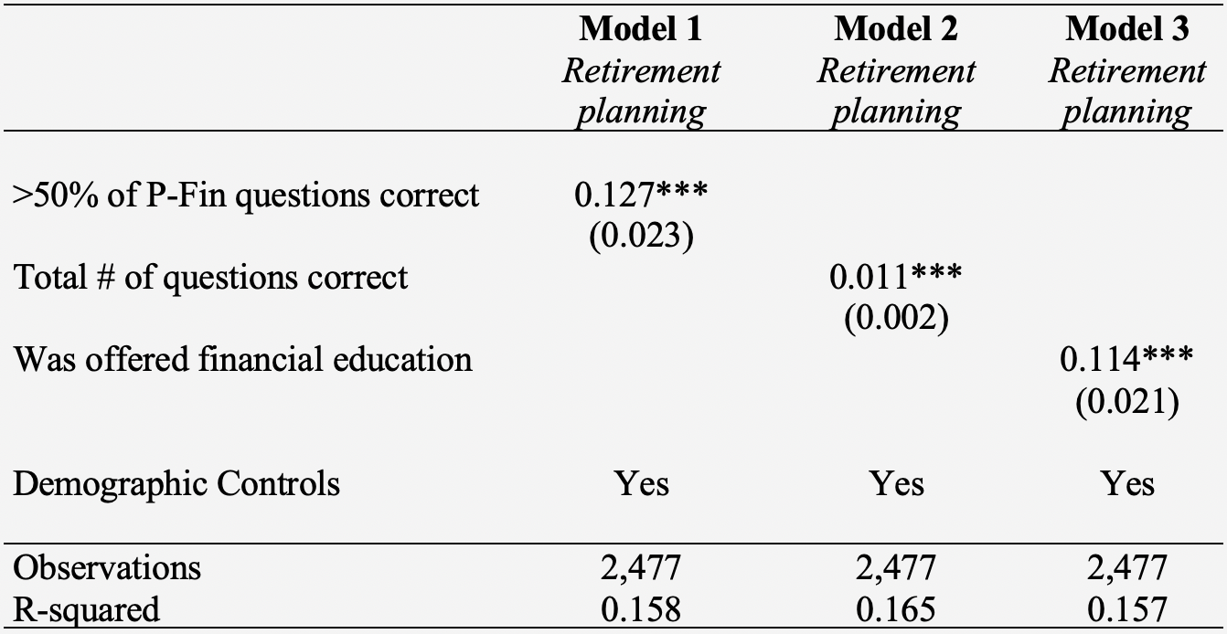
The relationship between retirement planning and financial literacy
_________________________________________________________________________________________________
Source: TIAA Institute-GFLEC Personal Finance Index (2023); non-retirees.

Slide 35
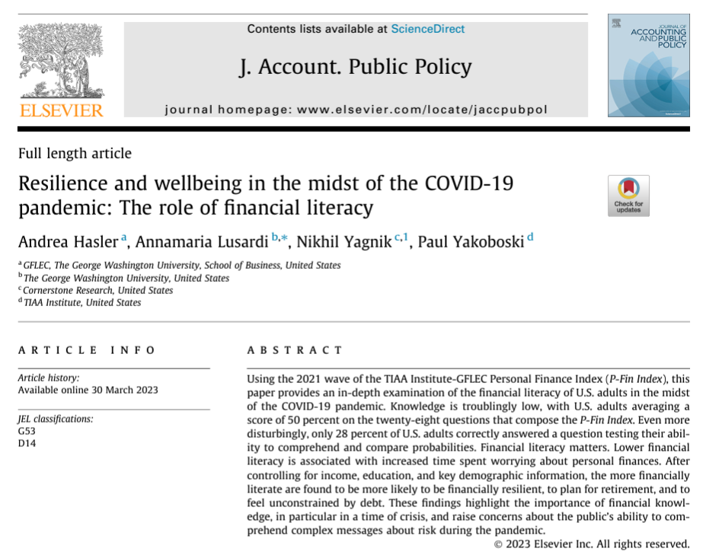
Resilience and the wellbeing in the midst of the COVID-19 pandemic: The role of financial literacy

Slide 36

Financial literacy matters
Financial literacy matters
Who is financially literate:
is more likely to cope with financial shocks
is more likely to plan for retirement
is more likely to save
is less likely to be debt-constrained
The findings in the P-Fin Index confirm the results in other studies using other measures of financial literacy.

Slide 37
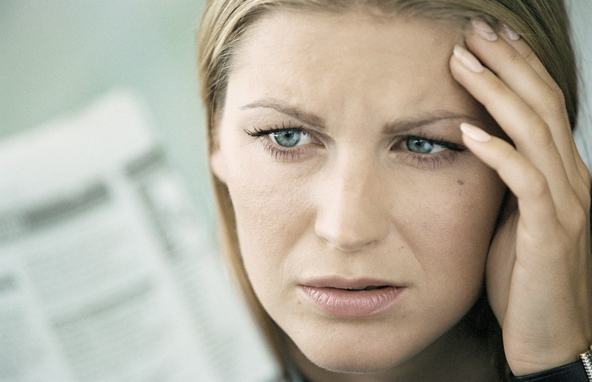
What we have learned
What we have learned
Need to improve levels of financial literacy
  Levels of knowledge are critically low
Some topics are particularly complex
  Risk and risk diversification
Gaps across demographic subpopulations
  One size does not fit all
Increasing financial wellbeing
  Financial knowledge matters too

Slide 38

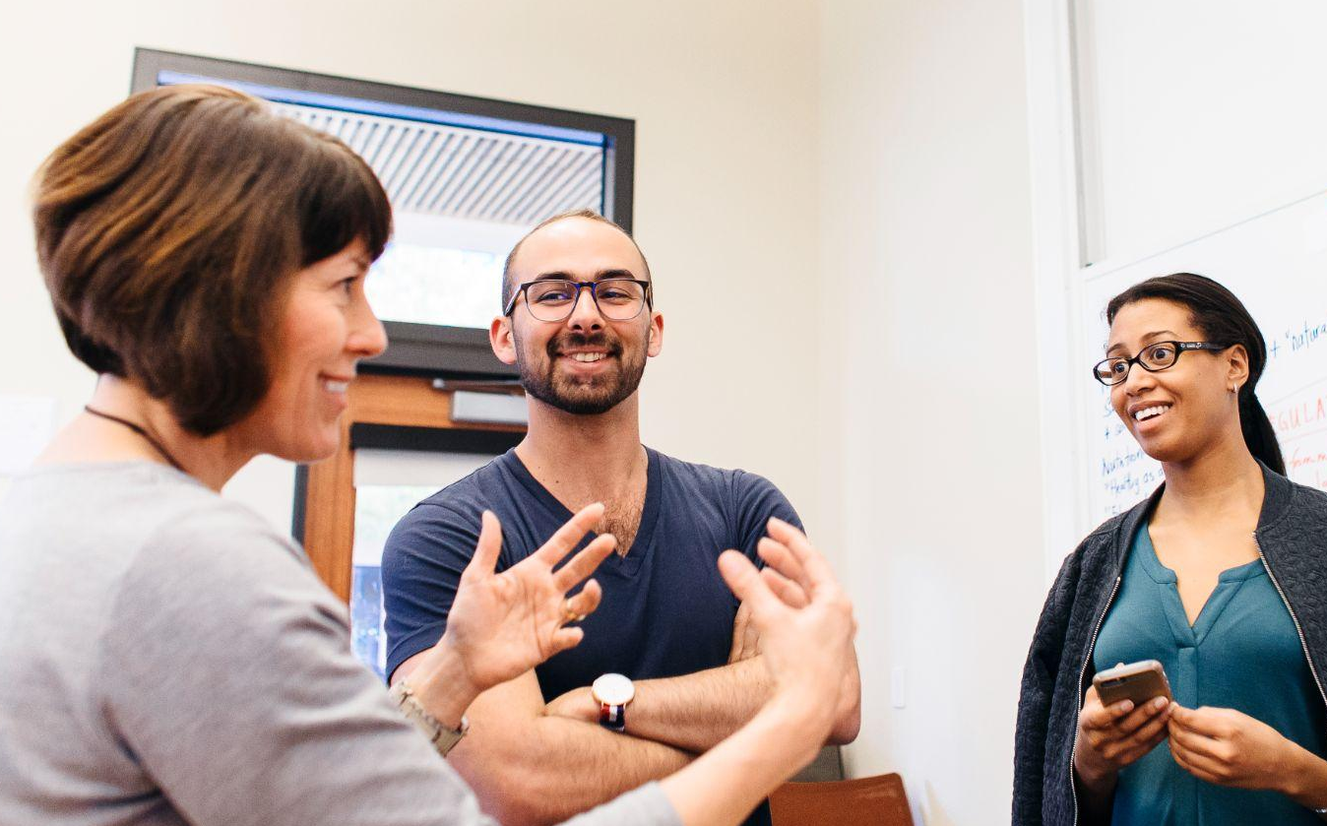

Using research and data for teaching, policy and programs
_________________________________________________________________________________________________

Slide 39
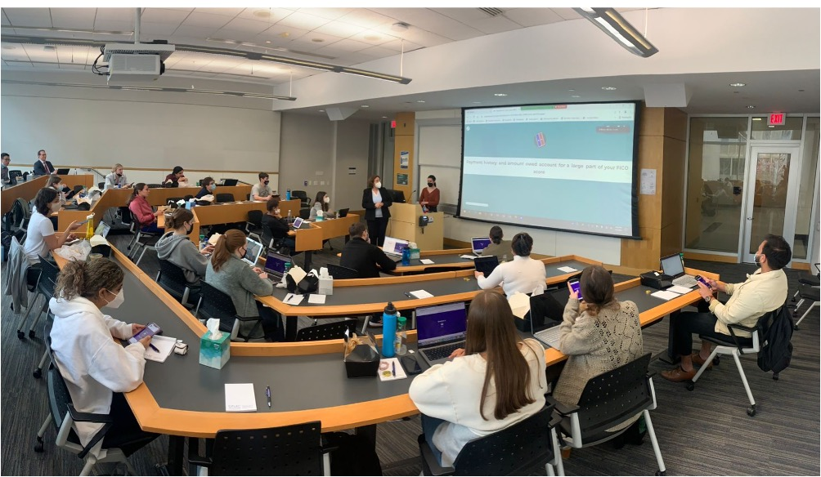
From research to teaching
From research to teaching
Personal Finance courses for undergraduate and graduate students
Extensive coverage of risk and risk management
Paying attention to gender and other differences in financial literacy
Use the P-Fin Index data in every class to motivate and illustrate the topic
A lot of applications

Slide 40
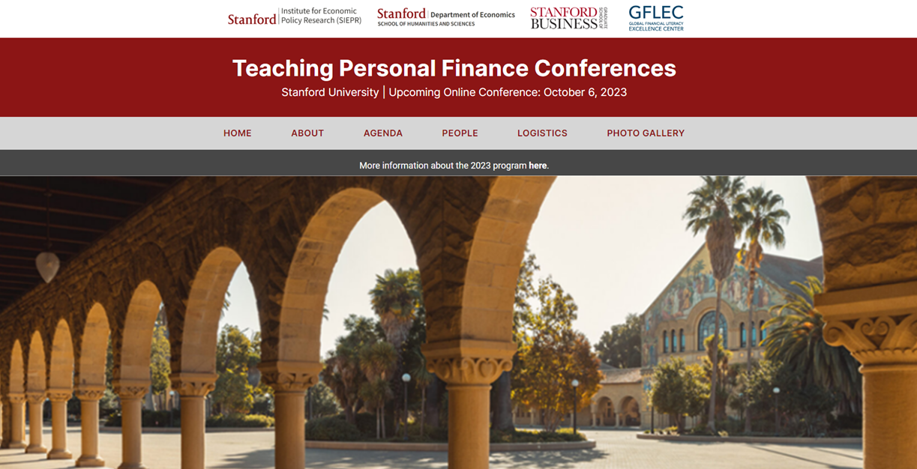
It’s time to teach personal finance in every college and university
It’s time to teach personal finance in every college and university

Slide 41
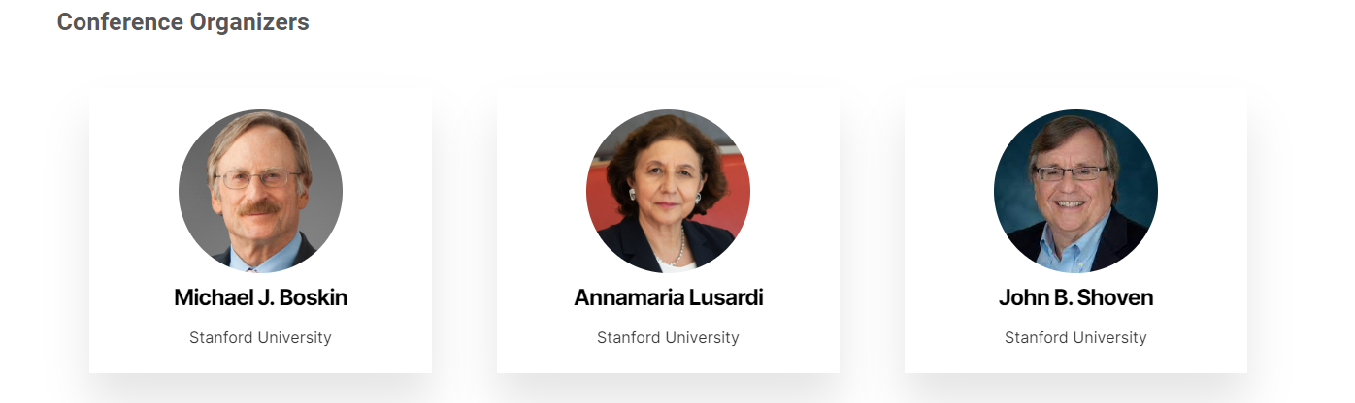
It’s time to teach personal finance in every college/university
It’s time to teach personal finance in every college/university
We organized the first conference on teaching personal finance
We want to promote personal finance in other universities and colleges
We want to extend the course to create programs for alumni and other groups and have students become ambassadors for financial literacy

Slide 42
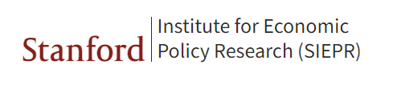


Initiative for Financial Decision-Making
Initiative for Financial Decision-Making
Collaboration between:
An initiative in which education, technology, policy, and research come together.

Slide 43
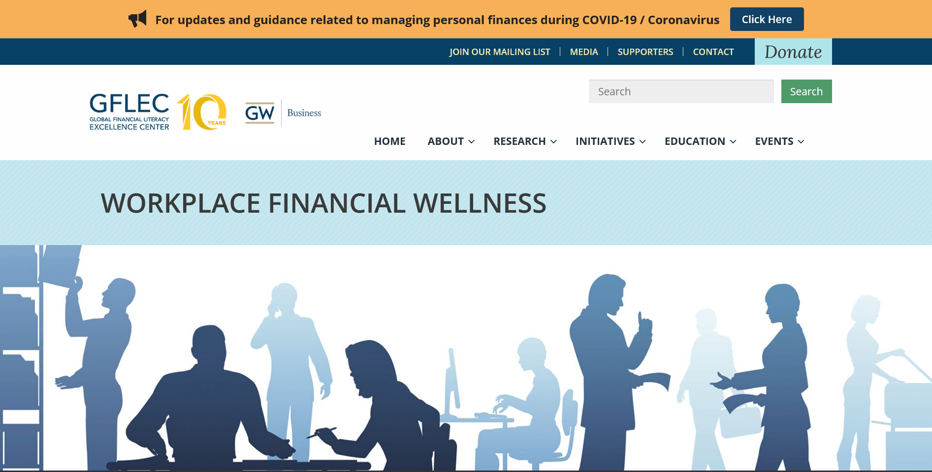
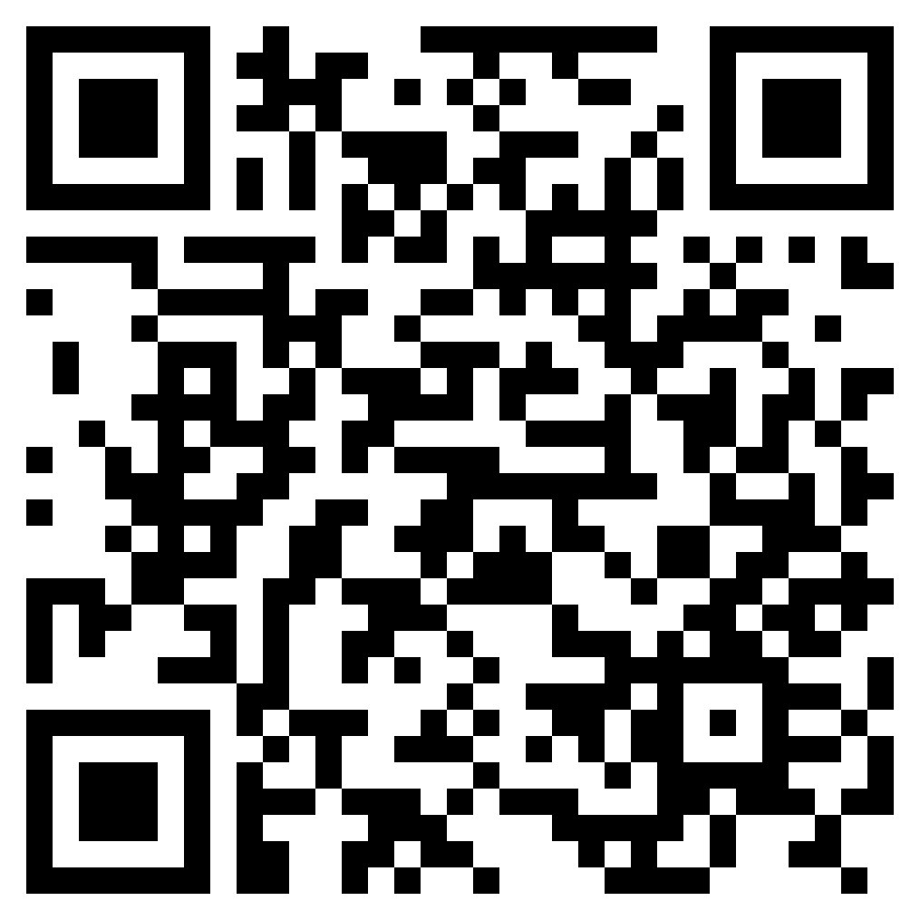
Research–based workplace financial education programs
Research–based workplace financial education programs
Our workplace financial wellness webpage describes the financial wellness programs we have designed based on our research

Slide 44
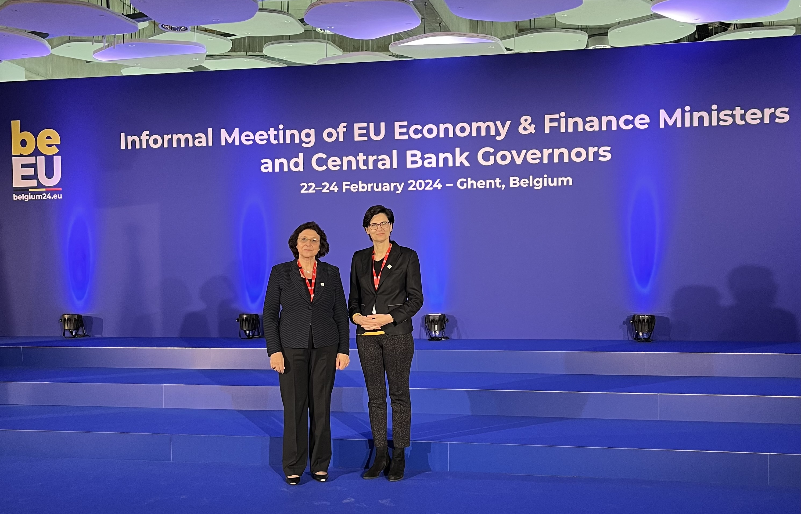
From research to policy
From research to policy
We have:
Advised countries on national strategies for financial literacy
Chaired the National Financial Education Committee in Italy

Slide 45
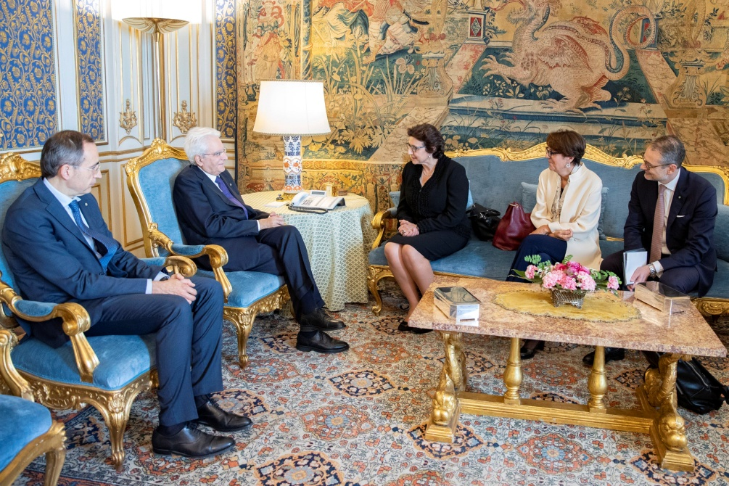
Implementing the national strategy for financial literacy in Italy
Implementing the national strategy for financial literacy in Italy
I chaired the Italian Committee for Financial Education in charge of the national strategy for financial literacy
Our initiatives available at www.quellocheconta.gov.it
Collected data to better design policy and programs
Supported a law mandating financial education in school

Slide 46
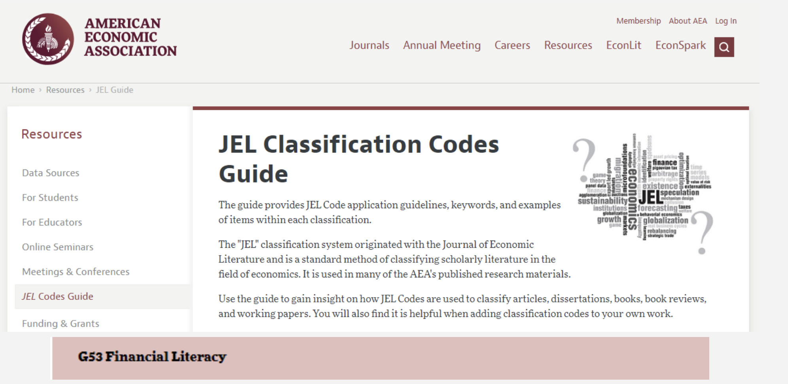
Opening a new field
Opening a new field

Slide 47
For a summary: New paper describes the research in the past 20 years
Annamaria Lusardi and Olivia S. Mitchell
Journal of Economic Perspectives
Fall 2023
For a summary: New paper describes
the research in the past 20 years

Slide 48

Living well
Living well
We need to teach and provide access to knowledge and skills so that people can be more financially resilient and financially secure. Financial literacy is like water in an eco-system, it is needed to grow and flourish.

Slide 49

Thank you
Thank you
Thank you.
If you have any questions, please send them to alusardi@stanford.edu.

