Slide 1
Who Benefits from Retirement Savings Incentives?
Choukhmane, Colmenares, O’Dea, Rothbaum, and Schmidt
Can Everyone Tap into the Housing Piggy Bank?
Conklin, Gerardi, and Lambie-Hanson
Discussion by Jake Krimmel
Federal Reserve Board*
March 15, 2024 – FDIC Consumer Research Symposium
* The views expressed here are my own and do not reflect those of the Board of Governors or the Federal Reserve System.

Slide 2
Overview of Common Themes
Drivers of racial wealth inequality are better known than understood
  ‘Accounting’ for wealth inequality ≠ Explaining the why or how
Both papers take seriously the why and how
  Most analyses discuss either access or outcomes – these do BOTH!
  At the root: How and why does the experienced wealth building process differ across racial groups?
  Process is dynamic, and both intensive and extensive margins matter
Similar flavor to both papers
  Document large unconditional differences, add controls that somewhat mediate gaps, offer hypotheses on what drives residual differences

Slide 3
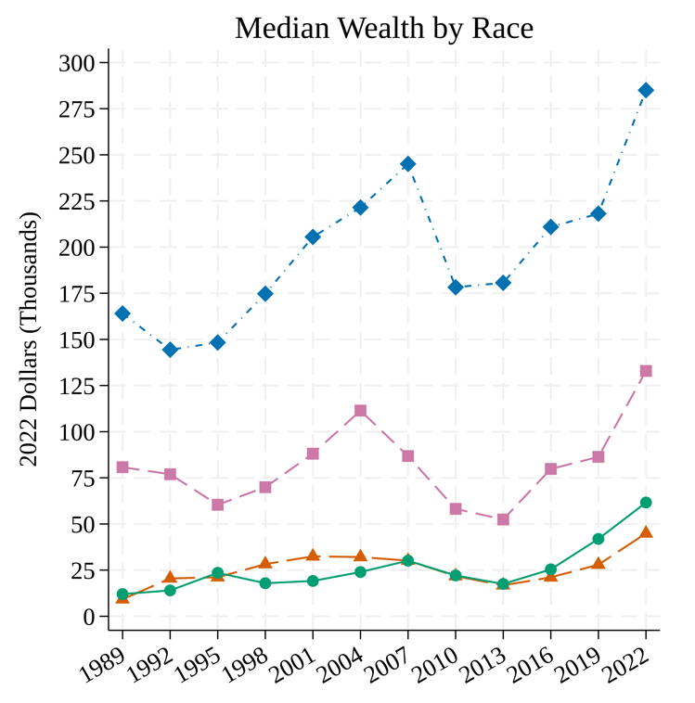
Racial wealth inequality remains a dominant feature of US political economy
Over past 20 years, Black-White and Hispanic-White wealth ratios average about 13%
  Slightly narrowed in 2022, 16% and 22%
  (Source: Survey of Consumer Finances)
In 2022, differences in home equity and retirement assets alone accounted for between 50-60% of racial wealth gaps
  Function of both ownership rates and conditional asset values
Source: Aladangady et al. (2023) calculations using SCF data

Slide 4
Overview of Common Themes
Drivers of racial wealth inequality are better known than understood
  ‘Accounting’ for wealth inequality ≠ Explaining the why or how
Both papers take seriously the why and how
  Most analyses discuss either access or outcomes – these do BOTH!
  At the root: How and why does the experienced wealth building process differ across racial groups?
  Process is dynamic, and both intensive and extensive margins matter
Similar flavor to both papers
  Document large unconditional differences, add controls that somewhat mediate gaps, offer hypotheses on what drives residual differences, add quantification and policy implications

Slide 5
Overview of Common Themes
Drivers of racial wealth inequality are better known than understood
  ‘Accounting’ for wealth inequality ≠ Explaining the why or how
Both papers take seriously the why and how
  Most analyses discuss either access or outcomes – these do BOTH!
  At the root: How and why does the experienced wealth building process differ across racial groups?
  Process is dynamic, and both intensive and extensive margins matter
Similar flavor to both papers
  Document large unconditional differences, add controls that somewhat mediate gaps, offer hypotheses on what drives residual differences, add quantification and policy implications

Slide 6
Racial Gaps in
Retirement Wealth Accumulation
Choukhmane, Colmenares, O’Dea, Rothbaum, Schmidt

Slide 7
A tour de force of a paper
A+ on data, organization, writing, figures
Brief summary:
  Large gaps in DC retirement savings between White and Black + Hispanic workers
    Participation rates, employee contributions, and employer matching
  Individual chars, family structure, and parents’ income are key drivers
    Suggestive evidence that liquidity constraints play a large (and lurking) role
    DC system is virtuous cycle for privileged (wealthy, educated, job stability, etc. )
  Microsimulation exercise: changing norms of current DC system could substantially reduce remaining retirement wealth gaps

Slide 8
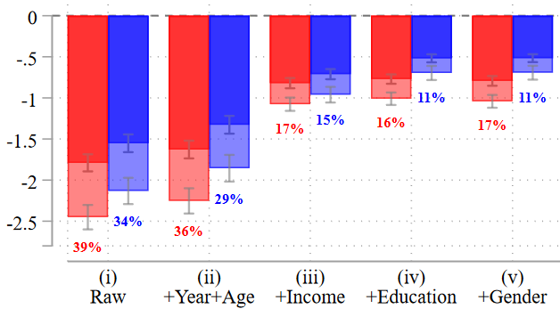
Comment 1: Unpack the tricky role of income
  Income is doing a lot of work, but also highly correlated with edu, gender, parents’ income, etc.
    Plus, inextricably linked with race
  More than just a proxy for liquidity?
    (minor point) – income volatility/certainty might be key to this puzzle
  How would the ordering of these specifications change the interpretation?
    What is left in each ‘residual gap’ in contributions depends on what has already been partialled out.
    Not sure I understood the “cascading” exercise in Appendix C

Slide 9
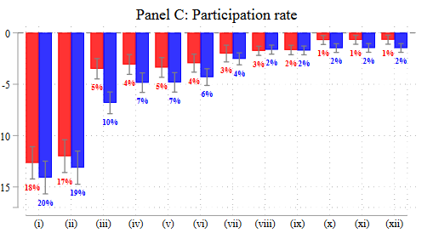
Comment 2: More focus on take-up
Though participation gaps can be ‘accounted for’ by controls, endogenous take-up seems to be driving overall contribution gap
  Side note: racial retirement participation gap is as large or larger than homeownership gap
  (source: 2022 SCF)
Would be helpful to see participation gaps separately by:
  Worker income, age, family structure, and parental income
  Burning policy relevant question:
  Where does intensive vs. extensive margin matter more?

Slide 10
Racial Disparities in
Access to Home Equity
Conklin, Gerardi, Lambie-Hanson

Slide 11
Another tour de force
(but with only slightly fewer appendix figures)
Again: novel data, well-written, clear contribution to academia and the public
Summary:
  Documents and explains racial disparities in access to MEW
    Larger disparities than standard mortgage denials, more so in ppt difs than relative probabilities
  Non-trivial “residual” disparities after controlling for credit scores, DTI, etc.
    Lender type matters – maybe more proof of discrimination channel
  Quantitative exercise: billions in excess equity denied

Slide 12
Comment 1: Explore the intensive margin
How do racial disparities in demand for MEW fit in?
  (caveat: yes, this may be a separate paper)
  1) Do disproportionately large loan amounts explain denial disparities?
  2) Can you exploit multiple applications? Evidence of differential shopping behavior?
  Intensive margin exercise reveals more about welfare losses
  Do black and Hispanic households have fewer options for consumption smoothing?
  Role of MEW may be relatively more important

Slide 13
Comment 2: Open up pandora’s box of discrimination?
Adding to the suggestive evidence
  Racial animus at media market (or MSA level) seems crude.
  What about finer geographies that exploit within-MSA segregation?
  Minority applicants in white neighborhoods and vice versa
  Explore Fintechs within non-bank lenders
  Any anecdotal evidence to test?

Slide 14
Appendix Stats
 | Ownership Gap |  | Conditional Median Ratio
 | Black-White | Hisp-White | Black-White | Hisp-White
Home Equity | 27 ppt | 22 ppt | 60% | 65%
Retirement | 27 ppt | 34 ppt | 39% | 56%

