Slide 1
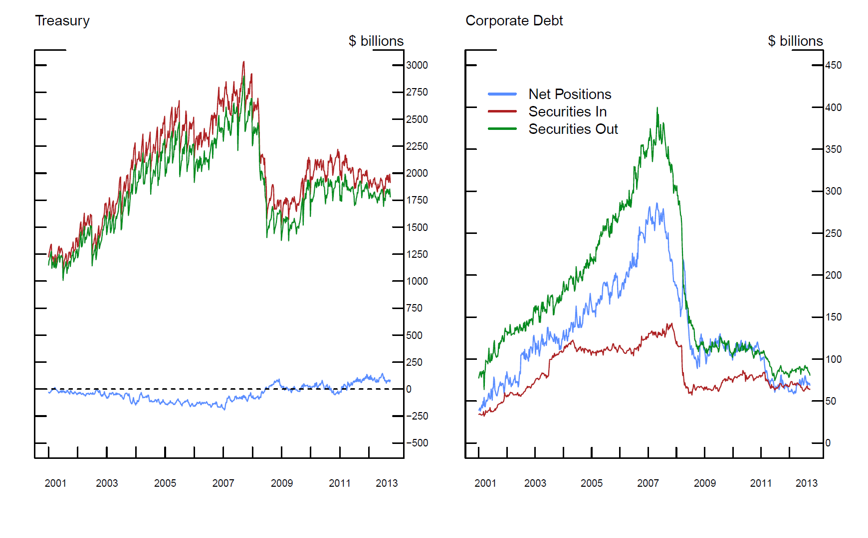
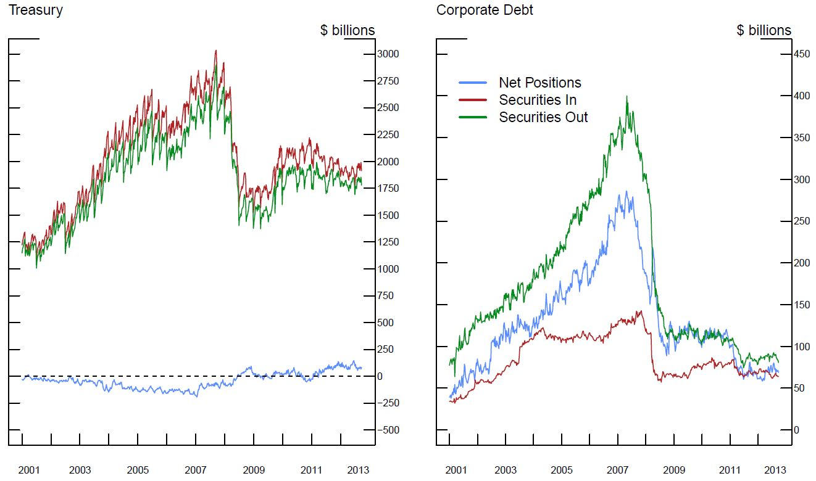
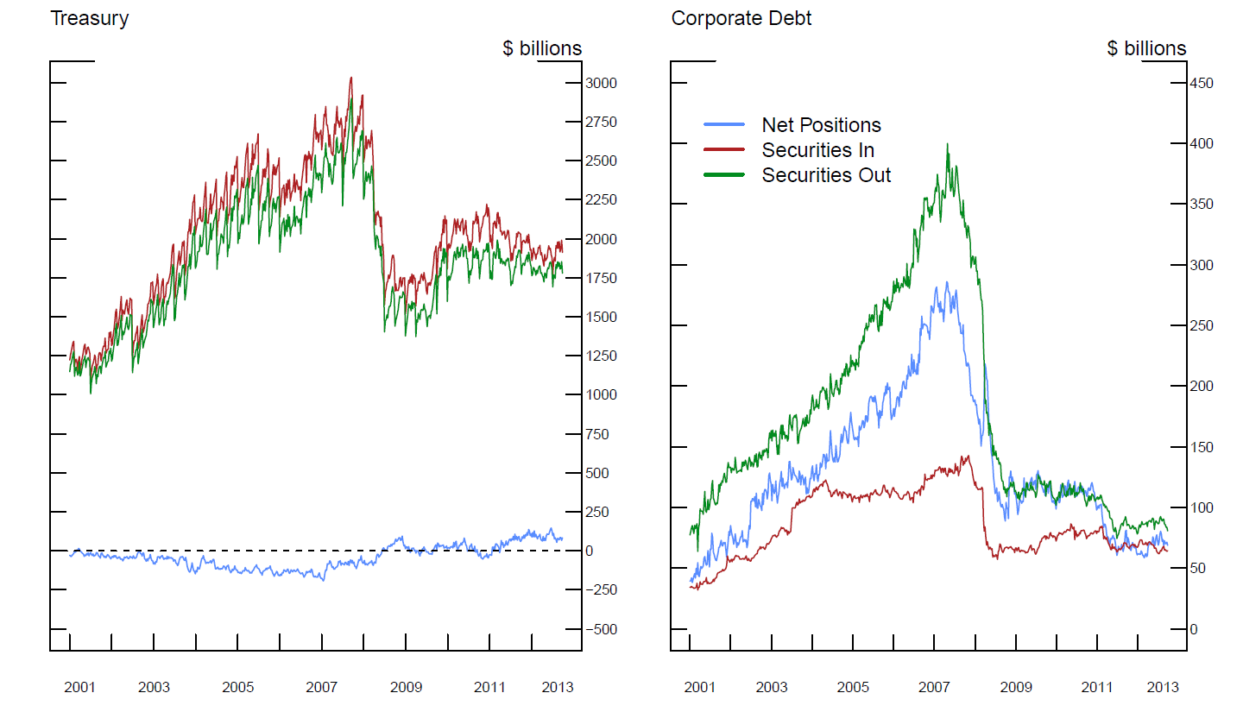


Liquidity Regulation and Financial Intermediaries
Marco Macchiavelli & Luke Pettit
Board of Governors of the Federal Reserve Disclaimer: these are the views of the authors and do not necessarily reflect those of the Federal Reserve System
MOTIVATION
IDENTIFICATION
Basel implementation:
Followed by EU & JP dealers
Based on quarterly average of month-ends
Jan 2015: LCR $≥$ 60% + 10% each year
Jan 2019: LCR $≥$ 100%
U.S. implementation is more stringent:
Followed by US dealers
Based on daily averages
Jan 2015: LCR $≥$ 80% + 10% each year
Jan 2017: LCR $≥$ 100%
Use a Diff-in-Diff strategy:
US vs Basel
Post announcement (Post implementation)
Broker-dealers were at the epicenter of the 2007-09 financial crisis.
Basel Committee designed the Liquidity Coverage Ratio (LCR) rule to avoid another liquidity crisis.
The LCR requires financial institutions to have enough liquidity to withstand a 30-day run.
In this paper we study the effects of the LCR on broker-dealers:
Are they more stable now?
Do they have enough liquidity?
Did they de-risk after the crisis or wait for new regulations?
FINDINGS
A more stringent LCR leads to:
Term structure changes in triparty repos
Unchanged for Treasury repos
Term out lower-quality repos ($↓$ Outflows)
Increase in liquidity pools ($↑$ HQLA)
Less collateral upgrades for clients ($↑$ HQLA)
Significant de-risking occurred post-crisis but pre-regulations:
Corporate inventories rely much less on repo financing ($↓$ fire-sale risk)
$$LCR= \frac{HQLA}{30 Day Net Cash Outflow } ≥100$$
HQLA unencumbered & can be monetized:
Level 1 (0% haircut) – Treasuries, Ginnies
Level 2A (15% haircut) – Agencies, Upper-IG Corporate Debt
Level 2B (50% haircut) – Lower-IG Corporate Debt, Select Equities
Run-offs for $≤$ 30-day Repos (outflows) and Rev Repos (inflows):
L1 collateral (0% runoff); L2A collat (15% runoff); L2B collat (50% runoff).
INCENTIVES:
Term out repos backed by low-quality collateral ($↓$ Outflows)
Unencumber high-quality assets ($↑$ HQLA)

