Slide 1
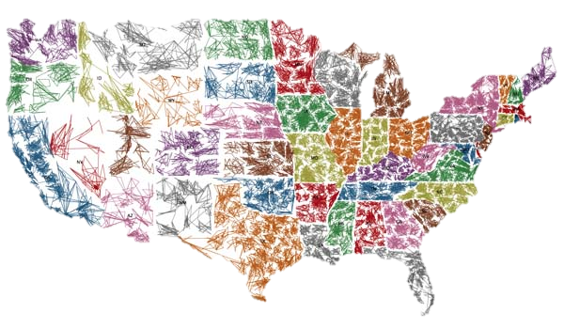
ORE Sales Process

Slide 2
Functions & Physical Locations of the ORE Group
Management & Disposition of Real & Personal Property
Oversight of all valuation & environmental work of the Division
We are located in:
Jacksonville, FL
Dallas, TX

Slide 3
ORE Business Model
Engage full service Asset Management Contractors (ORE Contractors) that can manage and dispose real property from cradle to grave anywhere in the USA.
These ORE Contractors hire subcontractors or engage in partnerships arrangements to manage and dispose the ORE.
Like all prudent sellers, the FDIC guidelines requires that we obtain title work, an appraisal, environmental assessments, and surveys prior to marketing. It takes 45-60 days to place a property on the market. During this period we may market without a list price.
Properties are secured and maintenance initiated. Our goal is to maintain our properties clean and presentable at all times.

Slide 4
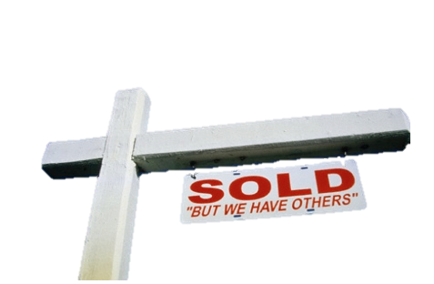
What Happens with ORE Acquired from a Failed Financial Institution?
Existing Contracts are analyzed to ensure the transactions are:
Arms length
Makes business sense
Existing listing/property management agreements are either:
kept in place
re-negotiated by the ORE Contractor
repudiated if considered onerous to the receiver

Slide 5
How is ORE sold?
We are a willing seller seeking to maximize value
We have to market before we can sell a property
Upon acquisition, the asset is listed with a broker. It may not have a list price as we will be in the process of obtaining current information on the asset (title, value,…).
The list price is based on third party valuations under the following parameters:
SFR1-4 / SFR Lots - “as–is” value, pursuing disposition within 6 months with adequate marketing.
All other properties - “as-is” value, pursuing disposition within 12 months with adequate marketing.

Slide 6
How is ORE Sold? (Cont.)
List price is revised and adjusted in line with market response to ensure we are competitive.
Generally ORE is moved into sealed bids or auctions (outcry or on-line) when these have not sold through listing.
Prior to an auction or sealed bid sale, we obtain new valuations.

Slide 7
ORE Overview
Real property (ORE) - Our Portfolio (August 31)
No. Assets Appraised Value Book Value
729 $231 M $446 M
.
Historical Sales Since 2008
No. ORE Sales | Sales Price | % Appraised Value
8,961 | $2.3 B | 92%

Slide 8
ORE Overview
Real property (ORE) - Our Portfolio (August 31)
Asset Type | No. Assets | Appraised Value
SFR 1-4 | 246 | $22 M
Land | 264 | $101 M
Commercial | 209 | $98 M
Multi-family | 10 | $10 M
Total | 729 | $231 M

Slide 9
Bulk ORE Sale
We shy away from the bulk sale of ORE as the returns are not acceptable
Bidders have the option of reviewing the ORE portfolio and make offers on multiple properties.
Bidders can also participate in Seal Bids/Auctions where multiple assets are offered; the investor can bid on multiple properties or one property.
The FDIC will accept the offer or combination of offers that represent the highest return.

Slide 10
Identifying Available Properties
Disposition events such as Auctions, Sealed bids, retail sales are highly publicized in print and internet media. You can also find information on our web page.
Web Sites Hosting FDIC ORE Properties
fdic.gov web site:
http://www2.fdic.gov/drrore
- AND -
Prescient – Frisco, TX & Coral Gables, FL
http://www.fdiclistings.com
Quantum – Houston, TX
http://www.resolutionxpress.com

