Slide 1
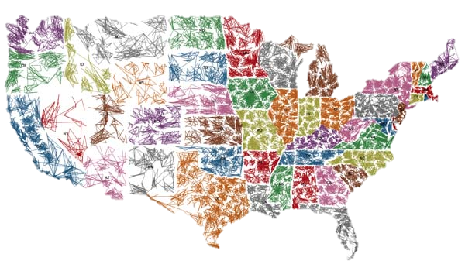


Structured Transactions
Legal Aspects

Slide 2

Three Categories of Structured Transaction Agreements & Documents
(Transaction-Specific)
Bid Documents
Transaction Documents
Transfer Documents
Transfers
Transactions
Bids

Slide 3

Bid Documents
Provide Information about a Specific Structured Transaction, including:
Statistics on the Assets.
Transaction Terms and Structure.
Transaction-Specific Qualification Process.
Bid Submission to purchase Private Owner Interest.

Slide 4

Transaction Documents
Spell out the rights and legal obligations of all parties to the Transaction.
Provide the “Meat on the Bones” to the structure described in the Term Sheet.

Slide 5

Transaction Documents (cont.)
Specified
Parent
Servicer
Servicing Agreement
Private Owner
(Manager)
Private Owner Interest
Initial Member
(FDIC)
Cash at Closing
Management Fee
Assets
PMN*
Company,
LLC
Holds Assets Documents
All Equity Interest
Custodian/
Paying Agent*
Manages Payments*
* Leveraged Transaction

Slide 6
Transaction Documents (cont.)
Collection Account – loan proceeds from all sources
  Principal
  Interest
  Prepayment fees, extension fees, late fees, assumption fees, insurance proceeds, condemnation awards, REO net operating cash flow, recoveries on guarantees
  Sales and refinancing proceeds

Slide 7
Transaction Documents (cont.)
Collection Account – use of proceeds:
  Pre-approved Charges
  Servicing Expenses
Distribution Account – remaining proceeds go to waterfall
  Single Waterfall – CRE and ADC transactions
  Dual Waterfall (separates principal and interest proceeds) – SFR transactions
Working Capital Account

Slide 8
Transaction Documents (cont.)
Sample Waterfall (Priority of Payments)
  Custodian Fee
  Management Fee
  Reimburse Excess Working Capital Advances
  Replenish Working Capital Reserve Account
  Possible Limited Distribution to Equity (“Leakage”)
  Remainder to Defeasance Account until Purchase Money Note(s) paid in full
  Distribution to Equity
Discretionary Funding Advances – repayable from proceeds of specific Asset

Slide 9
Miscellaneous Legal Issues
Zero Coupon v. Interest-Bearing Notes
Promote and Reverse Promote Features
No Representations or Warranties (very limited put-back rights)
Identity of Custodian – you select, paid from waterfall, must execute Custodial Agreement
Identity of Servicer – you select, must be rated, paid from Management Fee, form Servicing Agreement
MERS Loans
No Affiliate Transactions
No Use of FDIC Powers without consent

Slide 10

Transfer Documents
Used to Transfer ownership of the Assets from the FDIC as Receiver to the Company.
Transfer Documents include:
  the Endorsements or Allonges to Notes or Assignment and Lost Instrument Affidavits (if applicable).
  Assignments of Mortgages/Deeds of Trust.
  Deeds.
  Assignment of Leases and Rents.
  Other documents of assignment, conveyance or transfer.

Slide 11
Transfer Documents (cont.)
Typically, the Manager drafts and records, as applicable, the Transfer Documents based on FDIC forms.
Typically, Limited Power of Attorney granted by the FDIC as Receiver to the Manager to execute Transfer Documents.
Such work is considered a Pre-Approved Charge and payable out of Asset Proceeds (if completed within 6 months from the Closing Date).

Slide 12

Tax Matters
Private Owner is designated as the Tax Matters Member under the LLC Operating Agreement. Tax Matters Member prepares the annual tax returns for the LLC, including K-1s for the members.
Investors are advised to seek legal and tax counsel regarding tax consequences of operations under the Structured Transaction Agreements.

Slide 13

Purpose of Oversight
As an equity partner in each Structured Transaction the FDIC monitors asset level and entity level performance.
Performance and projections are reported to FDIC Management and internal accounting departments.
A Structured Transaction’s return is compared to outright sale.
The FDIC is required to resolve failed institution’s assets with the least loss to the Deposit Insurance Fund.
Notes:
13
13
FDIC Confidential

Slide 14
Managing Member Requirements
Reports & Oversight
Business Plan
Cash Flow Projection
Monthly Asset Level Data
LLC Financial Reporting
Compliance Monitoring Contractor (CMC) Visit
U.S. Government Accountability Office (GAO) Review
Office of Inspector General (OIG) Audit
Notes:
14
14
FDIC Confidential

